Slide 1
MIDORI GLOBAL · Enterprise-proven at Applied Materials, EaglePicher Technologies, and Philips, since 2005.
Better Commit Policy for Jira
Enforce commit, branch, and pull request rules on AI coding agent activity.
Implement in Bitbucket, tied to Jira, before non-compliant changes are committed or merged.
+ Better Commit Policy Connector for Bitbucket, free

Slide 2



The problem
Commit hygiene breaks down as teams scale
No standards at scale
Broken traceability
Compliance gaps
Conventions and code review catch commit hygiene at 5-10 developers. At 50+, messy history and missing ticket IDs create noise and slow every review.
Developers forget to link commits, use the wrong ticket, or bypass process with hotfixes.
AI coding tools don’t make these mistakes, but produce changes on a different level which need a deterministic control layer for all aspects of the change (path touched, files changed, etc…).
Regulated teams must prove traceability from requirement to code to release. Without enforcement, audits become painful, manual reconstructions.

Slide 3



The solution
Enforced at pre-commit and at merge
Commit, branch & PR rules
Pre-commit plus merge
Audit-ready by default
Validate commit messages, branch naming, PR titles, and work item linkage against configurable, JQL-based conditions.
Rules run on the developer’s machine before the commit exists, and again at merge. Pre-commit is something no other app does and it’s what makes this the safest and most reliable solution, moving the point of verification to the earliest place possible.
Every code change is automatically linked to a valid Jira issue, for a complete, reliable audit trail from requirement to release.
"Prevention, not detection: non-compliant changes are blocked before they enter the repo, not caught after."

Slide 4
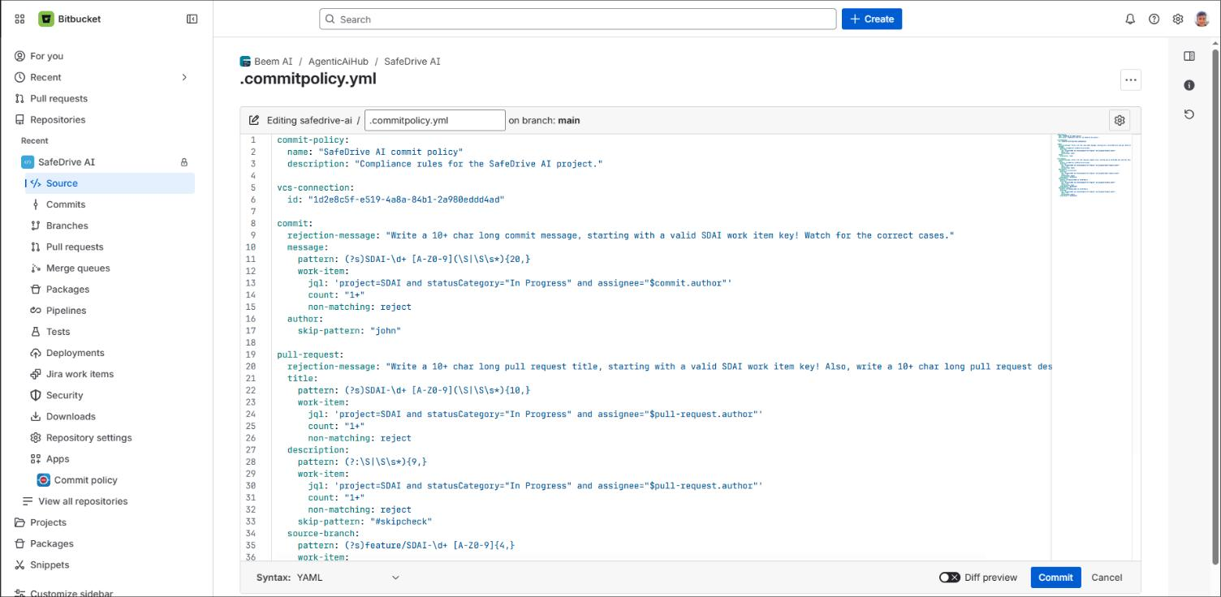
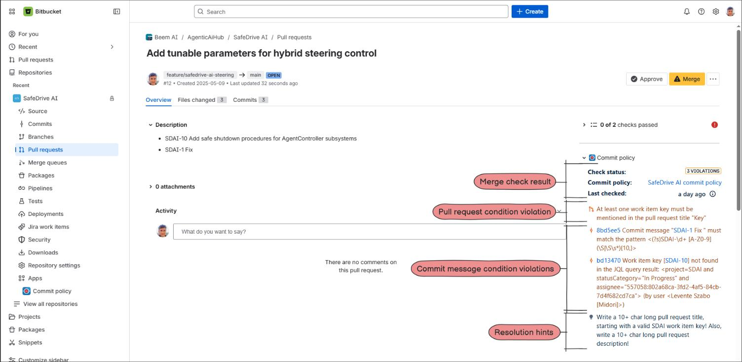
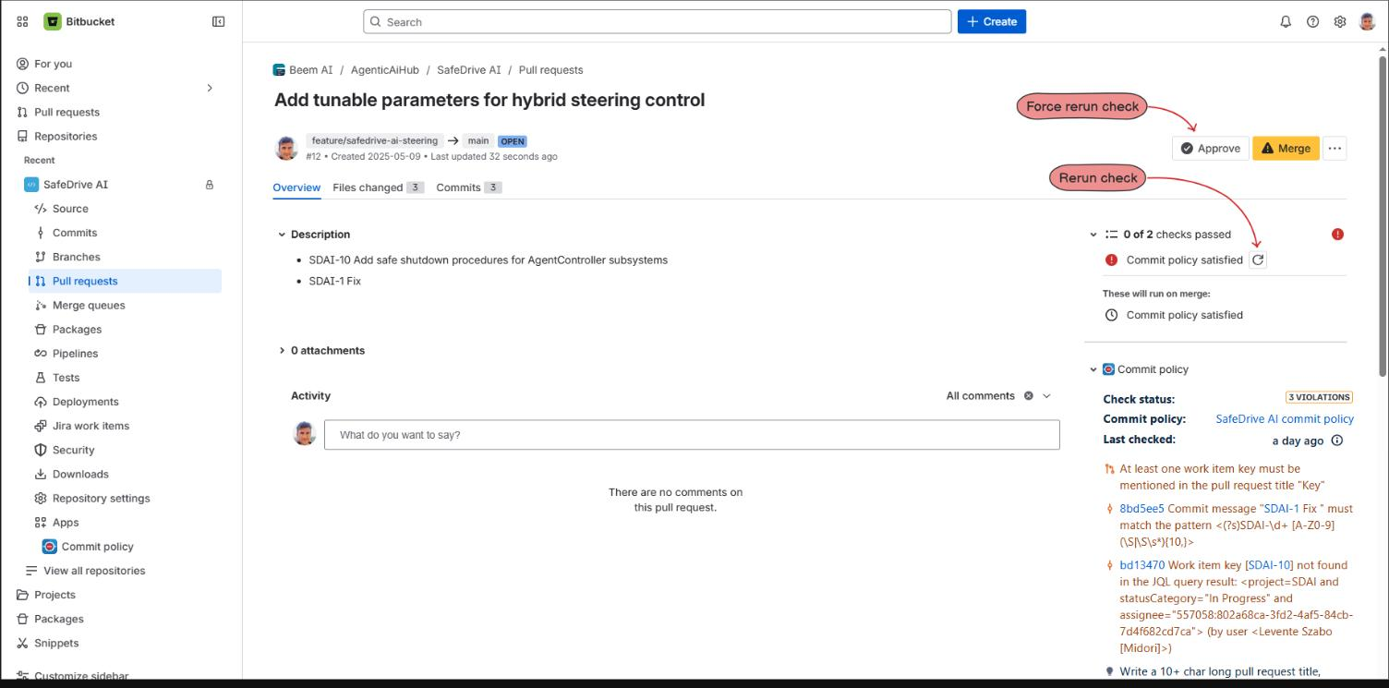
See it in action
Policy as code, enforced end to end
Real Bitbucket Cloud screens, pulled from Midori’s own product documentation.
Policy as code
Blocked before merge
Fast, safe re-checks
Rules live as version-controlled YAML in the repo, connected to Jira work item conditions.
A non-compliant pull request is rejected with clear, itemized violations, not a vague failure.
Once fixed, developers rerun the check directly from the PR, no waiting on a new CI pipeline.

Slide 5



Included free
Better Commit Policy Connector for Bitbucket
Completes the enforcement loop directly inside Bitbucket. No extra cost.
Pre-commit enforcement
Merge enforcement
YAML policy-as-code
Blocks non-compliant commits on the developer’s machine, before the commit is even created.
A second check at merge closes the loop: defense in depth, with no bypass path in between.
Rules live as version-controlled YAML in the repo on Cloud, or JQL conditions in the Jira UI on Data Center.

Slide 6

Proof
Enterprise-proven, since 2005.
Applied Materials · EaglePicher Technologies · Philips
8,000 users
2 checkpoints
"Before commit policies, our developers’ behavior was like in the wild west. The app helps us maintain a manageable development process, enforcing rules in a friendly, but strict way."
enforce Better Commit Policy at Applied Materials.
pre-commit and merge time
(+ push time on Data Center)
Yakov Yukhnovetsky, DevOps Engineer, Philips

Slide 7


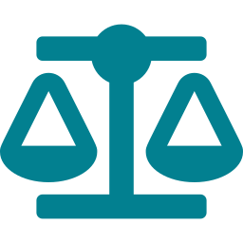
Why Midori
An established partner in the Atlassian Ecosystem
Cloud Fortified: meets Atlassian’s highest bar for security, reliability, and support.
Platinum Marketplace Partner, building Atlassian apps since 2005.
SOC 2 Type II and GDPR compliant.
The only Bitbucket Cloud app enforcing rules at pre-commit, before the commit even exists.
30-day free trial, with full functionality, Dual Licensing available.
NEXT STEPS
Documentation
Customer Stories
midori-global.com/.../documentation
midori-global.com/.../customer-stories

