Slide 1
MIDORI GLOBAL · Enterprise-proven partner to SICK AG, Generali, PostFinance, DICTU, and Storck.
Better Content Archiving and Analytics
for Confluence
The enterprise-focused governance layer for Confluence content, human-written or AI-generated.
Comprehensive reporting and dashboards, on par with native Confluence analytics.

Slide 2



The problem
Confluence content piles up faster than anyone can manage it
No lifecycle, by design
AI accelerates the pile-up
Trust erodes, audits fail
Confluence makes it effortless to create content, but gives no way to track, review, or retire it once it exists.
Confluence Automation breaks at enterprise-level scale and wasn’t designed to fit the custom organization-level conet
AI tools like Rovo make new pages faster than ever to produce, with no guardrail on what happens to them next.
While AI agents can make suggestions on content validity, organizations need a deterministic, auditable governance layer that harnesses the AI activity and helps humans understand what’s current.
Stale pages break search results, confuse users, and leave compliance teams unable to answer basic lifecycle questions.
User activity or page owner responsibilities are hard to track without a clear dashboard of who did or responsible for what.

Slide 3



The solution
Automated lifecycle management, start to finish
Automatic freshness tracking
Owner notifications & reviews
Safe, reversible archiving
Every page is tracked for views, edits, and age, so stale content surfaces itself instead of hiding in plain sight.
AI may have contributed to the content, the tracking rules are predictable and set by your organization.
Content owners are notified when their pages need a review, before anyone else notices they are out of date.
Stale pages move to a hidden, searchable, restorable archive space or their dedicated archive section.
Content is only deleted if you specifically set up the dislocation rules to delete instead of archive, for example for regulatory reasons.
"Confluence makes content easy to create. Better Content Archiving and Analytics makes sure it stays trustworthy."

Slide 4
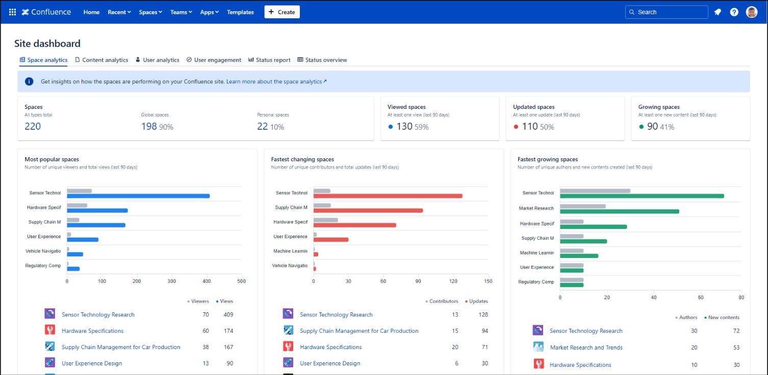
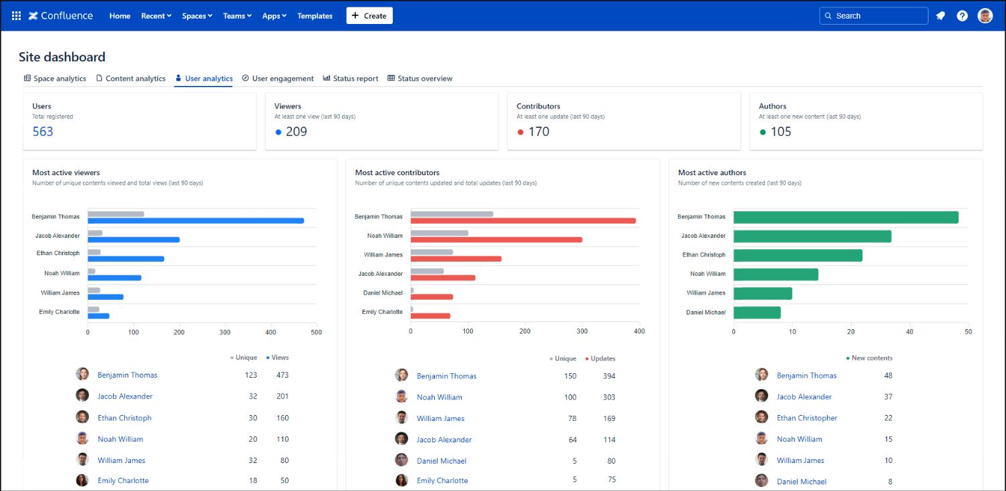
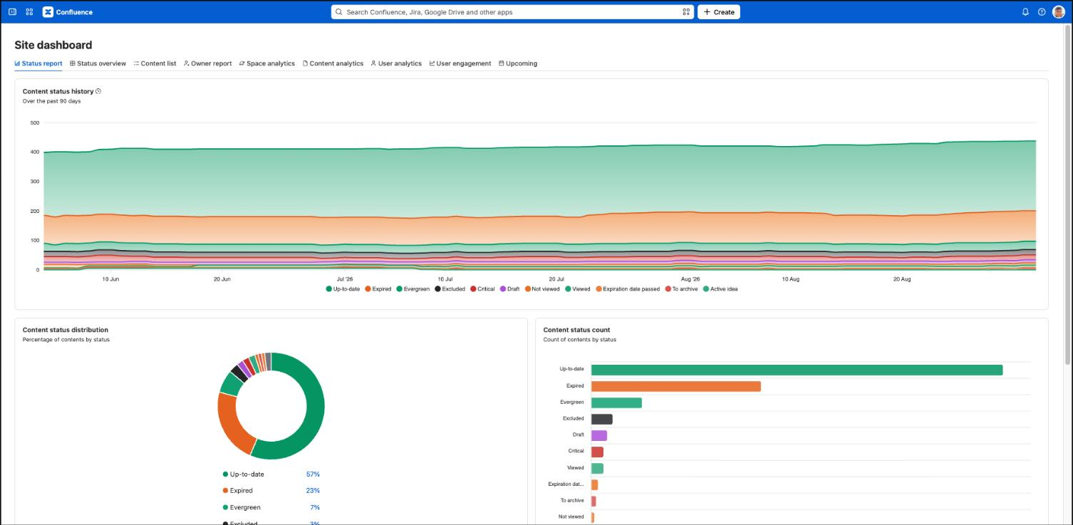
See it in action
Nine built-in reports, from Space Analytics to User Engagement.
Real dashboards, visualizing user activity, content freshness metrics and giving custom content listing options
Space-level insight
User-level visibility
Content health over time
See which spaces are most popular, fastest changing, and fastest growing, at a glance.
Identify your most active viewers, contributors, and authors across the entire site.
Get a clear overview of content owners and contents not owned by anyone.
Track the status of every page, up to date, expired, or evergreen, as a trend and a live count.
Use the Upcoming dashboard to see what pages expire next or what are slated for archiving.

Slide 5



Built for the AI era
One governance layer, whoever wrote the page
As AI tools like Rovo make Confluence content faster than ever to create, lifecycle control matters more, not less.
Content-agnostic by design
A gate, not a bottleneck
Visibility that scales with AI volume
Freshness tracking, review cycles, and archiving apply to every page the same way, whether a person or an AI wrote it.
Nothing blocks publishing. Better Content Archiving and Analytics watches what happens after a page goes live, and flags it when it needs attention.
The gate is your deterministic set of rules, not a probabilistic AI.
The same reporting dashboards that show human authorship patterns show AI-driven ones too, so admins never lose sight of what is accumulating.

Slide 6

Proof
Enterprise-proven, since 2005.
SICK AG · Generali · PostFinance · DICTU · Storck
30%
15,000 users
"Archives no-longer-relevant information automatically, increasing the relevance of current information for all users."
reduction in total page count, nCino (FinTech).
run Better Content Archiving and Analytics at SICK AG.
SICK AG (15,000 users, Confluence Data Center)

Slide 7



Why Midori
An established partner in the Atlassian Ecosystem
Cloud Fortified: meets Atlassian’s highest bar for security, reliability, and support.
Platinum Marketplace Partner, building Atlassian apps since 2005.
SOC 2 Type II and GDPR compliant.
Governs AI- and human-authored content alike, no separate tooling needed.
30-day free trial, with full functionality, Dual Licensing available.
NEXT STEPS
Documentation
nCino case study
midori-global.com/.../cloud/documentation
midori-global.com/blog/.../ncino-abandons-...

