Slide 1
MIDORI GLOBAL · Enterprise-proven partner to Broadcom, T-Systems Austria, DB Schenker, US Government, and Towers Watson.
Better Excel Exporter for Jira
Analysis-ready Excel spreadsheets from Jira, with formulas and charts.
+ Better Excel Automation, free

Slide 2



The problem
Stakeholders need clean, structured Jira data in Excel
Broken CSV exports
Hours lost to manual reporting
Stakeholders live in Excel, not Jira
Jira’s built-in CSV export is plaintext. Dates, numbers, and multi-value fields all break, and teams spend hours cleaning it up before it’s usable.
Export, clean, reformat, rebuild formulas, chart, distribute: the same cycle every week. One manual report already costs 50+ hours a year.
Finance, leadership, and clients need pivot tables and formulas, not a Jira login. Someone has to bridge that gap by hand, every time.

Slide 3



The solution
Native Excel files, from many Jira screens
One-click native Excel export
Template-based customization
Full Excel features included
Issue Search, Backlog, and Board views. Correct data types and formats out of the box, no manual post-processing.
Design the layout in Excel, and the exporter fills it with Jira data. Groovy scripting available, never required.
Formulas, pivot tables, pivot charts, and Visual Basic macros all work in every exported file.
"If you can design a layout in Excel, you can design a Better Excel Exporter report template."

Slide 4
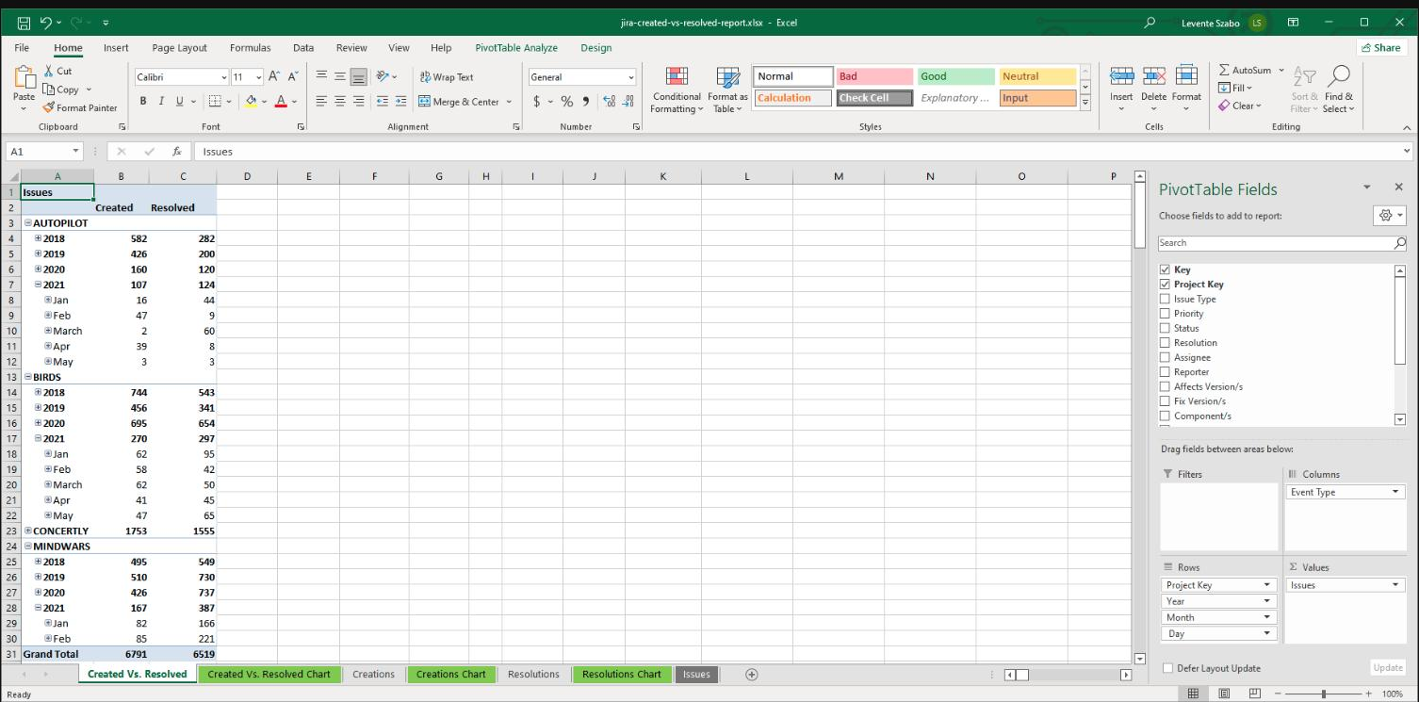
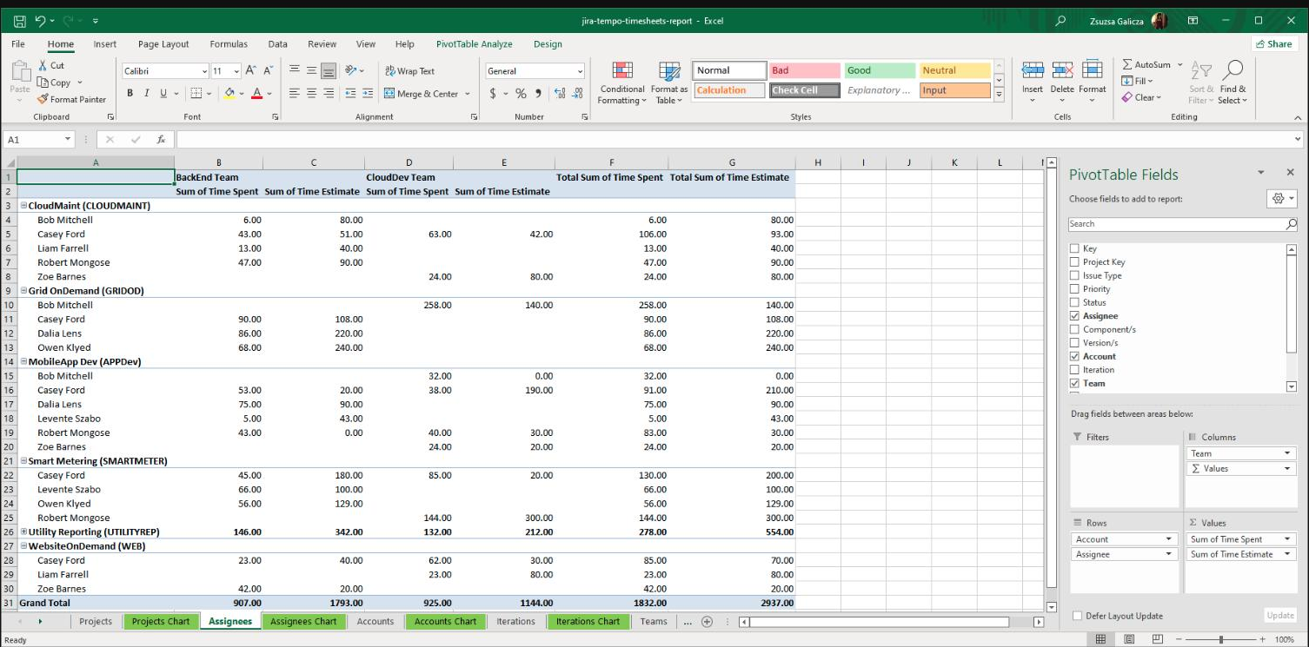
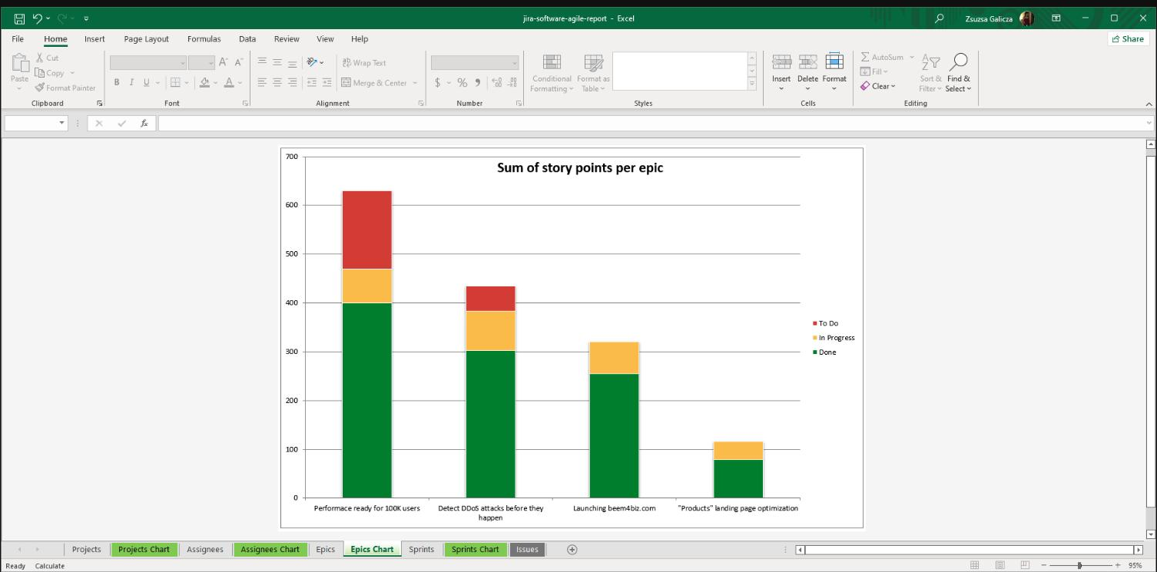
See it in action
Pivot tables, charts, and formulas, out of the box.
Real exports, pulled straight from the sample library, integrations included.
Pivot tables and charts, built in
Deep integration with your stack
Reports built for stakeholders
Multiple pivot tables and pivot charts, comparing issue creation and resolution trends across projects, types, and assignees.
Native Tempo Timesheets fields, pulled straight into Excel to compare time estimated against time spent, by team.
Sprint and epic-level story point breakdowns, delivered as a chart executives and PMs can read in seconds.

Slide 5



Included free
Better Excel Automation
Turns Better Excel Exporter from a manual tool into a fully automated reporting system. No extra cost.
Scheduled reports
Event-driven triggers
Three ways to distribute
Daily before standups, weekly on Monday, or at sprint close. Stakeholders get the file before they have to ask.
Issue created, SLA breached, sprint completed, deployment success. Excel generated automatically, on the event.
Email it, attach it to the Jira issue, or save it to Dropbox, Google Drive, or OneDrive.

Slide 6

Proof
Enterprise-proven, since 2005.
Broadcom · T-Systems Austria · DB Schenker · US Government · Towers Watson
5 min
9,000 users
"With Better Excel Exporter we were able to create our Excel reports exactly the way we wanted."
sprint reports that used to take hours, SkyTouch (Hospitality).
run Better Excel Exporter at Broadcom.
Tobias, Jira Technical Expert, Swiss Bank (Banking)

Slide 7



Why Midori
An established partner in the Atlassian Ecosystem
Cloud Fortified: meets Atlassian’s highest bar for security, reliability, and support.
Platinum Marketplace Partner, building Atlassian apps since 2005.
SOC 2 Type II and GDPR compliant.
Works alongside 20+ Jira apps, including Tempo Timesheets and Advanced Roadmaps.
30-day free trial, with full functionality, Dual Licensing available.
NEXT STEPS
Documentation
Export samples
midori-global.com/.../cloud/documentation
midori-global.com/.../cloud/export-samples

