Slide 1
MIDORI GLOBAL · Trusted by 10,000+ teams, including Pinterest, SAP, Mercedes-Benz, JPMorgan Chase, Adobe, Samsung, and the EU Commission.
Better PDF Exporter for Jira
Transform Jira data into professional PDF documents, with one click or scheduled.
+ Better PDF Automation included, free

Slide 2



The problem
Stakeholders need structured Jira data in PDF format
Limited native exports
Hours lost to manual reporting
Stakeholders locked out
Jira’s built-in export is basic. Browser printing loses formatting, and there is no native PDF for dashboards, boards, or reports.
Teams copy, reformat, and re-brand the same report every week. One customer cut a 1+ hour report down to seconds.
Clients, auditors, and executives need formatted project data, but none of them should need a Jira license to get it.

Slide 3



The solution
A custom document from many Jira screens
One-click PDF generation
Full template customization
Exclusive export capability
Issue Search, boards, dashboards, and reports. Bulk exports, full history, comments, and attachments all included.
Custom layouts, branding, and logic. Produce invoices, release notes, or compliance reports from the same underlying data.
The only Jira app that exports dashboards, reports, and agile boards to PDF. No other Marketplace app offers this.
"Only Jira app on the Marketplace that can export dashboards, reports, and agile boards to PDF."

Slide 4
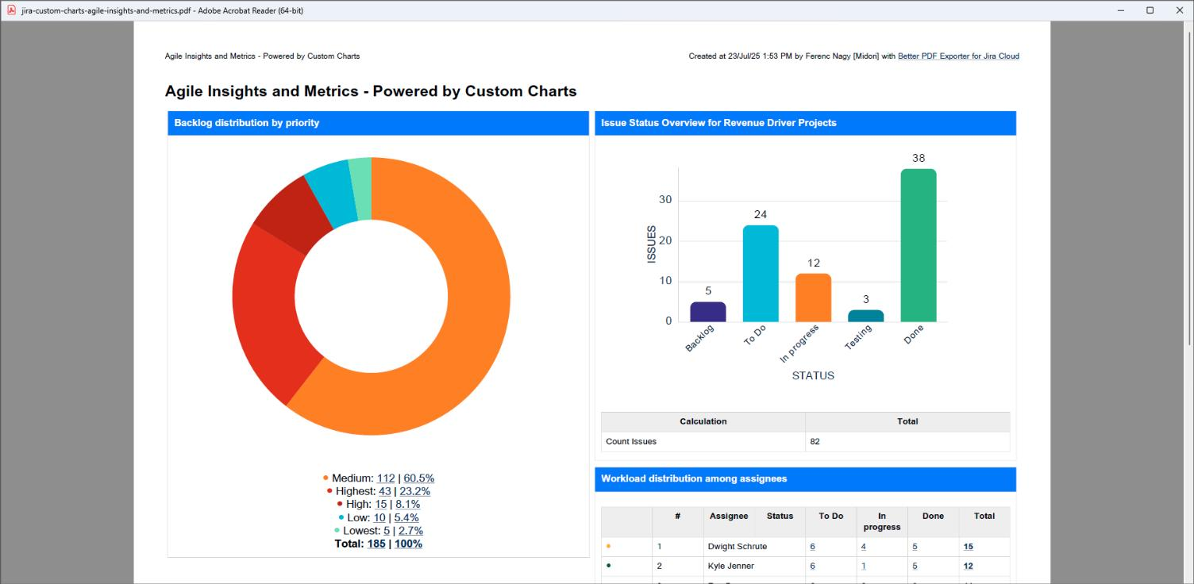
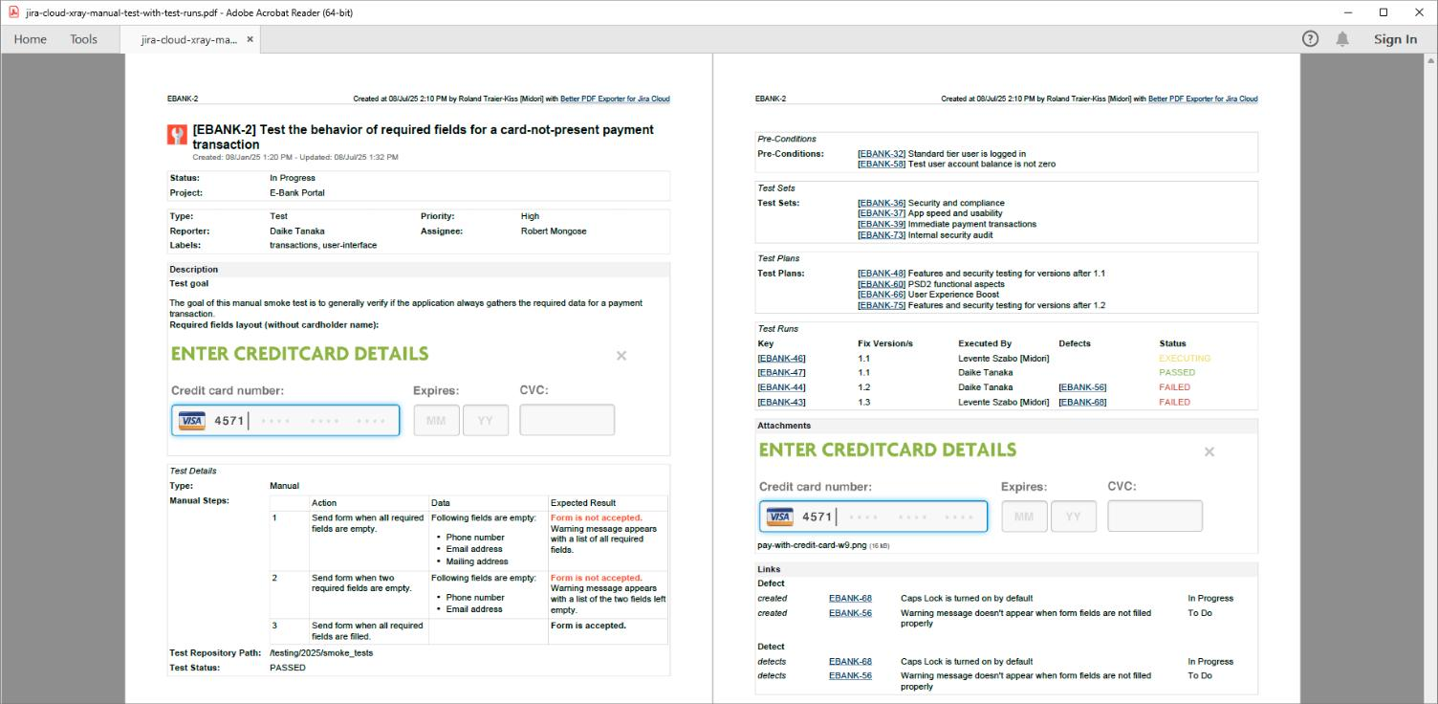
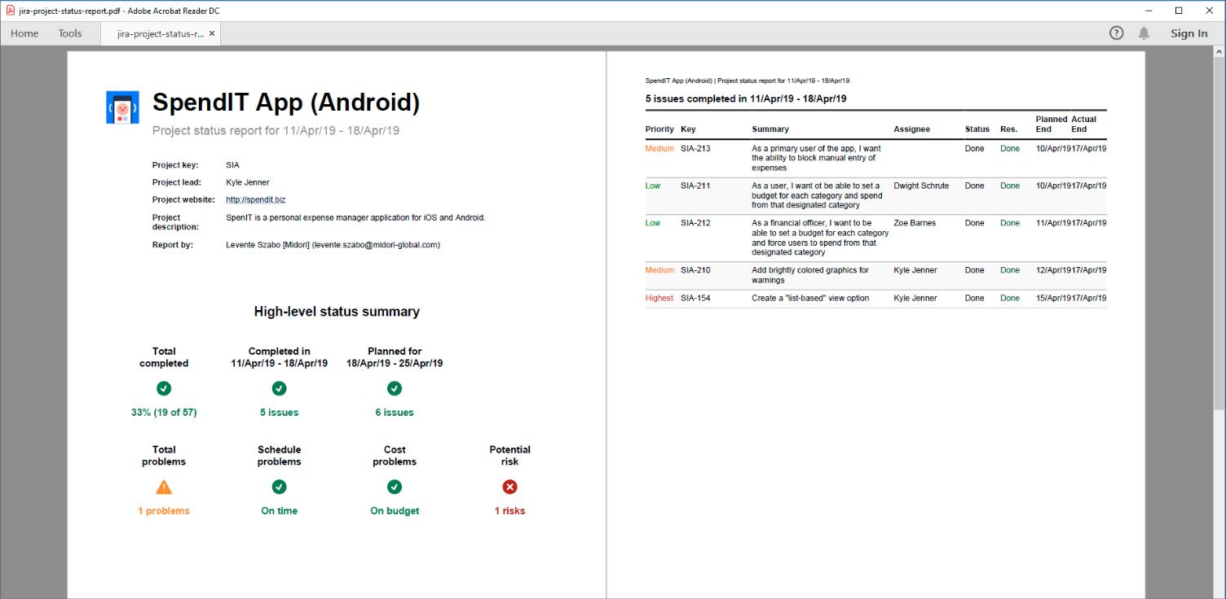
See it in action
One export engine, endless output formats
Real exports, pulled straight from the sample library, branding and third-party integrations included.
Fully customizable templates
Deep integration with your stack
One dataset, many audiences
Branded layouts, calculated fields, and conditional logic in every export. No two customers’ PDFs have to look the same.
Exports pull native fields straight from Xray, Zephyr, Tempo, ScriptRunner, Advanced Roadmaps, and 20+ other Jira apps.
The same underlying Jira data becomes an executive status report, a compliance record, or a client deliverable.

Slide 5



Included free
Better PDF Automation
Turns Better PDF Exporter from a manual tool into a fully automated reporting system. No extra cost.
Scheduled reports
Event-driven triggers
Three ways to distribute
Every weekday at 6am, weekly on Monday, or at sprint close. Delivered before anyone has to ask.
Issue created, SLA breached, sprint completed, deployment success. Documentation generated automatically.
Email it, attach it to the Jira issue, or save it to Dropbox, Google Drive, or OneDrive.

Slide 6

Proof
Trusted by 10,000+ teams since 2005.
Pinterest · SAP · Mercedes-Benz · JPMorgan Chase · Adobe · Samsung · EU Commission
10,000+
$5,000/yr
"Better PDF Exporter saves us hours of manual work, creating professional PDF documents customized to our requirements."
teams run Better PDF Exporter, on Cloud and Data Center.
saved on license costs by consolidating reporting into Better PDF Exporter. Morosystem, Atlassian Consultant.
Raymond Côté, CTO, Auric Systems (SOC 2 & PCI compliance)

Slide 7



Why Midori
An established partner in the Atlassian Ecosystem
Cloud Fortified: meets Atlassian’s highest bar for security, reliability, and support.
Platinum Marketplace Partner, building Atlassian apps since 2005.
SOC 2 Type II and GDPR compliant.
Works alongside 20+ Jira apps, including Tempo Timesheets and Advanced Roadmaps.
30-day free trial, with full functionality, Dual Licensing available.
NEXT STEPS
Documentation
Export samples
midori-global.com/.../cloud/documentation
midori-global.com/.../cloud/export-samples

