Slide 1
How to create custom Excel reports from Jira issues in no time
Business Intelligence and native Excel reports from Jira data with Better Excel Exporter
Notes:
Welcome
Thank you all for joining!
My name is Levente Szabo, Customer Success Manager here at Midori and I’d like to welcome all of you to our webinar about exporting Jira data to Excel!
Excel exporting in Jira has been and continues to be a strongly debated topic among Jira users.
Let me real quick a historic background on Jira Excel exporting.
Jira never had a real Excel export option. It used to have a built-in export option called “Excel”, but it actually exported an HTML file with the .xls file extension. The file contained an HTML table with the issue data, which Excel could successfully import in most cases. This approach had the same fundamental limitations as all the other text-based data export options that don’t produce a native Excel file: namely, the data had no type (everything was text, dates were broken, numbers were broken), and even worse, you could not utilize Excel’s powerful features like formulas, functions, charts, pivot tables and such, during the export.
As the “import HTML” feature was also a potential security hole in Excel, Microsoft decided to discourage that in modern Excel versions and started to display annoying warning messages when someone tried to import files that were previously exported from Jira.
Later, Atlassian replaced the now-useless HTML export with a newer approach that exports CSV files. CSV stands for Comma Separated Values, and this is basically a simple plain text file that uses the comma character to separate pieces of data. Unfortunately, it still has the limitations I mentioned previously.
So, today I want to show you how you can create native Excel exports or reports from your Jira issues, so you can use the output to do your usual Excel wizardry.
I’ll introduce Better Excel Exporter for this. I will explain the first steps with the app, and what kind of output you can have with it. I will talk about administration and customization options, and finally we will see what other Jira apps you can use with Better Excel Exporter.
Before we kick things off, let me mention a few housekeeping items:
The presentation is recorded and will be available soon after.
During the presentation you can use the live chat feature to ask questions, or if you are watching the recording, please leave your question as a comment below!
We will tackle the questions at the end, or if won’t have time for all, please still submit them as comment as we will collect all questions and answers and publish them in a blog post on our blog later on, so feel free to subscribe to that as well.
First off, let’s get started with a little background of Midori, the company behind Better Excel Exporter.

Slide 2
Who is Midori?
What is Better Excel Exporter?
Experience
10+ years in the Atlassian Ecosystem
On the market since 2014
Reliable maintenance, guaranteed support and top-notch docs
Top rated app for Jira Server
Jira reporting
with native Excel spreadsheets
All Excel data analysis features on all Jira data
Powering 4000+ customers
Amazon, Airbnb, Boeing, Mercedes, McDonald’s, NASA, etc.
Notes:
Midori
Midori is a long time member of the Atlassian Ecosystem. We’ve been around for more than 10 years, following Atlassian’s journey, using their products and also developing apps for them. >>NEXT<<
We are also Atlassian Verified. It’s an official certificate, that Atlassian gives to app vendors who live up to their high standards of software and support quality. It also means that we keep our apps compatible with the new versions of host applications with quick compatibility releases, and we issue maintenance updates of our own apps whenever needed. >>NEXT<<
Among our customers we have companies from around the world of all sizes from startups to globally recognized brands, many of them industry leaders.
>>NEXT<<
Now what is Better Excel Exporter and why should you choose it?
First of all, it’s an actively developed, maintained and supported app for the last 4 years. >>NEXT<<
It’s highly appreciated by customers - it’s one of the top rated apps for Jira. Most mentioned among the reviews are the flexibility and the great support. >>NEXT<<
Better Excel Exporter is the most advanced option to export data from Jira and Jira Service Desk to native Excel files. It also handles data types correctly, so for example if you are exporting dates from Jira, those will show up as dates in Excel, similarly for numbers or text. This makes the use of Excel data analysis tools possible. But it still doesn’t mean that it’s complicated to use. It was created with business users in mind, and the typical use cases and report types are all covered with built-in templates. So you can just pick the right one and have your Excel downloaded. If something doesn’t fit your liking, the export templates are there to be customized to align Excel reports with your business requirements.

Slide 3
How to export custom Excel reports from Jira
Comparison of Jira Excel export options
Exporting a list of issues to Excel
Creating Excel reports from Jira
Managing Excel views
Managing Excel templates
API, REST API, Automation
Integrations with Jira apps
Notes:
What are we going to cover today?
First of all, I would like to give a quick comparison of the currently available choices that Jira provides for exporting information to Excel. I trust that this way you will have a better overview of the situation and why Better Excel is an outstanding player
We will continue our agenda with the first thing that you probably want to do after installing the app - exporting a simple list of issues
Turn issue lists into reports
Then we will clarify what “views” are and how you use them
What are “templates” and how you use those
Then we will look into APIs and other options for automating Excel exporting that make your work faster and more efficient
Integrations with other apps

Slide 4
How to export custom Excel reports from Jira
Comparison of Jira Excel export options
Exporting a list of issues to Excel
Creating Excel reports from Jira
Managing Excel views
Managing Excel templates
API, REST API, Automation
Integrations with Jira apps
Notes:
What are we going to cover today?
First of all, I would like to give a quick comparison of the currently available choices for exporting information from Jira to Excel. I trust that this way you will have a better overview of the situation and why Better Excel is an outstanding player

Slide 5
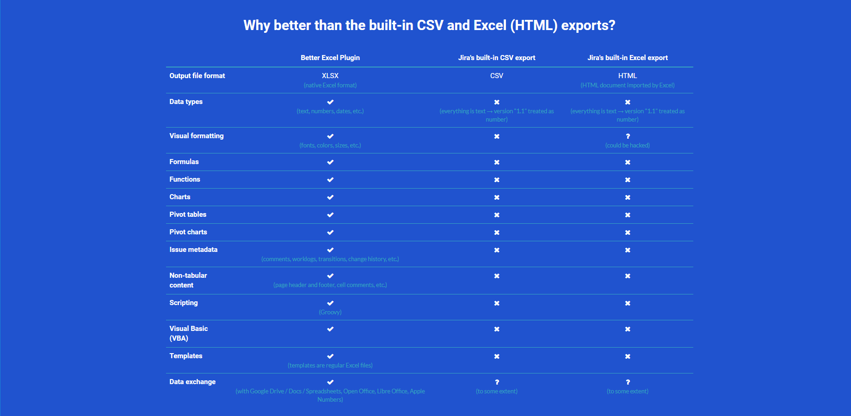
Jira Excel export options in comparison
XLSX vs. CSV vs. HTML
Notes:
Let’s look at in summary how Better Excel compares to the built-in CSV or Excel (or more like HTML) export.
Better Excel Exporter exports real Excel files in the XLSX file format, not something else. XLSX is the de-facto standard file format for spreadsheets. XLSX is an open (non-proprietary) format and it is supported by all major spreadsheet tools.
It handles all data types correctly by separating the “value” of the data from the “presentation” of the data. It works correctly with numbers, allowing those be formatted as decimal numbers, currencies, percentages, and so on. It also works correctly with dates in any timezone.
It enables you to use Excel features like formulas, functions, pivot tables and pivot charts. Microsoft has been developing those features for decades and we wanted to be sure that you can intuitively utilize those on Jira data.
It enables you to export not only issues, but practically any information from Jira. It includes issue metadata such as comments, worklogs, change history, or user accounts, projects, data from third party apps like Tempo, Insight or Zephyr, and more. Our motto is that “if this information is available in Jira, you can export it to Excel”.
You can work with Excel’s non-tabular content features, like adding cell comments or adding worksheet headers.
Another kind of advantage comes from the ability of scripting. Not only you can run Visual Basic scripts when the output file in opened in Excel, but Better Excel let’s you execute custom logic during the export with custom Groovy scripts. These can process data, collect data from additional sources (like external databases or APIs), for example.
Finally, it also allows you to flawlessly transfer Jira data to other spreadsheet programs like Google Sheets or OpenOffice.
These are all features that are not available or not fully available for you if you export data with Jira’s CSV export or the deprecated HTML export.

Slide 6
How to export custom Excel reports from Jira
Comparison of Jira Excel export options
Exporting a list of issues to Excel
Creating Excel reports from Jira
Managing Excel views
Managing Excel templates
API, REST API, Automation
Integrations with Jira apps
Notes:
What are we going to cover today?
We will start our agenda with the first thing that you can do after installing the app - exporting a simple list of issues (including Jira users!)
Turn issue lists into reports
Then we will clarify what “views” are and how you use them
What are “templates” and how you use those
APIs and automation options to make your work faster and more efficient
Integrations with other apps

Slide 7
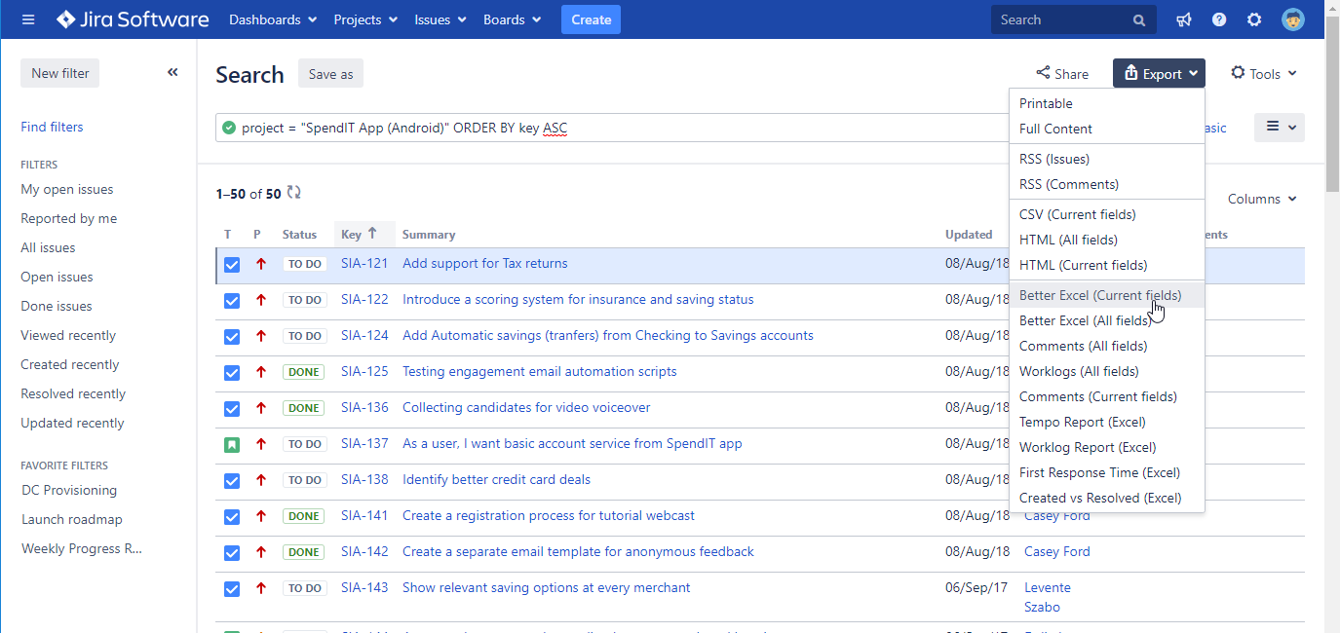
Exporting a list of issues to Excel
Available from the “Export” menu in Issue Navigator, Jira Software boards, Jira Service Desk queues
export types
Notes:
If you pull up the Issue Navigator screen, you’ll find that the Export menu is extended with additional options added by Better Excel Exporter. >>NEXT<<
Like Basic Export, or Better Excel (Current fields).
As you are looking at the Issue Navigator, the export options appear on the existing user interface, that you are familiar with already.
We wanted to fit Excel exporting into the Jira interface as frictionlessly as possible.
These export menu options are also called Excel views (technical name), and we will talk about it in a few minutes.
When you click these, all the issues currently in the Issue Navigator will be exported to an Excel spreadsheet.
Again, it is not only the visible page, but all issues, the currently applied JQL query has returned.

Slide 8
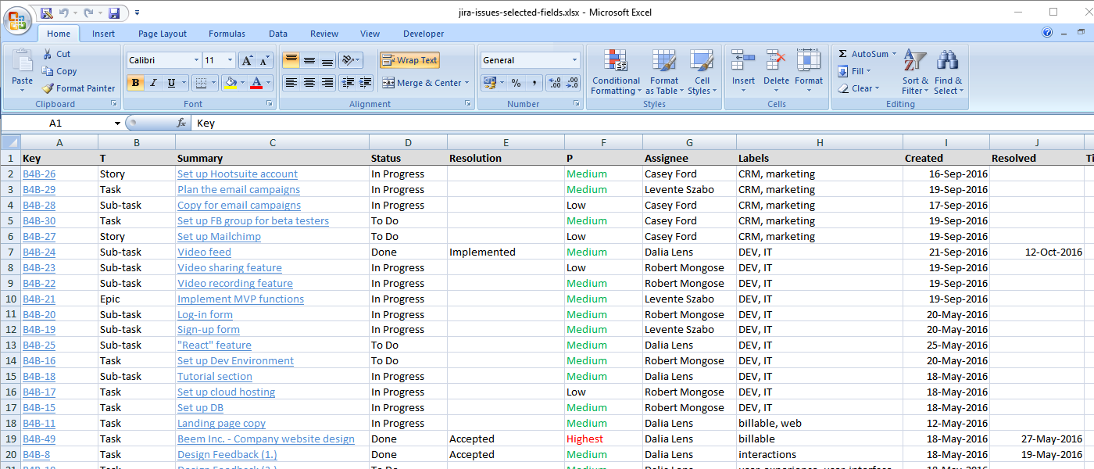
Exporting a list of issues to Excel
Precise data that require no post-export processing
Notes:
This is how your exported issues will look in Excel, with the fields selected in the Issue Navigator.
So, just select your columns in Issue Navigator and that view will be re-created in Excel after a single click.
Notice, how the date type fields are formatted as date in Excel and everything else is text in this example.
Also note that the “Key” and “Summary” columns are links to the originating issues. This, as pretty much everything else, can be configured! Configurability and customization is a major design goal for the app.
Finally, there are no line breaks in cells, as the template automatically sized the columns to fit the content. As a result, you will get the optimal layout immediately.

Slide 9
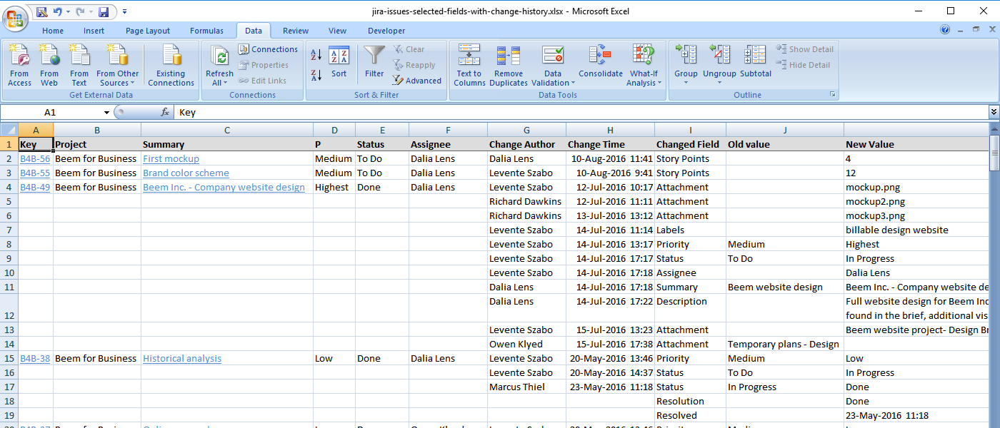
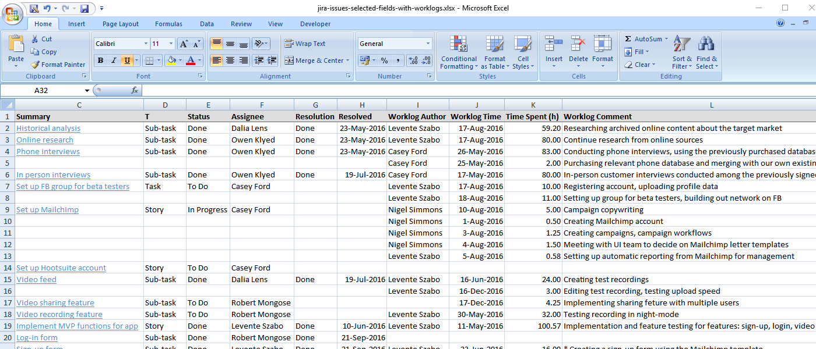
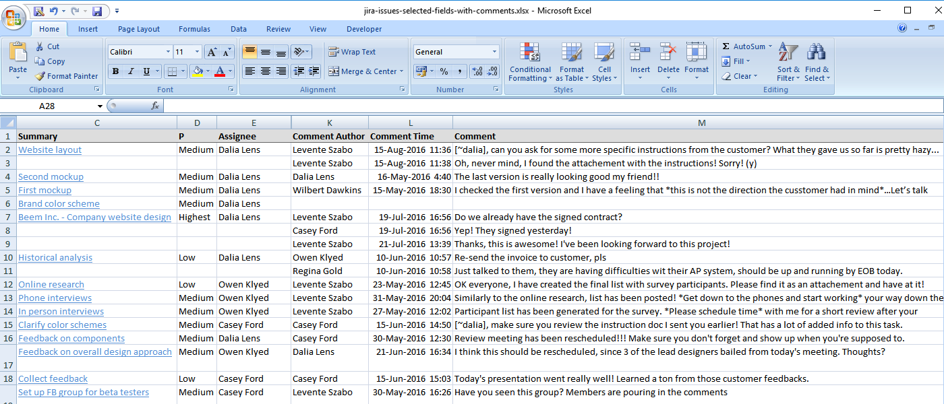
Exporting a list of issues to Excel
Add comments, worklogs, change history to your exports easily
Notes:
In addition to field values, you can export the meta information of the issues.
>>NEXT<<
Just choose a different template, >>NEXT<< and export the issues with their comments, >>NEXT<< or worklogs >>NEXT<<or you can decide to export >>NEXT<< the full change history >>NEXT<< to Excel.
Needless to say, these additional columns are also using the correct data types.

Slide 10
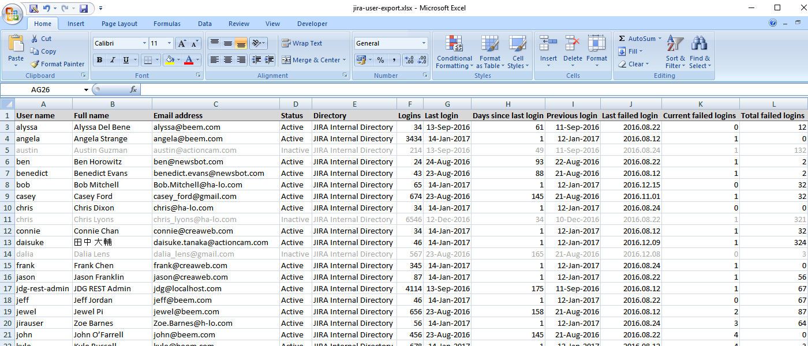
Exporting Jira user accounts to Excel
Export Jira user accounts and any other information for analysis
Notes:
What’s even more, you can use a template to export Jira user accounts and their information to Excel.
>>NEXT<<
Jira user account export is a fine example of exporting non-issue related information from Jira with Better Excel Exporter.
The template for this come with the app built-in, so you can use this template right away.
This is useful, for instance, when you want to do an overhaul of Jira users and optimize the seats taken. By exporting Jira accounts and all their information, like active or inactive status, last login date and more, you can easily analyze it further, filter the results and make decisions about unused accounts.
Or, you can also use this to verify group memberships or failed login attempts.

Slide 11
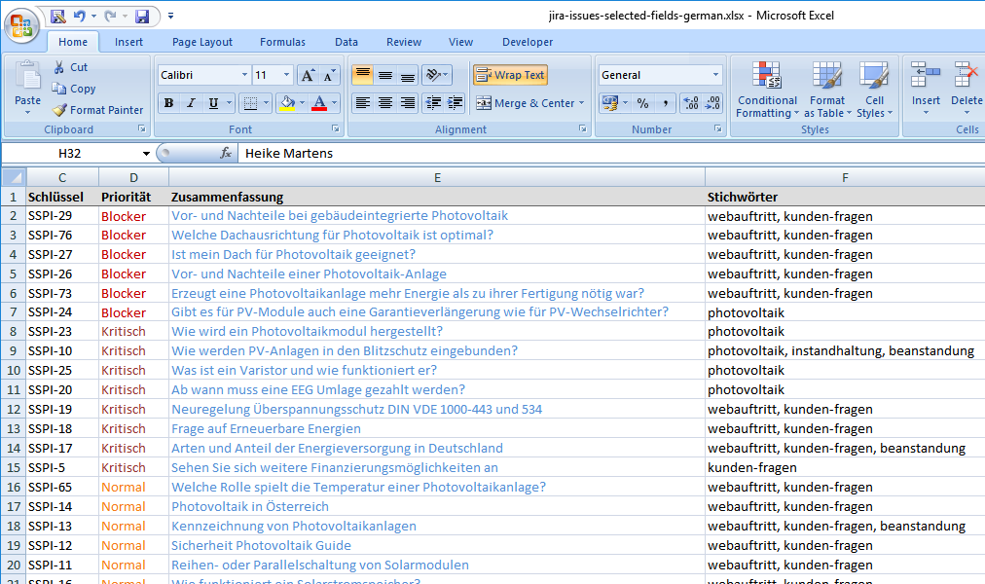
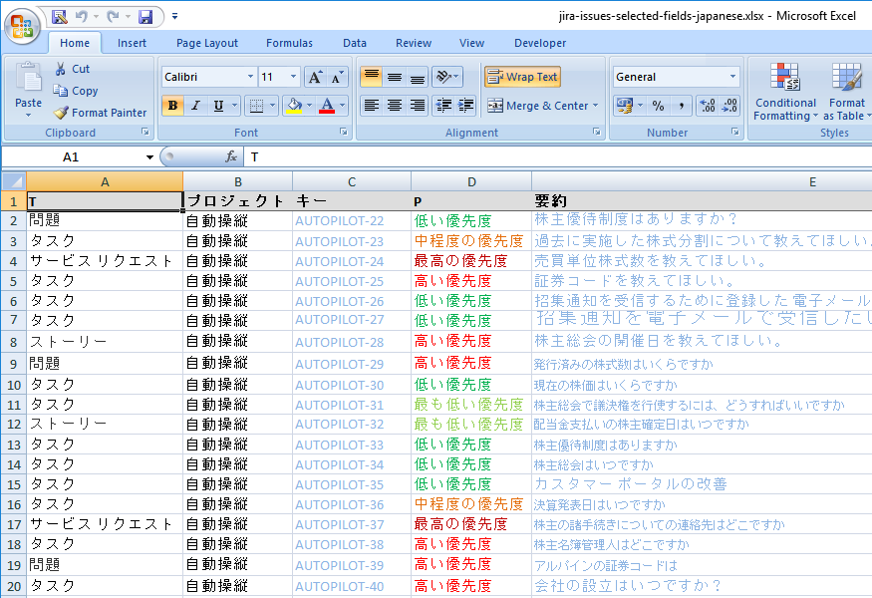
Exporting a list of issues to Excel
Better Excel Exporter speaks your language and supports your character set
Notes:
Another frequently surfacing concern is language support.
Text-based export formats, like HTML or CSV, are prone to encoding problems which gets even worse if your teams are using multiple operating systems or multiple languages.
You can use any language, any operating system, we have you covered. >>NEXT<<
Better Excel Exporter works with 100% Unicode internally, therefore it supports any language and character set out of the box.

Slide 12
Exporting a list of issues to Excel
Integrated with many popular third-party apps (Tempo, Insight, nFeed, Zephyr, Time to SLA, etc.)
nFeed custom fields
Insight custom fields
Tempo custom fields
Zephyr
custom fields
Notes:
In addition to the data stored in Jira itself, Better Excel Exporter can export data stored in third party Jira apps like >>NEXT<<
nFeed, >>NEXT<<, Insight, >>NEXT<< Tempo Timesheets, >>NEXT<< or Zephyr.
You can export the custom fields that are provided by a third party app the same way as built-in custom fields. There is absolutely no difference from the user’s point of view.

Slide 13
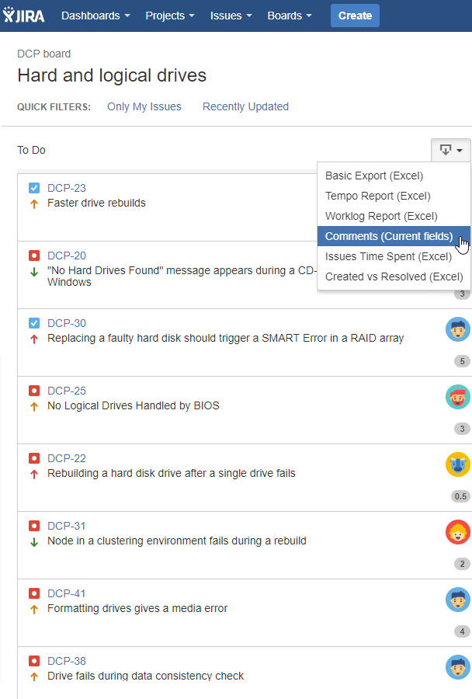
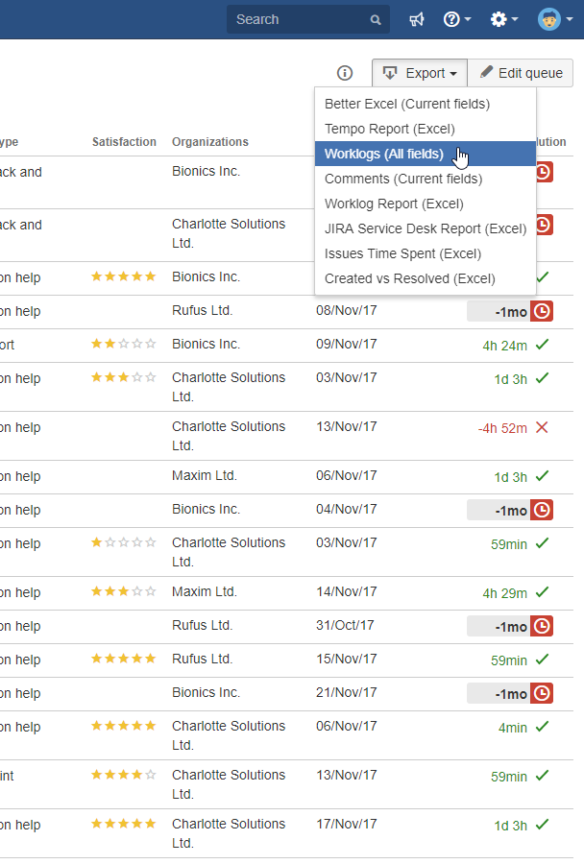
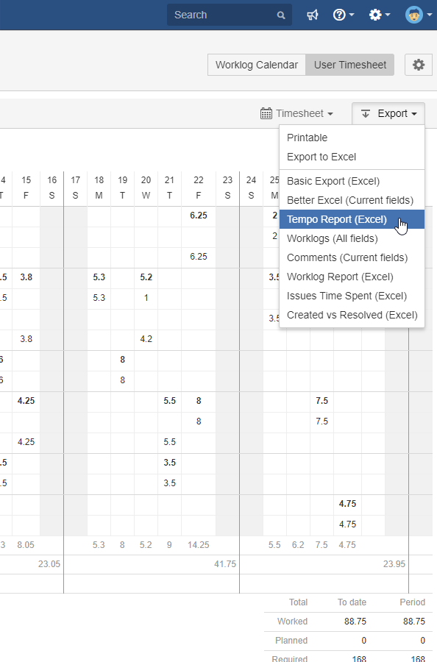
Exporting a list of issues to Excel
Typical Jira contexts where you work with a list of issues
Jira Software boards
Jira Service Desk queues
Tempo timesheets
Notes:
A list of issues is sometimes not just a simple list of issues.
There are also a few typical contexts where you want to work with a list of issues, like >>NEXT<< Agile board (columns), >>NEXT<< Service Desk queues, or >>NEXT<< Tempo Timesheets and more. The good thing, is that Better Excel Exporter appears in these scenarios as well, adding the appropriate export menu option, according to the context.

Slide 14
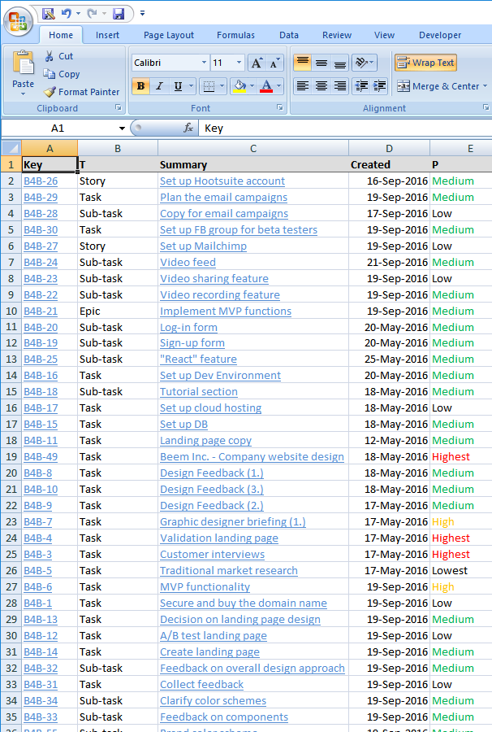
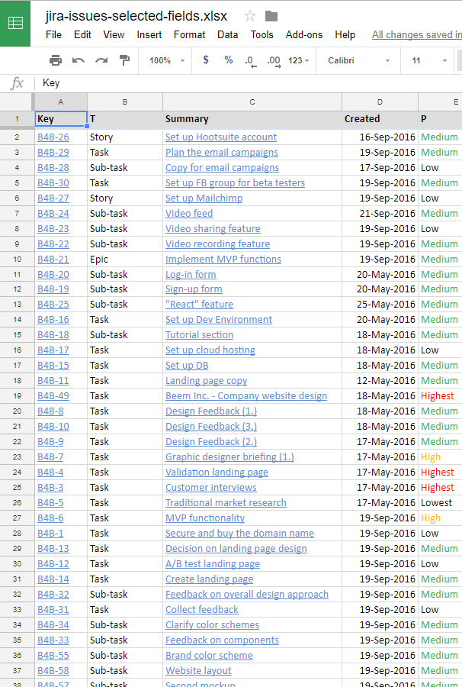
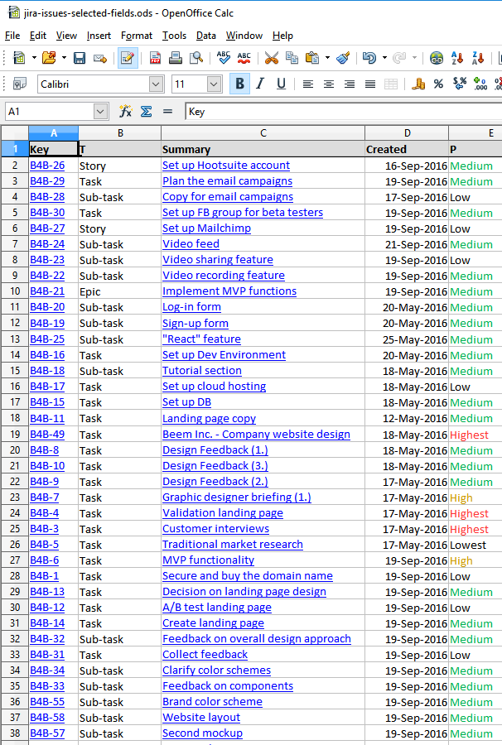
Exporting a list of issues to Excel
Exports are compatible with any spreadsheet tool that supports the XLSX fileformat
Microsoft Excel
Google Sheets
LibreOffice (OpenOffice) Calc
Notes:
Since you are getting a standard XSLX file as export output, it also means that the file will be fully >>NEXT<< compatible with all popular spreadsheet software out there.
>>NEXT<< When opening it with Google Sheets, >>NEXT<< OpenOffice or Numbers on Mac, it will just work.

Slide 15
How to export custom Excel reports from Jira
Comparison of Jira Excel export options
Exporting a list of issues to Excel
Creating Excel reports from Jira
Managing Excel views
Managing Excel templates
API, REST API, Automation
Integrations with Jira apps
Notes:
So far, we only looked at simple issue exports, where all you wanted was to see the Jira issues with their custom and system fields in Excel
Now, let’s see how you can create Excel reports from Jira Software or Service Desk issues

Slide 16
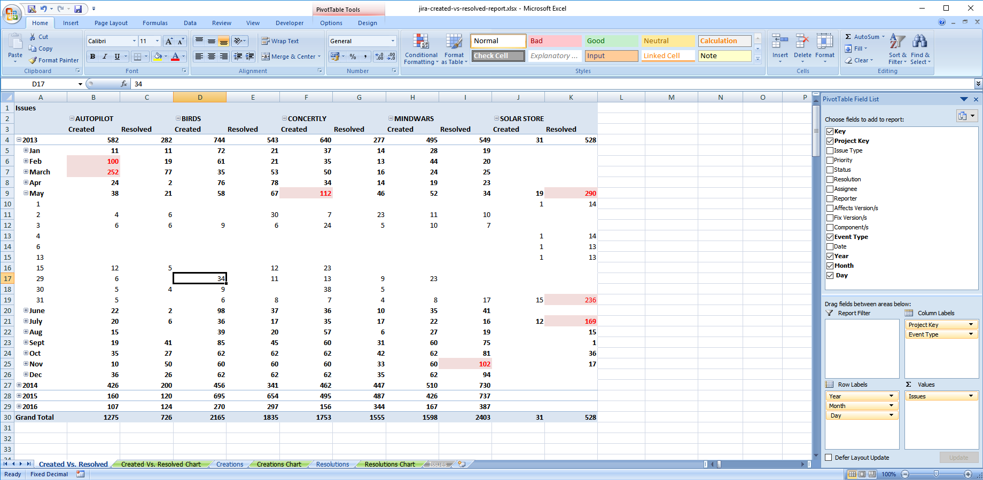
Creating custom reports from Jira data
Analyze Jira data using Excel pivot tables
Notes:
Better Excel Exporter comes with built-in pivot report templates that help you create instant business reports.
What built-in means, is that the pivot table is created automatically during the Excel export.
When you open the exported Excel file, the pivot table is already there, so you don’t have to create it yourself using the raw data.
Once you got the Excel spreadsheet, you obviously can modify the created pivot table, select or unselect fields and adjust the dimension, depending on what you want to analyze.
You can also choose to create new pivot tables since the export always contains the raw data as well.
>>NEXT<<

Slide 17
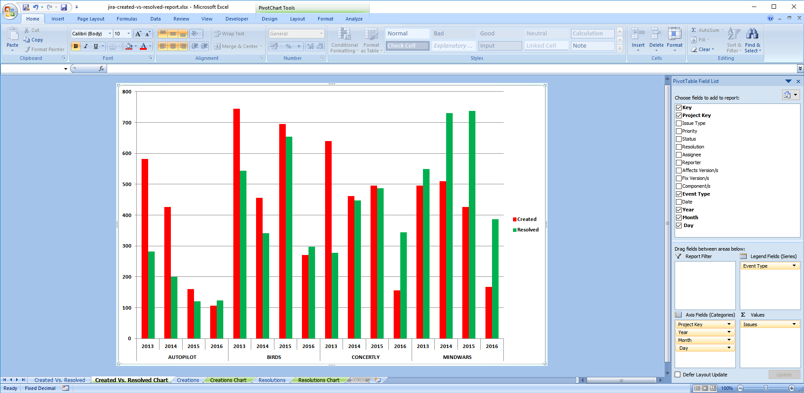
Creating custom reports from Jira data
Visualize Jira data using Excel pivot charts
Notes:
And as you probably guessed, a pivot chart is also created on another worksheet, to visualize and therefore make the exported data more understandable.
Exactly as with pivot tables, the pivot charts are created during the export, and are readily available when you open the exported spreadsheet.
Both the pivot table and pivot chart can be further customized by turning on and off the fields you are interested in.

Slide 18
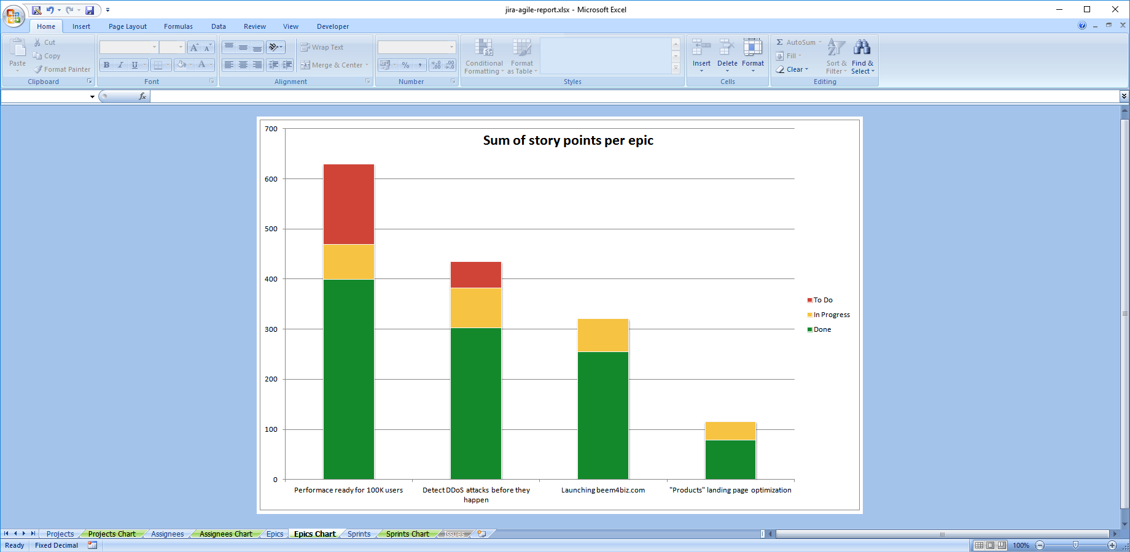
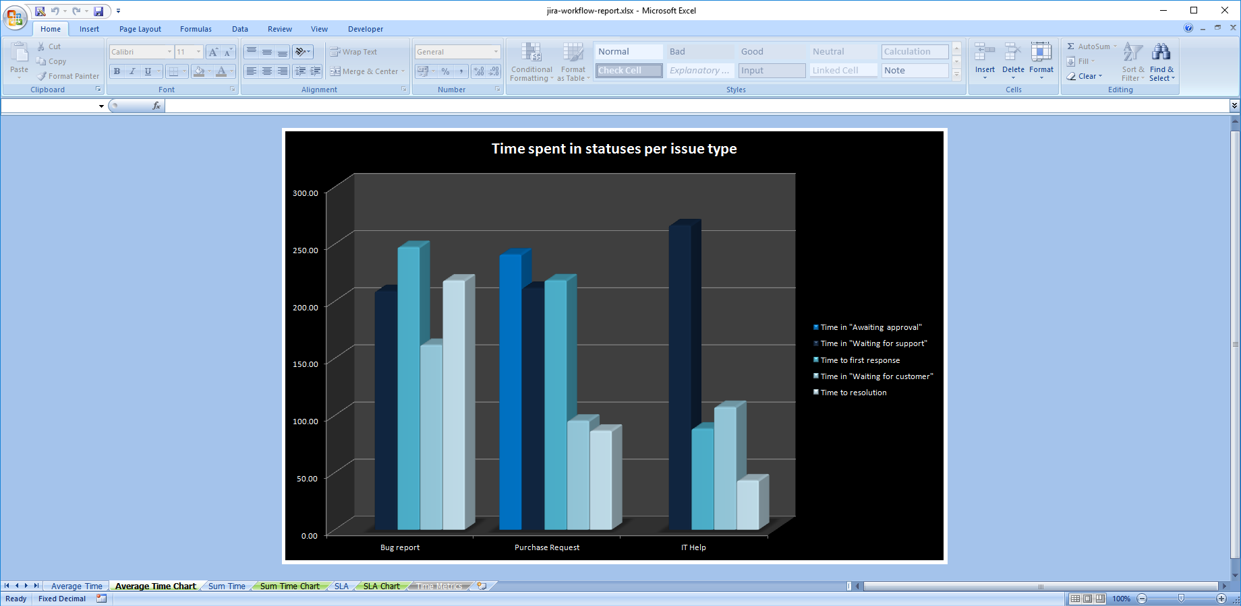
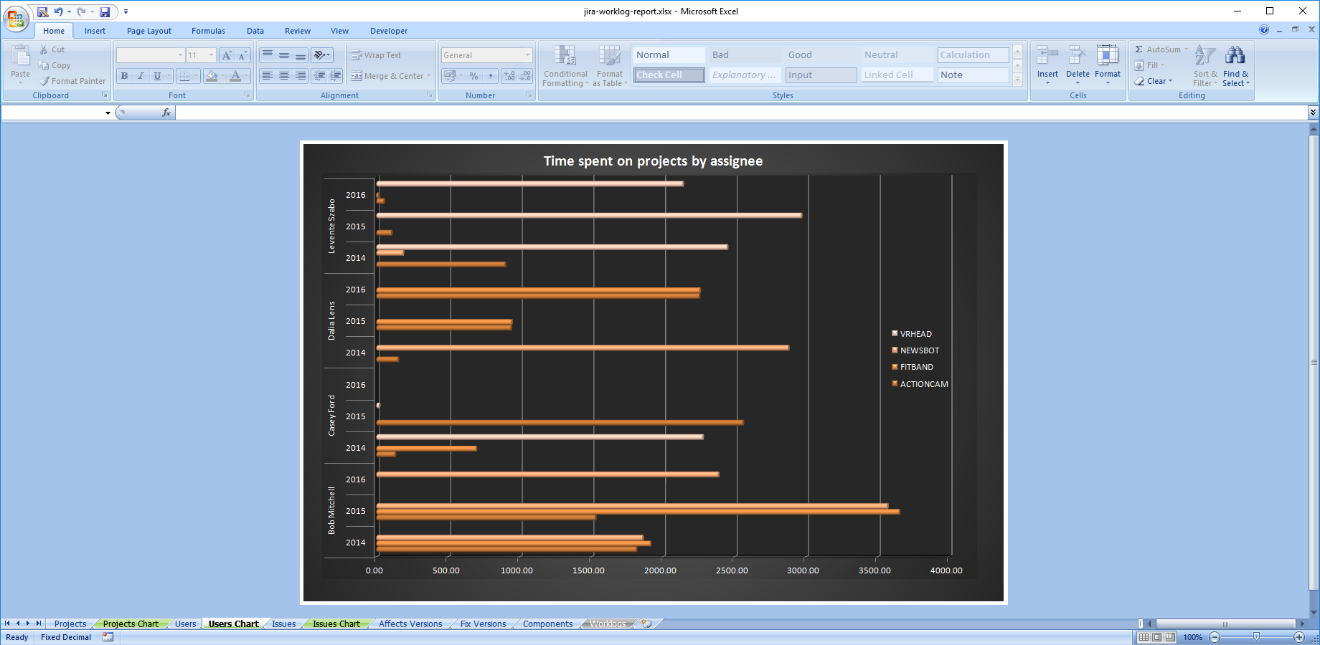
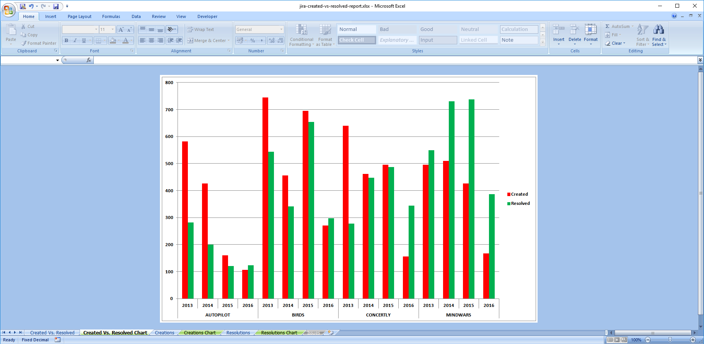
Creating custom reports from Jira data
List of issues turned into business reports with the right template
Created vs. Resolved reports
Jira Software Agile reports
Jira Service Desk reports
Workflow reports
Worklog reports
Notes:
Let’s see some examples of business reports created with Better Excel Exporter. I will not go into details, just wanted to demonstrate some typical examples of what is possible with our app. >>NEXT<<
By using the Created vs Resolved report template, you can analyze the rate issues are being solved at, or the >>NEXT<< worklogs, so you can have a clear picture on who worked on stuff and how long.
Similarly, you can easily >>NEXT<< create a workflow report, that tells you the effectiveness of your team by showing how much time does an issue type spend in a status.
>>NEXT<< Better Excel integrates with Jira Software and handles the Jira Software specific custom fields, like Epic, Sprint or Story Points. By choosing the agile report template, you can get an epic status report like this, that shows the sizes of the epics and also their current progress status. Or you could use this same template to compare sprint sizes, or visualize which team member has the most story points allocated to them. These are just examples of all the different aspects that you can analyze with Better Excel Exporter.
>>NEXT<<
Service Desk also has its own report template, that you can utilize to get a clear picture of your support team’s progress.

Slide 19
How to export custom Excel reports from Jira
Comparison of Jira Excel export options
Exporting a list of issues to Excel
Creating Excel reports from Jira
Managing Excel views
Managing Excel templates
API, REST API, Automation
Integrations with Jira apps
Notes:
Our next stop is Excel Views

Slide 20
Managing Excel views
Concepts
What are
the Excel views?
How do
the Excel views work?
How to create, delete, rename, reorder Excel views?
The options that appear in the “Export” drop-down menus.
Each Excel view has a name plus a position in the “Export” menu.
You can select which Jira screen should offer this.
Each Excel view renders an Excel template.
Just go to Administration → Add-ons → Excel Views.
Notes:
Excel views are the export types or menu options that appear in the Export drop-down menus, the elements of those Export menus. They have their names and positions in the menu.
You can refine which Export menus in which Jira screen should offer which view. For example, a “story card” export may make sense in a Scrum board and in Issue Navigator, but not in a Service Desk queue.

Slide 21
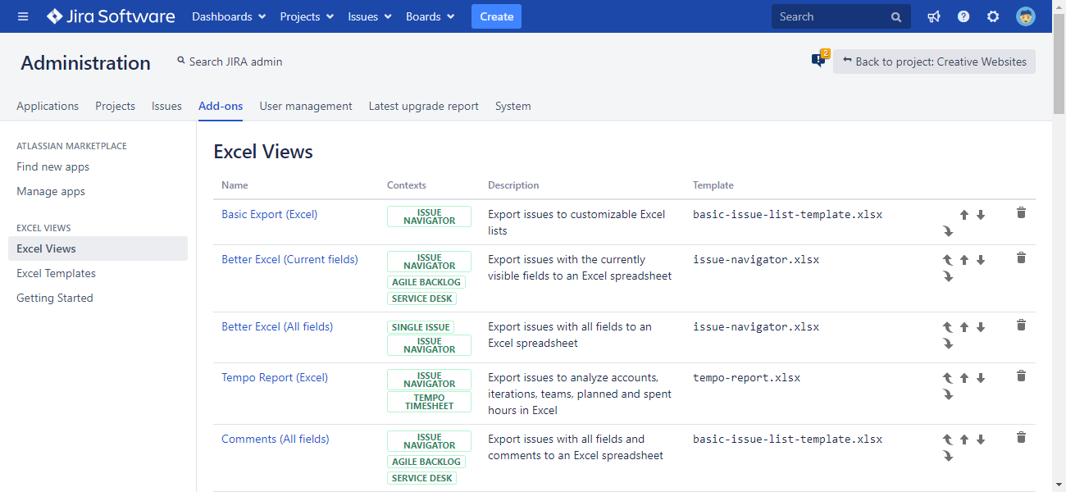
Managing Excel views
Excel views are managed in the Jira admin interface
Notes:
Each Excel View is linked to an Excel template, so here you control what template, or in other words what type of document should a view create.
Here you can also reorder them, which order will be reflected in the Export menus.
Excel Views can be managed in the Add-ons section of the Jira administration interface.

Slide 22
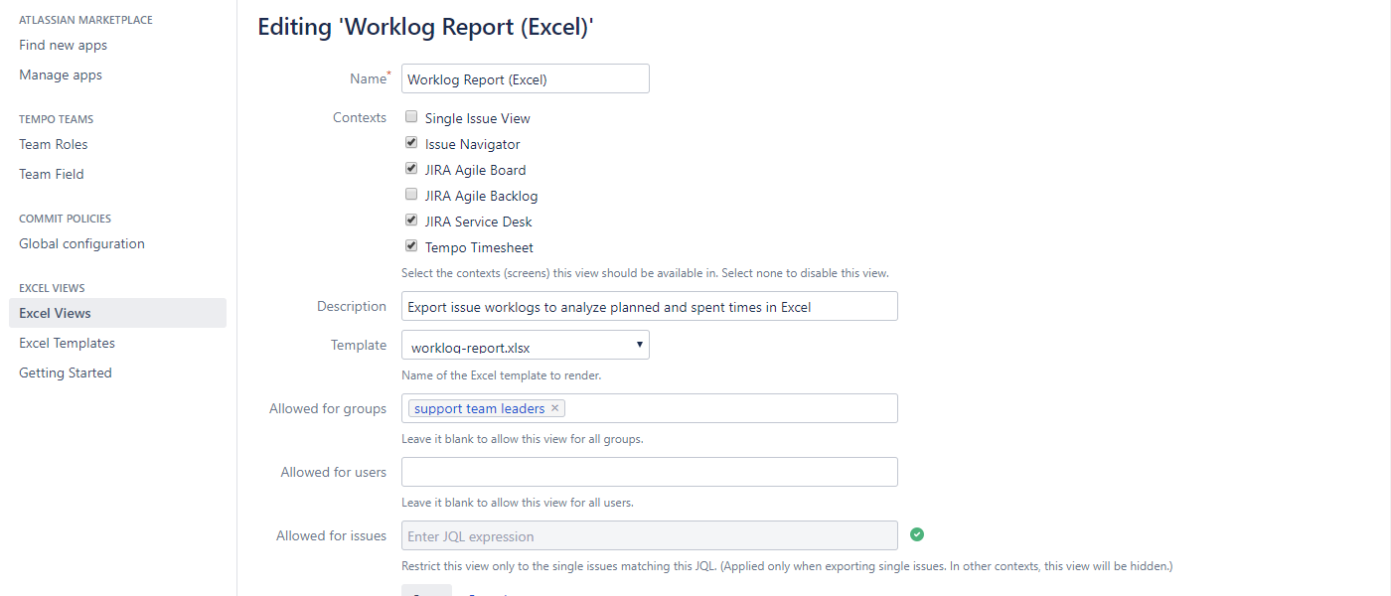
Managing Excel views
Easily configure the Excel views
visibility of this export type
Notes:
You have a couple of options when you are editing an Excel view.
First, you can add it an intuitive and descriptive name. This name will appear in the Export drop-down menus, so here you are basically editing the menu options. Try keeping the name really short, concise and intuitive for your users.
>>NEXT<< At the context section, you can define the Jira contexts or screen, where you want to export option to be visible.
The description will appear in the administration view only, as a quick reminder about what the export option is for.
>>NEXT<< Then you are defining a template, that the view will render.
>>NEXT<< Finally, you can control the visibility of the view. This is like a “security” option. You can hide a specific export option from users or group that never need to use it, or allow the export type only for specific issues that you define using JQL.

Slide 23
How to export custom Excel reports from Jira
Comparison of Jira Excel export options
Exporting a list of issues to Excel
Creating Excel reports from Jira
Managing Excel views
Managing Excel templates
API, REST API, Automation
Integrations with Jira apps
Notes:
We mentioned Excel templates a lot so far, so let’s see what they are good for

Slide 24
Managing Excel templates
Concepts
What are
the Excel templates?
What are Groovy scripts used for?
How to edit
the Excel templates and scripts?
Templates define
the data and its format
to export to Excel.
Templates are
regular Excel files, too.
Scripts are executed while
generating the Excel spreadsheet to:
do custom processing
access Jira internals
integrate with external sources
implement any logic
plus more
Just go to Administration→Add-ons, download the template XLSX file, and edit it in Excel.
Notes:
The export templates are Excel files themselves, too. You can edit the templates directly in Excel and insert special placeholders to the cells which will be replaced with the actual values during the export. We will show a template example later.
If a template requires more complex business logic, like some calculation or loading information from an external database, then it can be accompanied by a Groovy script, which does the heavy lifting.
And while it doesn’t hurt if you are familiar with code, basic changes can still be made easily by anyone.
There are parameters in the templates are really easy to modify and you can also download a Reference Manual.
The Reference manual is a collection of expressions that you can copy and paste into your templates.
So if you want to know how to put the issue creator or current status or number of votes, and so on, you can use that as a cheat sheet.
If you want to hear more in-depth about templating in Better Excel Exporter, let me know in the comments, so we can reach out or if there is demand, organize a separate webinar just on templating.

Slide 25
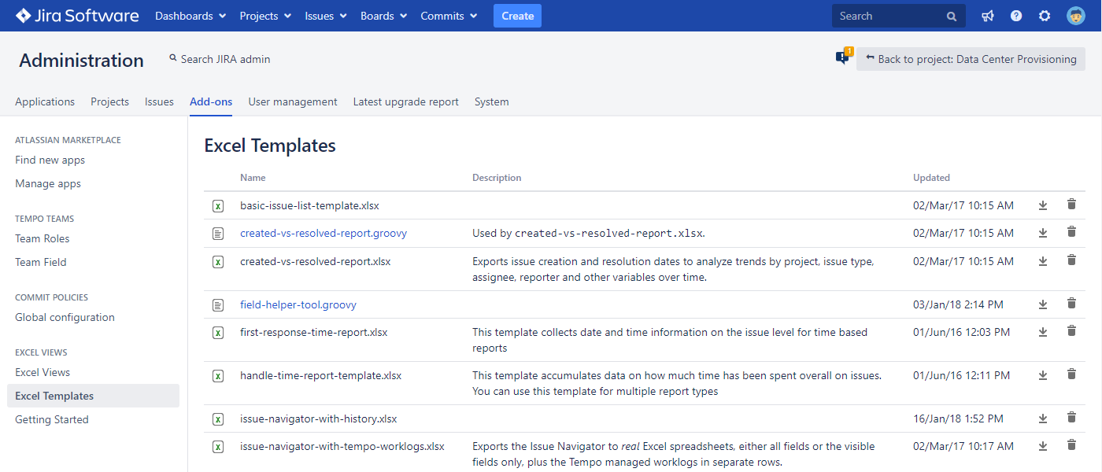
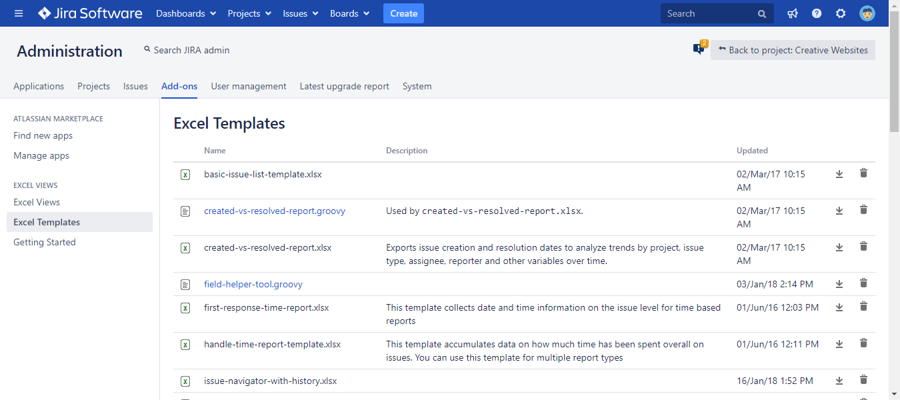
Managing Excel templates
Excel templates and scripts are managed in the Jira admin interface
Notes:
When you open up the Excel Templates section, you find the list of your existing templates and scripts.
Important: you are not starting from scratch.
Better Excel Exporter comes with many built-in templates, that you can use right away, like the reports I just showed as you earlier.
They cover the typical use cases as they are, so if those fit your use case, than you might not need to customize templates at all.
If you don’t like something, you can customize the template.
If you have specific requirements, make a copy and customize the copy and keep the original.
>>NEXT<<

Slide 26
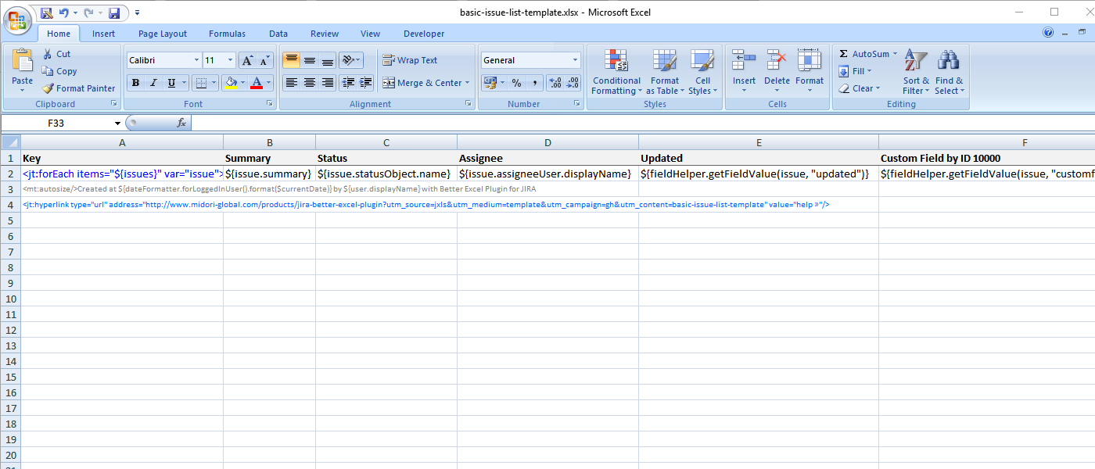
Editing Excel templates
Edit templates directly in Excel
Notes:
The Excel templates, being XLSX files themselves, can be downloaded then edited directly in Excel on your computer.
When you are done with your changes, save and upload the file back to Jira. The next export will reflect your customizations immediately.
This is especially practical if you are making relatively minor changes to your templates once in a while.
If you are building a new template from scratch or making major modifications, and you would like to continuously test your changes, you can use the so-called Developer Mode instead. Developer Mode lets you source your Excel templates and scripts from your filesystem. This way there is no need to upload the template after every little change. You just save it locally and can export immediately. Developer Mode was designed to accelerate developing templates and scripts.
If you are interested in how to use it, there is tutorial video about it on our Better Excel Exporter YouTube playlist, I suggest you check it out.

Slide 27
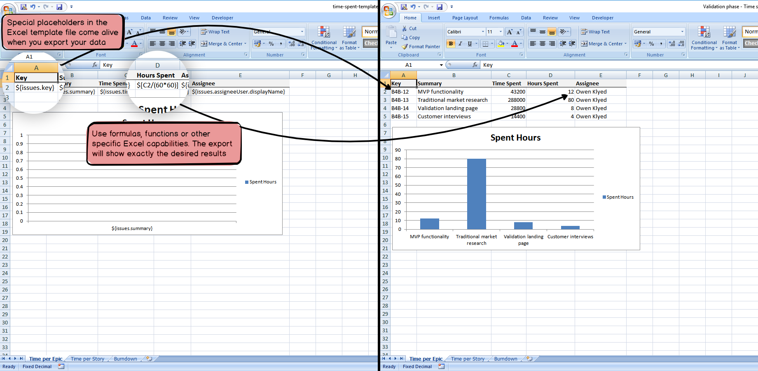
Edit Excel templates
Insert template expressions, formulas, charts, pivot tables, pivot charts, etc. to the templates
Notes:
Here is a template file opened in Excel in the left, and the export rendered from this template in the right.
Cells in the template contain expressions written in JEXL, the standard Java Expression Language. If you ever worked with any programming language, using expressions will be familiar to you. And if you never, they are very easy to understand. See the expression in “A2” in the left, for example,
This means: “insert the key of the current issue to this cell in the output spreadsheet”.
During the export, these expressions will be replaced with the actual data in Jira.
If there are multiple issues to export, then those rows and cells will be automatically repeated. As you see in the right, 4 issues to export caused row “2” to appear 4 times in the output, and the key of the 4 issues were inserted to the cells in column “A”.
In addition to JEXL expressions, you can use Excel formulas, Excel functions and any other Excel feature in the cells.
See the formula in “D2” in the left, for example
This converts the Time Spent value in “C2” from seconds to hours.
Then see the output in the right, where the cells in column “D” are calculated using this formula. It is totally intuitive.
The chart in the left is blank because there is no data in the template.
As soon as actual values appear in the output the chart starts working to visualize the data.
Finally, as you can see, the colors, cell sizes, fonts, formatting are kept without any change in the output. The editing experience is WYSIWYG in this sense.
This approach relying on expressions, formulas, blank charts, blank pivot tables and such offers ultimate flexibility. I strongly suggest to check out the examples in the Template Gallery on our website, to get an impression of what is possible.

Slide 28
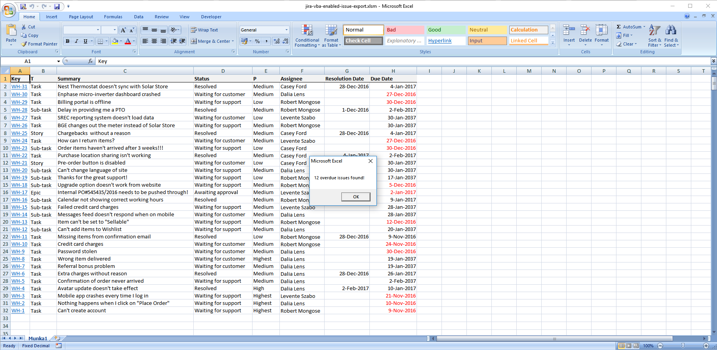
Use all Excel features
Create dynamic Excel spreadsheets with Visual Basic macros
Notes:
I always highlight that with Better Excel Exporter you can take full advantage of all the features Excel has.
This also includes Visual Basic (VBA) macros.
By using VBA macros in your template, you can add dynamic behaviour to your Excel spreadsheets.
For example, you can update the sheet content at every open, display alert boxes for the user, or add form-based interactions.

Slide 29
How to export custom Excel reports from Jira
Comparison of Jira Excel export options
Exporting a list of issues to Excel
Creating Excel reports from Jira
Managing Excel views
Managing Excel templates
API, REST API, Automation
Integrations with Jira apps
Notes:
Now let’s see what options are there to take some weight off of your shoulders using APIs and automation.

Slide 30
API, REST API, Automation
Multiple ways to automate Excel exporting and integrate that to your processes
Excel (XLSX) rendering engine
All Jira data
Web UI
(Export menus)
Java API
(for anything on the JVM)
REST API
(for HTTP)
Browser
Automation for Jira
ScriptRunner
Your Jira app
Your HTTP based integration
Your rules
Your scripts
Notes:
So far, I mentioned situations where your users want to get an Excel export on a case-by-case basis, manually.
>>NEXT<<
The way they go about it is they open Jira in the browser, select the data to export, open the “Export” menu and create the Excel.
It’s probably the most common, but definitely not the only option to use Better Excel Exporter!
Since the very beginning of building this app, we always wanted to integrate the capability of Excel exporting to Jira workflows and offer other types of automatic processes.
As a result, today we offer multiple ways for integration.
>>NEXT<<
First, our Java API is a “classic” in-process interface that Better Excel Exporter provides for any other program running within the same Jira.
>>NEXT<<
For example, the Java API is the interface used by the highly popular app Automation for Jira to generate, save or email Excel files.
We will discuss it in details in just a second.
>>NEXT<<
Also, the Java API is used by another super-popular Jira app called ScriptRunner.
If you’re not familiar with it, ScriptRunner can run scripts within Jira, written in Groovy, the standard scripting language of the Jira Virtual Machine.
These scripts add new workflow post functions, periodic jobs and similar new features to Jira.
>>NEXT<<
And, of course, the Java API can be used by any other Jira app.
>>NEXT<<
Our second API for the outside world is the REST API.
If you are familiar with the concept of REST, this is an integration method that relies on the HTTP protocol, the standard protocol that powers the Internet.
In a nutshell, the REST API allows external systems to connect to Jira, request it to export an Excel file then return that to the caller over the Internet in a standard and secure way.
A few more details on this later.
>>NEXT<<

Slide 31
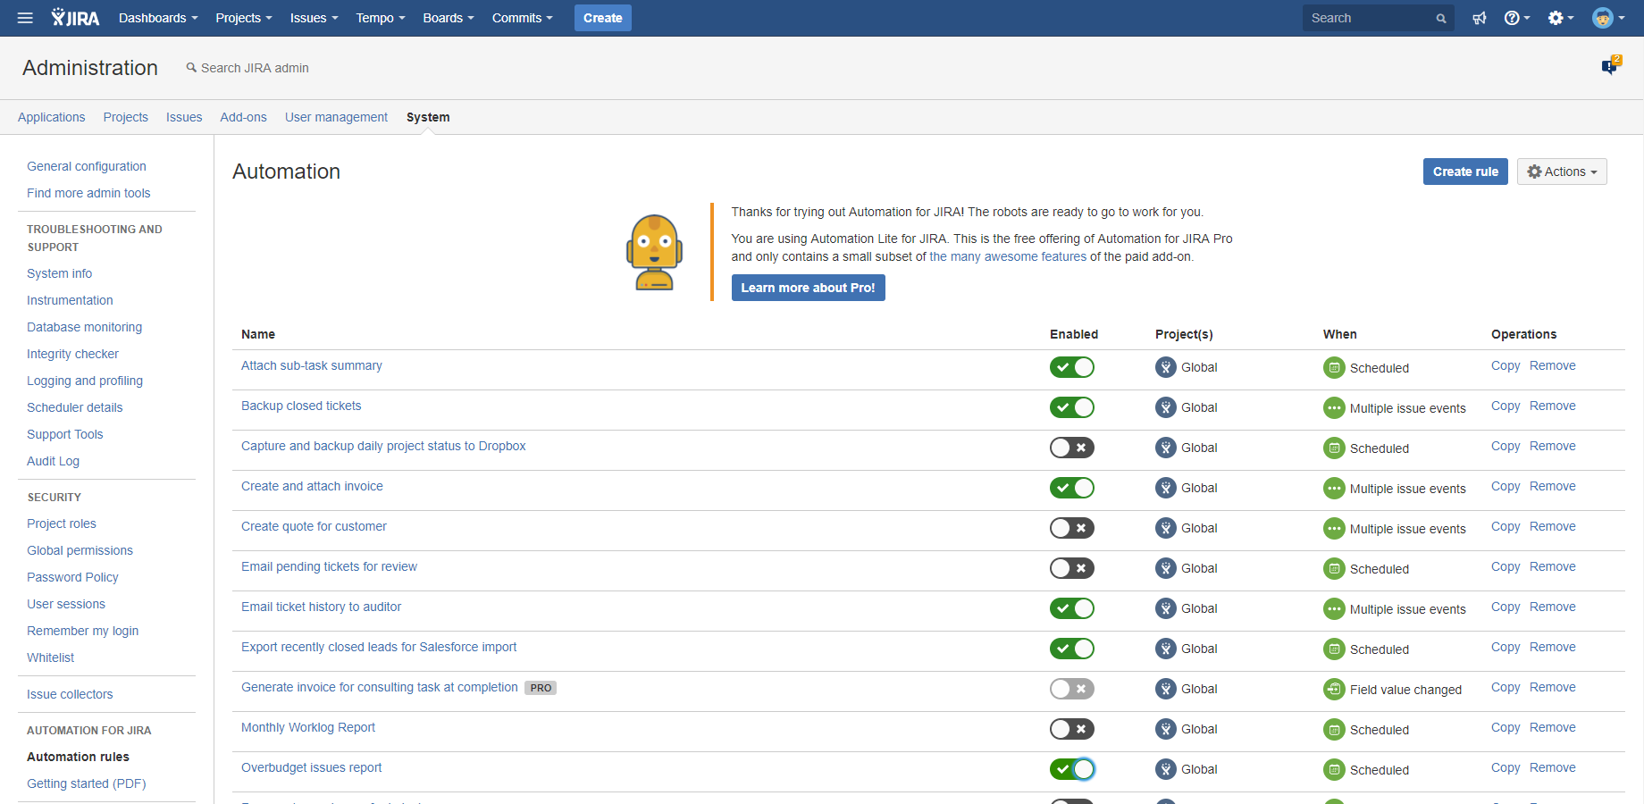
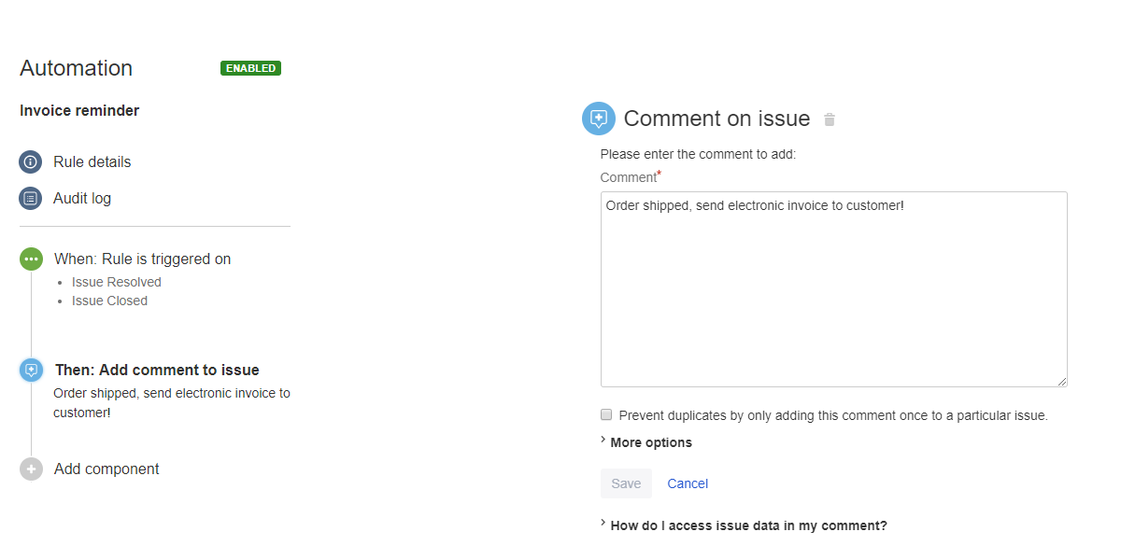
Better Excel Automation for Jira
Free app bridging Better Excel Exporter and Automation for Jira
Notes:
For most automation use cases, we recommend to use Automation for Jira.
This is a very popular Jira app, developed by our friends at Codebarrel.
You should know, that this app has both a free and a paid and supported version, but Better Excel Exporter supports both.
Automation for Jira allows implementing automation by defining so-called automation rules. >>NEXT<<
Each automation rule contains a trigger (when to start the rule) and one or more actions (what to do when executing the rule).
To extend the available automation actions, we offer a free app intuitively called Better Excel Automation, which bridges Automation for Jira and Better Excel Exporter.
So, you need 3 apps: Automation for Jira to manage the automation rules, Better Excel Exporter to generate the Excel files, and Better Excel Automation to connect these two.

Slide 32
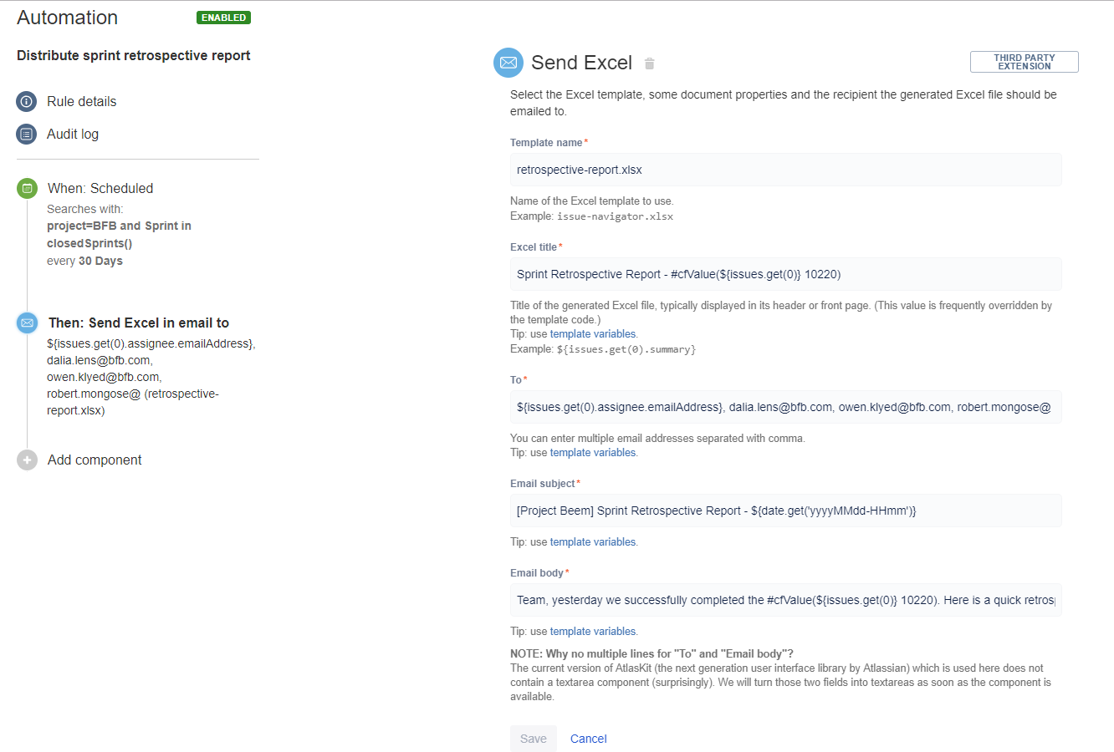
Better Excel Automation for Jira
Free app bridging Better Excel Exporter and Automation for Jira
Notes:
As I said, Better Excel Automation for Jira is like a “bridge” app, and it offers 3 new automation actions that you can add to automation rules:
“Send Excel“ action - This action allows you to send the generated Excel document via email. You can set recipients, and also the subject and body of your emails, and send those emails automatically.
“Save Excel“ action - Which saves the generated Excel on the server filesystem or to a network drive (like Google Drive or Dropbox) mounted into that
“Attach Excel“ action - Which lets you define a Jira issue to attach the exported Excel to as an attachment
Overall, Automation for Jira offers a friendly and straightforward interface to implement business automations in Jira.

Slide 33
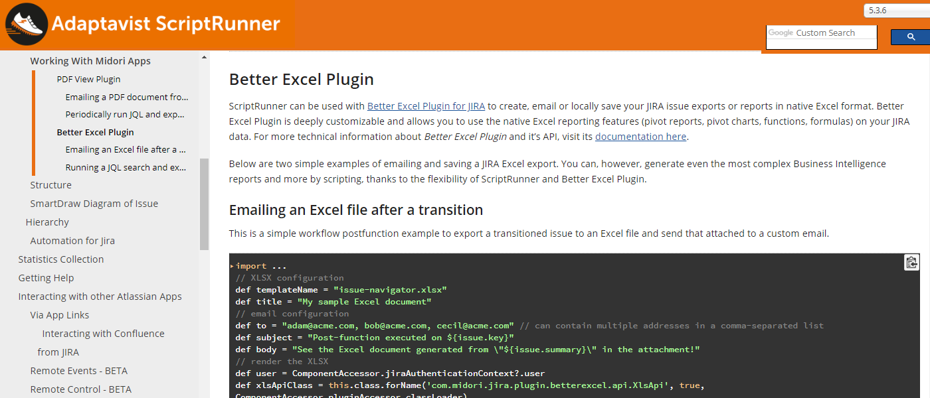
ScriptRunner
Write powerful workflow post-functions, services, etc. in Groovy to automate Excel generation
Notes:
If your use case needs an alternative to defining user-friendly automation rules, then you have the option of writing your own automation logic in Groovy scripts.
ScriptRunner, a Jira app developed by Adaptavist, allows running these Groovy scripts as workflow post-functions, services (periodic jobs) and in many other extension points.
The advantages and disadvantages are similar to the ones we mentioned at the templates.
Scripts are flexible, but you need to write or at least manade code.
The good news is that similarly to our templates, you can find complete working code examples in the Better Excel Exporter section of the ScriptRunner documentation. You can just copy and paste these.
So, if you are comfortable with managing short Groovy snippets or you require more flexibility than what the automation rules offer, we strongly suggest checking out ScriptRunner.

Slide 34
REST API
Call RESTful endpoints and the Excel file will be returned in the HTTP response
For issues:
/xls/xls-view/{xls-view-id}/render
http://jira.mycompany.com/rest/.../xls/xls-view/7/render?context=ISSUE_NAVIGATOR&jql=project+%3D+DEMO&tempMax=100
For menu items:
/menu
http://jira.mycompany.com/rest/.../menu?context=SINGLE_ISSUE_VIEW&jql=key+%3D+DEMO-2
– Learn more:
http://www.midori-global.com/products/better-excel-exporter-for-jira/documentation/rest-api
Notes:
As I promised, a couple of more thoughts about our REST API. I’m gonna keep it really short, but it belongs to the full picture.
First off, Better Excel Exporter REST API extends the standard Jira REST API by adding further endpoints to that.
It also means that you can freely combine Better Excel Exporter REST calls with Jira REST calls.
In its current form, Better Excel Exporter offers two REST endpoints as you can see here.
>>NEXT<<
The first endpoint is to generate a spreadsheet from issues. Renders an Excel spreadsheet from the result of a JQL query or a filter.
In the first example, the view with the ID 7 will merge its template with the issue DEMO-4.
>>NEXT<<
The second endpoint is for menu items. Returns the "Export" menu items with respect to the specified context
It is really that simple.
You can use it for a million things, calling it from an external system, automation script, etc.
>>NEXT<<
If you want to read more on this, you find everything in our documentation’s API section.

Slide 35
How to export custom Excel reports from Jira
Comparison of Jira Excel export options
Exporting a list of issues to Excel
Creating Excel reports from Jira
Managing Excel views
Managing Excel templates
API, REST API, Automation
Integrations with Jira apps
Notes:
Now let’s get to know the Jira apps you can use Better Excel Exporter with!

Slide 36
Integrations with Jira applications
Better Excel Exporter supports all Jira editions
Notes:
We put great efforts into building out integrations.
Obviously, it integrates with all Jira editions like >>NEXT<< Jira Core, >>NEXT<< Software and >>NEXT<< Service Desk.
As for deployment options, it supports the Jira Server and Data Center, as well.

Slide 37
Integrations with Jira apps
Better Excel Exporter integrates with the most popular Jira apps
ScriptRunner
Zephyr
nFeed
Automation for Jira
Tempo Timesheets
Time to SLA
Insight
New integrations coming...
+more
Notes:
Furthermore, we build integrations with the most popular Jira apps. These apps complement our functionality in a very logical and useful way, and we also build integrations with apps that were demanded by our customers.
It means that with Better Excel Exporter you can export your Insight assets, Zephyr tests or create Tempo Timesheet reports easily, just to mention a few.

Slide 38
Thank you!
Levente Szabo • levente.szabo@midori-global.com
Notes:
And with that, I would like to thank you for your attention and encourage you to reach out to me with any questions or comments, using my email you see on the screen.
>>NEXT<<

Slide 39
Try our other apps, too (free)!
Better PDF Exporter for Jira
Better Content Archiving
for Confluence
Better Commit Policy for Jira
Easy emailing, sharing, archiving, printing for Jira data
Verify the changes committed to Git, Bitbucket, GitHub, GitLab, Subversion & Mercurial against configurable rules
Usage tracking, expiration, review workflow, retention and clean-up for your Confluence pages
Notes:
And if you liked what you heard, give our other apps a try as well. Those cover slightly different aspects of productivity for business users as well as developers.
Better PDF Exporter is very similar to what you just heard, but instead of Excel files, it exports your Jira data to PDF documents.
Archiving Plugin is a Content Lifecycle Management app for Confluence, mainly for large instances. It helps keeping Confluence content always up-to-date and streamlined.
Commit Policy Plugin helps developers be more productive and compliant. The app verifies commits against configurable rules, so the code change history is always consistent and easy to follow.

