Slide 1


How commit policies enable
end-to-end traceability and faster code reviews
Code commit rules your developer team will follow
Notes:
G’day Everyone, Welcome
And thanks for joining our webinar!
I’m Levente, Customer Success Manager here at Midori and I’ll be talking about how you can maintain a well-controlled code change history and make your team of developers more efficient with commit policies.
If there is a group of professionals that is famous for resisting any rules and regulations, now that are the software developers.
Not because they are anarchical or want to tear up the fabric of a well adjusted team, but simply because the process of writing code is most of the time easier in an uncontrolled fashion.
Without caring about anything else like company regulation or other team members.
They are often thinking about hard problems and just like to get to coding when the solution starts to form.
We can’t blame them for this, but in a large organization with tens or hundreds of developers, having no discipline in contributing code to a product, just won’t work.
Especially in regulated industries, like aviation, automotive, pharma, medical or banking, where you have to comply with industry standards, regulations as well as governmental laws in order to stay in business.
Software products are mission and safety critical in these industries and the code changes, particularly the details about what has been changed, where and why it was necessary need to be captured, so it’s easily understood and followed by auditors months or even years later.
In today’s webinar I’m introducing Commit Policy for Jira, an app we created to help DevOps teams, and lead developers, managers and the developer community in general create the balance between company rules and the way they like to work on software code.
Before we start, just a few usual housekeeping notes:
The recording of this presentation will be available on Youtube soon after it concluded
During the presentation you can use the live chat feature to ask questions, or if you are watching the recording, please leave your question as a comment below!
We will answer the questions at the end, or if won’t have time for all, please submit them as comments anyway, because we will answer them in a follow-up blog post on our blog. So if you haven’t already, free to subscribe to that as well on our website.
Before we dive into the nitty-gritty, let’s get started with a background of Midori, the company behind Commit Policy for Jira.

Slide 2


Who is Midori?
What is Better Commit Policy?
Experience
10+ years in the Atlassian Ecosystem
On the market since 2015
Top Vendor
The must-have app for every developer team
(earlier was called “Atlassian Verified”)
Reliable maintenance, guaranteed support and top-notch docs
“Set it and forget it” commit rules
Code change, tag and branch verification for
Git, Bitbucket, GitHub, GitLab, Subversion & Mercurial
Powering 4000+ customers
Bank of America, BMW, Northrop Grumman, Lenovo, etc.
Notes:
Midori
We are Midori, a long time member of the Atlassian Ecosystem. We’ve been around for more than 10 years, working with and also developing apps for the Atlassian products. >>NEXT<<
We are also a Top Vendor. It’s an official certificate, that Atlassian gives to app vendors who live up to their high standards of software and support quality. It also tells you that our apps are always compatible with the latest Atlassian host applications and we issue maintenance updates whenever needed. >>NEXT<<
Among our customers we count many global companies from industries like technology, healthcare, entertainment as well as government organizations
>>NEXT<<
Now what is Commit Policy for Jira and why should you use it?
First of all, it’s an actively developed, maintained and supported app for more than 3 years. >>NEXT<<
It’s appreciated by customers and has many positive reviews. If you read through them, they tell you that it’s a must-have app if you want a really organized, consistent code repository, that is easy to follow both for new developers on the team and auditors. >>NEXT<<
Commit Policy is a Jira app that provides a straightforward and friendly way to manage and improve change control over your source code and make code reviews faster and more efficient.
But what really differentiates it apart from similar apps, is that it is Version Control System agnostic, meaning that it works with all the major centralized and distributed VCSs (like Git, Mercurial and Subversion).
Also, there is extra attention paid to making the verification process as frictionless as possible, for example by using a special technique called “local verification”. The idea is to make the frustrating process of correcting rejected commits less frustrating and that way to increase the adoption rate within the developer team.

Slide 3
How commit policies enable
end-to-end traceability and faster code reviews
Why do you need commit policies?
How do commit policies work?
Defining commit policies
Installing commit policies
Commit policies in any environment
Introducing commit policies to your team
Notes:
What are we going to cover today?
First, let’s look at the problem at hand. Why do you even have to care about a clear commit history?
Then you will understand how a commit policy work through a simplified schema
Then we will break down the components of a commit policy and see what you can customize
Once that’s clear, we will go through the steps of installing a policy and make it work in your repository
I’ll show you that commit policies are platform agnostic - you can use them in any IDE or VCS, as you are not tied to any one solution
Last, I’ll try to help you with ideas and tactics to successfully introduce this new tool to your team and avoid resistance

Slide 4
How commit policies enable
end-to-end traceability and faster code reviews
Why do you need commit policies?
How do commit policies work?
Defining commit policies
Installing commit policies
Commit policies in any environment
Introducing commit policies to your team
Notes:
So what’s the problem that needs attention?

Slide 5



Why do you need commit policies?
Key reasons for using commit policies
Code repositories need to follow processes/regulations
Changes to source code need to be connected to requirements
A well-controlled code base makes reviews and audits easy
Commit policies ensure compliance in industries like:
Avionics
Automotive
Financial
Defence
Medical
Pharmaceutical
(Other safety-critical)
The relation needs must be traceable between code changes and:
Requirements
Test executions
Bug reports
Version releases
User stories
Commit Policies help
answer questions like:
Why was this changed?
Was it tested?
Is this within the scope of the current release?
Who approved this merge?
Is there a programmatic test for this story?
Notes:
The exact reasons can be all specific from organization to organization, but here I would like to highlight 3 major causes why commit policies can make a difference.
In certain industries, development work (particularly source code changes) is strictly controlled by processes and regulations.
The format and thoroughness of how code is committed, documented, approved, accessed and changed can all be subject to specific rules.
A commit policy can be your help as you strive to comply with these internal regulations.
You can mirror your company’s different security, documentation or other guidelines in commit policy conditions, so your team will never forget to follow those.
>>NEXT<<
Code changes shouldn’t happen without a well described technical reason or business requirement in the background, however insignificant they might be.
>>NEXT<<
In other words, the change must be traceable to one specific requirement, specification, user story or test.
Even more so, this link must exist for a long time in the future so that an audit 15 years later can still detect a potential software defect.
Here is a real life example for you, from one of our customers, who works for an avionics supplier company in the US.
They are regulated by the FAA (the Federal Aviation Administration).
They told us that when the authority come knocking to conduct audit, they are also looking at changes in software code that supports the hardware they are manufacturing.
When the auditor points at a certain change made to the code, they need to be able to explain what requirement made that change necessary, and who performed and approved the change.
Commit Policy for Jira ensures that their every commit is linked to a Jira issue, and submitted by the responsible developer assigned to the issue and not someone else. Making the audit less stressful and quicker.
>>NEXT<<
This also leads to a third common advantage of using commit policies.
Since granular code changes can be verified right on the developers’ machine before they are even committed, when it comes to code review, there won’t be formal errors like missing commit messages, wrong committers, wrong target branches, wrong files, and so on.
Instead, the reviewer can focus on what really matters, the code and the business logic itself, making the whole process more effective.
This way commit policies contribute to the effective workflow of how your team delivers software.

Slide 6
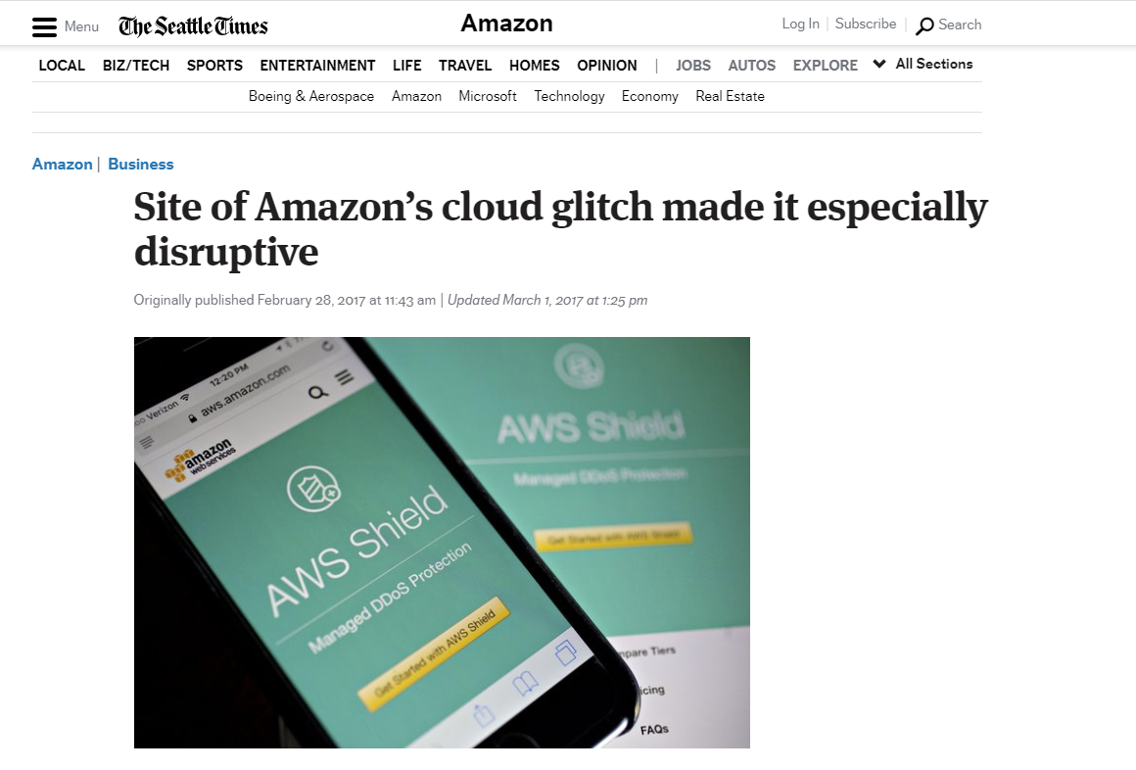



Why do you need commit policies?
What are the risks of an uncontrolled repository?
YOUR
COMPANY
Source: https://money.cnn.com/2017/05/29/news/british-airways-cancellations-compensation-cost/index.html
Source: https://www.seattletimes.com/business/amazon/outage-in-aws-storage-service-causing-online-disruptions/
Source: https://www.navytimes.com/news/your-navy/2016/03/27/secret-weld-how-shoddy-parts-disabled-a-2-7-billion-submarine/
Source: https://threatpost.com/fda-software-failures-responsible-24-all-medical-device-recalls-062012/76720/
Notes:
And if you think this is an isolated problem that does not affect you, think again.
It has been reported that software failures caused $1.7T of financial loss last year alone.
>>NEXT<<
>>NEXT<<
As we depend on software more and more in every domain of the everyday life, this trend needs to be addressed.
Even big names, like Apple, Amazon and British Airways, who allocate enormous budget on software verification, were among the affected companies.
>>NEXT<<
So better deal with software traceability and quality, because who knows, maybe next >>NEXT<< is your company...

Slide 7
How commit policies enable
end-to-end traceability and faster code reviews
Why do you need commit policies?
How do commit policies work?
Defining commit policies
Installing commit policies
Commit policies in any environment
Introducing commit policies to your team
Notes:
Now let’s get to the inner workings of commit policies!

Slide 8


How do commit policies work?
The commit verification process
Better Commit Policy for Jira
Changes sent to Jira for verification
Rejected changes
Accepted changes
Developer machine
Target
repository
Commited changes
Commit Policy
hook script
Commit rejected with descriptive message
Successful commit
Notes:
So again, what Commit Policy for Jira does is verifying the committed changes to your Version Control System against a set of rules.
Version control systems can be centralized or distributed.
I generally assume you are familiar with the differences between the two types of systems, but let’s just have a reminder very quickly:
In case of a centralized VCS, there is a single central version of the code base and developers all commit changes to that, one commit at a time. Subversion is the mostly widely used centralized VCS.
With DVCS all developers have a working copy of the code base including its history. They can commit as many changes as they want into their local repository until they are ready to push their local changes to a remote server where the production ready code is managed. Git and Mercurial are popular DVCS implementations.
The Commit Policy app works similarly in both architectures, but for the sake of simplicity, in this demonstration I will use the example of a centralized repository.
So let’s walk through the steps.>>NEXT<<
The whole process starts when the developer commits a change.>>NEXT<<
Before the commit is actually accepted to the target repository, the hook scripts installed to that repository will be executed.
Generally speaking, hook scripts are little programs that are automatically ran by the Version Control System at certain events, most importantly when a developer commits a change.
We will discuss how to install a hook script later, but for now, just know that the hook script is responsible for collecting information about the commit and for sending that to the Commit Policy app in Jira. >>NEXT<<
The information includes the changed files, affected branches, affected tags, the committer user’s name and the commit message.
The hook script also tells the app which commit policy to verify the changes against.
Having all these, the Commit Policy app evaluates the commit against the given policy, which can lead to 2 types of results.
If the commit policy was not fully satisfied, the commit is rejected. >>NEXT<<
In the rejection message, the app tells you why the commit was rejected so you know how to fix it.
Once you fixed it, you can re-commit the change and see if it satisfies the policy now.
>>NEXT<<
Only if the policy is fully satisfied, the commit is accepted and allowed to enter the target repository.
In a very simplistic form, this is the way code changes are verified.

Slide 9



How do commit policies work?
level of frustration when rejected
The KILLER feature you won’t find elsewhere: local commit verification with Git
commit, commit, commit
push
Usual approach:
Verify remotely when pushing
Local repository
Remote repository
Arghhh!
I must use interactive rebasing to fix all those...
all rejected! too late!
commit
push
...will always succeed!
The Midori approach:
Verify locally when committing
Local repository
Remote repository
Okay, let me just quickly re-commit the very last one.
one rejected!
Notes:
Now let’s dive deeper into the local commit verification feature, because this is a game-changer when working with distributed VCS.
This is also something you won’t find in other apps with similar functionality.
So first let’s see how a developer usually works and how her work is verified.
>>NEXT<<
The developer works on some code and keep committing changes to the local clone of the Git repository.
No verification happens here so everything is accepted as is.
Verification happens only when the changes are pushed to the remote server.>>NEXT<<
>>NEXT<<
Let’s say there are some non-compliant commits, therefore all change pushed in one go get rejected.
It’s too late and it’s frustrating, because she may have created the problematic commits days before, so now she needs to recall “why did I do this and what’s the underlying requirement in Jira?”.
Then she needs to use the Git operation called interactive rebasing to fix all the problematic commits.
This is not only painful, but also an unnecessary waste of time.
>>NEXT<<
On the contrary, let’s see why the Midori approach is different.
With local verification, every commit is checked before accepted to the local clone! >>NEXT<<
If there is any problem, the commit gets rejected right away. And, as with every type of problems, the earlier you detect it the easier to fix it.>>NEXT<<
So the developer can take a quick second look, decide about the fix and recommit that single change.>>NEXT<<
When all her work is pushed to the server, the same rules verify the commits again (just to be sure), and… accepts all as they have already been verified at commit time!
Less wasted time, less frustration, faster code reviews as no major issue can surface this way.
Local verifications are optional, but we strongly encourage using this approach.

Slide 10
How commit policies enable
end-to-end traceability and faster code reviews
Why do you need commit policies?
How do commit policies work?
Defining commit policies
Installing commit policies
Commit policies in any environment
Introducing commit policies to your team
Notes:
Now that we know how the changes are verified, let’s break down the policies themselves and see what they can control

Slide 11
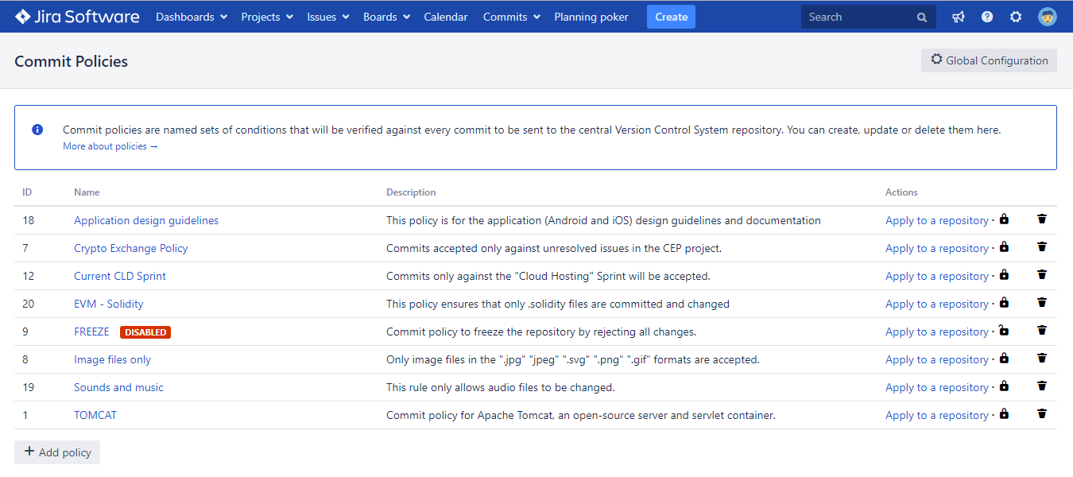
Defining commit policies
Commit policy = rules for who can change what under what conditions in repositories
Notes:
Once you installed the app, you can find the commit policies under the Commits menu in the top of the Jira screen.
Here you can manage your policies: add new policies, edit existing ones and apply them repositories.
A commit policy is basically a set of commit rules.
Let’s open one for editing.

Slide 12
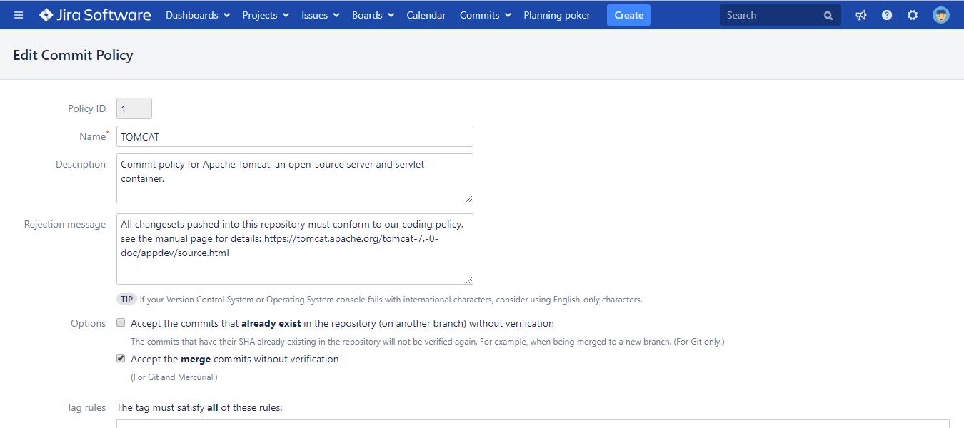
Defining commit policies
Editing the details of commit policies
Notes:
When you pull up a commit policy for editing, first you need to name it.
Following is a description, that should indicate the purpose of the rule.
You can also add a more detailed rejection message here.
If a commit is rejected there is always a short explanation why it was blocked, but here you have the option to phrase a more elaborate message that informs the developer about a failed commit and explain in more detail why a commit was not compliant.
As a best practice, in the rejection message we suggest showing a “positive” example that would be accepted.
This makes the developer’s life easier.
Then you have a few further options that pertain only to distributed VCS.
Namely, you can decide if commits that have already been verified on another branch should or should not be verified again.
Or if you want to verify merge commits, that are a special kind of commit and usually don’t have the same importance than regular commits.

Slide 13
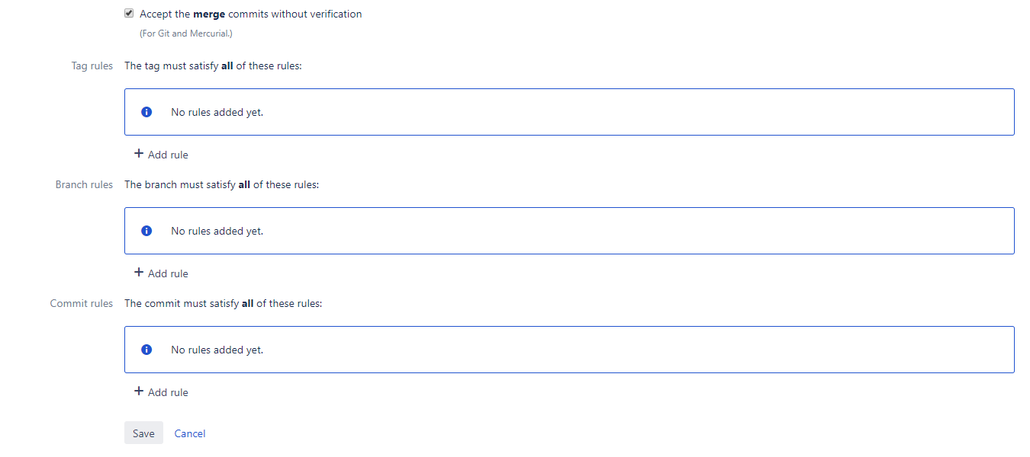
Defining commit policies
Adding tag, branch and commit rules to commit policies
Notes:
Moving on in the configuration, you can see the rest of a policy’s components.
There is a 3-level hierarchy of components: each policy consists of rules, and each rule consists of conditions.
Let’s start with rules.
Rules can verify tags, >>NEXT<<, branches >>NEXT<< and commits >>NEXT<< and grouped by these categories accordingly.
Let’s see the tag rules first.

Slide 14
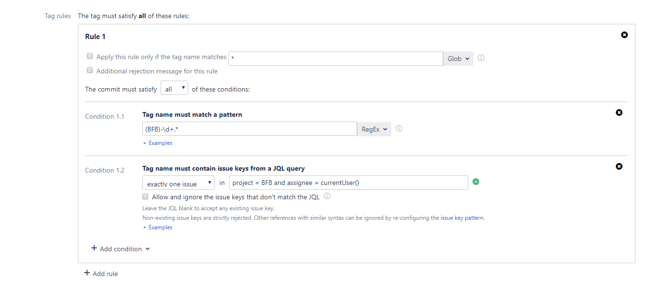
Defining commit policies
Customizing the conditions within a tag rule
Notes:
You can limit the scope of this rule by limiting to tags with names that match a given pattern.
This gives you extra flexibility as the rule won’t be considered if a commit is out of scope.
If this rule needs extra explanation, you can add a rejection message that will shown only when this rule is breached.
As I said before,you can define conditions within a rule.
In case of tags, you can set up 2 types of conditions.
>>NEXT<<
You can either check for the name of the tag and use a Regular Expression to require it to follow a certain pattern, contain certain characters, be a certain length and so on.
You can use this condition to enforce naming convention for tags, like enforcing semantic version numbers in the format “major version dot minor version dot patch version”.
>>NEXT<<
Another condition you can have for tags names is to require them to contain an issue key.
You can narrow down the circle of issues, that you expect the tag name to contain, with a JQL query.

Slide 15

Defining commit policies
Customizing the conditions within a branch rule
Notes:
Going forward, you can choose to also activate a branch rule.
Similarly to the tag rules, you can limit the scope of branch rules to branches with names that match a pattern.
You can also add a custom rejection message here as well.
>>NEXT<<
Just like with tag names, you can set up a condition for the name of the branch,
>>NEXT<<
Or require it to contain an issue key defined by a JQL query.
A good example for this could be to require an unresolved "Bug" type issue to be included in bugfix branch names.
So you can refer to the bug right from the name of the branch.

Slide 16
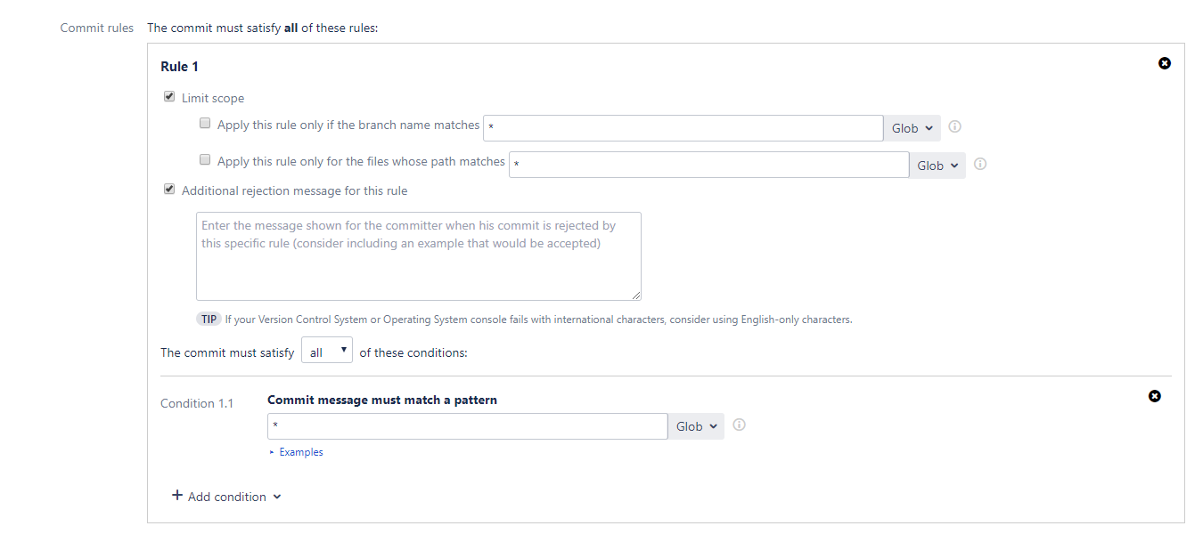
Defining commit policies
Customizing the conditions for commit messages
Notes:
Next are the rules for commits.
With those you have even more options:
>>NEXT<<
In addition to limiting to given branch names, you can also limit this rule to certain directories in the repository, applying stricter rules to selected directories or branches.
>>NEXT<<
And of course, in case of rejected commits, an additional rejection message can explain the detail of what this rule verifies.
There are a number of commit conditions, so let’s see them one by one!
>>NEXT<<

Slide 17
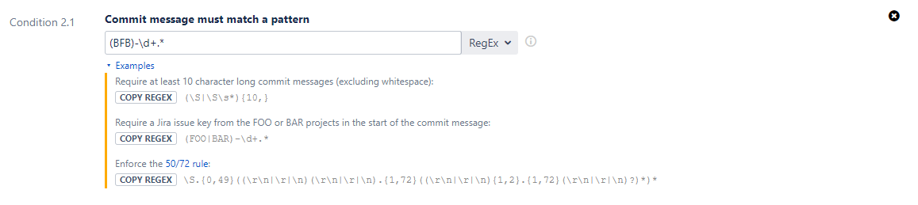
Defining commit policies
Customizing the conditions for commit messages
Notes:
First, let’s start with conditions you can use to control the commit message.
As you can see here, you have the option to require a certain pattern.
The Regular Expression gives you a wide variety of criteria, but you can also choose one of the listed examples, and customize those.
A real life example could be to require commit messages to have a minimum length, like 20 characters.
Or you can for example enforce the Git 50/72 rule, which is considered a best practice. It requires a maximum 50 characters long first line, like a summary for the message then a blank line, then breaks the lines at 72 characters, so it’s well readable on an 80-column terminal. If you want to learn more on the 50/72 rule, visit our blog, there is a great article about it.

Slide 18
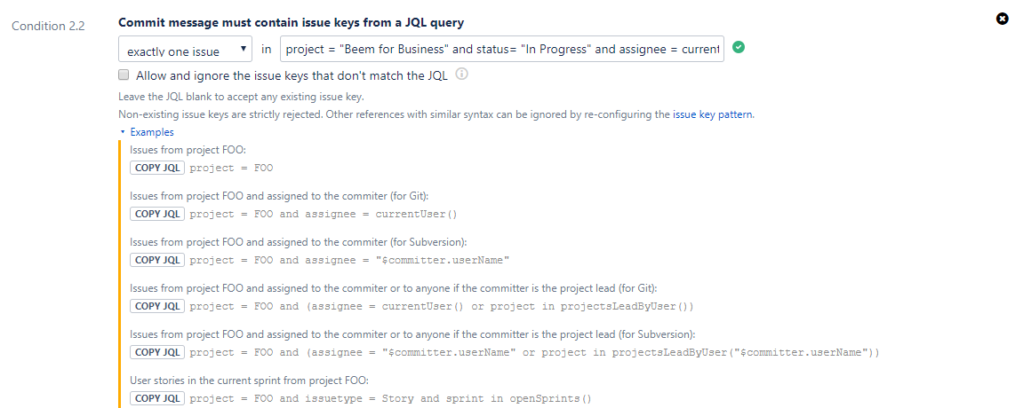
Defining commit policies
Customizing the conditions for commit messages
Notes:
As you probably guessed by now, you can also enforce the mentioning of an issue key or keys in the commit message.
JQL again gives you a wide range of options as you can see the examples.
To put this condition to good use, you could require exactly one unresolved issue from the currently running Scrum sprint to be associated with every commit.

Slide 19
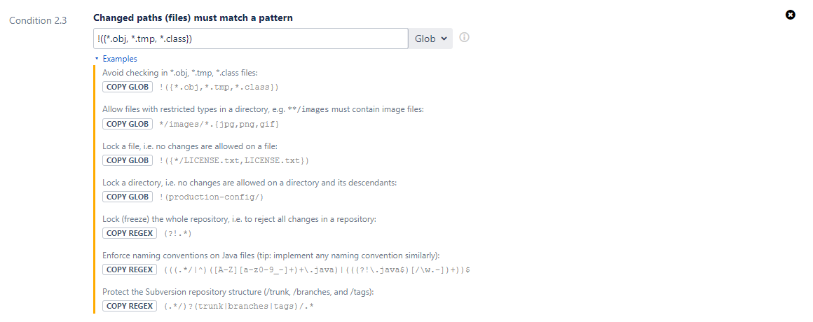
Defining commit policies
Customizing the conditions for changed files
Notes:
In the next section of conditions for commits, you can control if the developer changed the files that they were supposed to.
With this condition you can control what type of files should or should not be checked in, or in which directories.
This - as you see - gives you granular control over what can be changed in a repository.
In a production environment for example, this could be used to reject all temporary, hidden or local-only files from being checked into the repository.

Slide 20
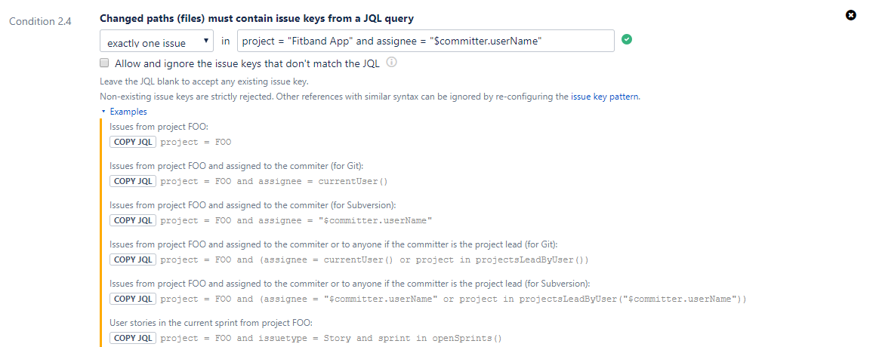
Defining commit policies
Customizing the conditions for changed files
Notes:
Staying with the changed files, the next condition allows you to control in which directory are files changed.
For example if you have a testresults directory to collect test result consistently, this condition can require a "Test" type issue to be mentioned in the name of each sub-directory.

Slide 21

Defining commit policies
Customizing the conditions for committer users
Notes:
Commit conditions can also dictate who can commit changes.
You can verify for example, if the user who tries to commit code is indeed a Jira user and has a valid Jira account.
You can go further and require any committer to also be part of a Jira group in order to be granted access.
So for example, if you are working on a mobile app for Android, you can set up this condition to accept commits only from Jira users in the android-developers group.

Slide 22
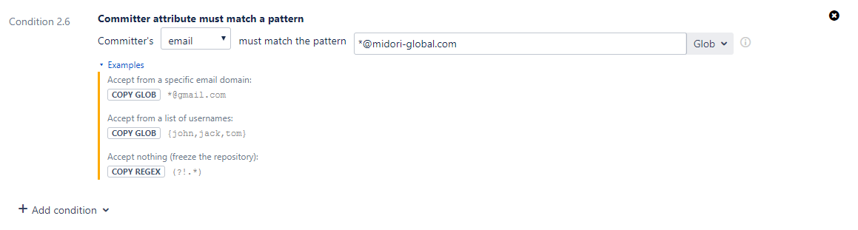
Defining commit policies
Customizing the conditions for committer users
Notes:
You can choose to check for the email address or the username of the committer user and require those to follow a predefined pattern of your choosing.
You can use this condition for example, to also make sure that the commit is submitted by the developer who is assigned to the issue or to check for your company domain in the email address of the committer.

Slide 23
How commit policies enable
end-to-end traceability and faster code reviews
Why do you need commit policies?
How do commit policies work?
Defining commit policies
Installing commit policies
Commit policies in any environment
Introducing commit policies to your team
Notes:
Okay, so now that you defined the conditions and rules within your commit policy, you saved it and now want to apply to the repository that you created the policy for.
>>NEXT<<

Slide 24
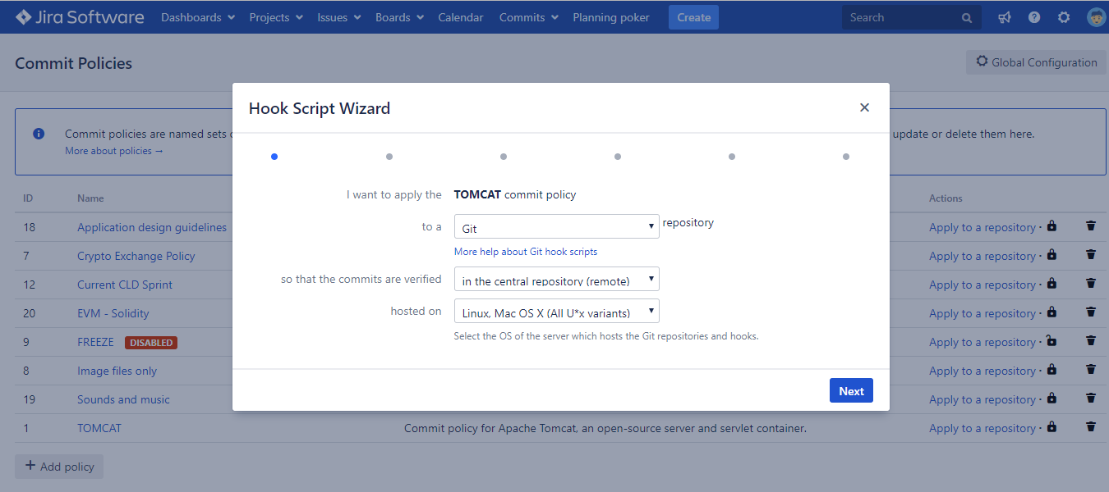
Installing commit policies
Installing and applying commit policies to repositories
Notes:
We invested into making the installation of hook scripts a breeze.
If you go back to commit policies, there is an option to “Apply to a repository” for every policy.
If you select that, you are greeted with a wizard that guides you through the process.
What we are basically doing here is preparing the hook script, that we already mentioned earlier.
This is the point, when we already created our policy, we just need a pre-configured downloadable hook script package (an actual ZIP file) that we can take and place into our local or remote repository.
This wizard helps us setup a few things and grab the hook script at the end.
>>NEXT<<

Slide 25
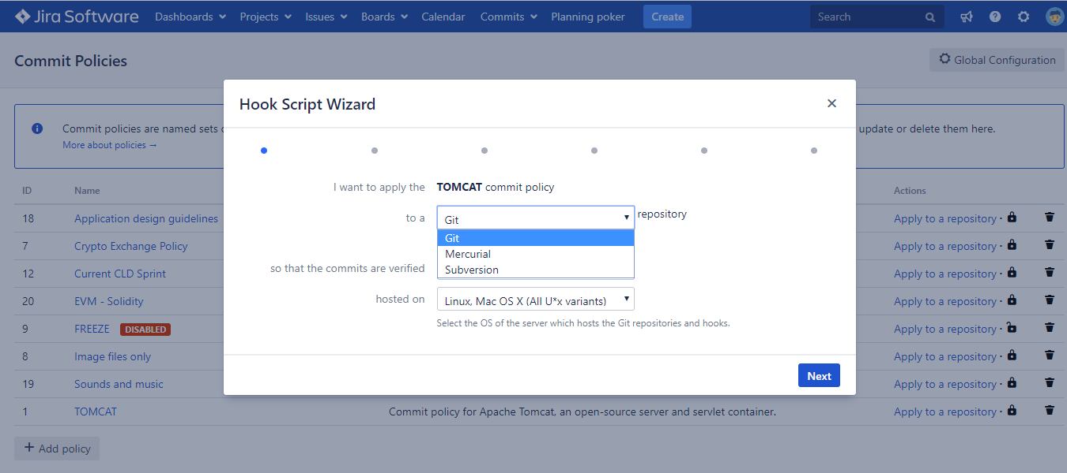
Installing commit policies
Installing and applying commit policies to repositories
Notes:
So let’s start.
First, select what VCS are you using.

Slide 26
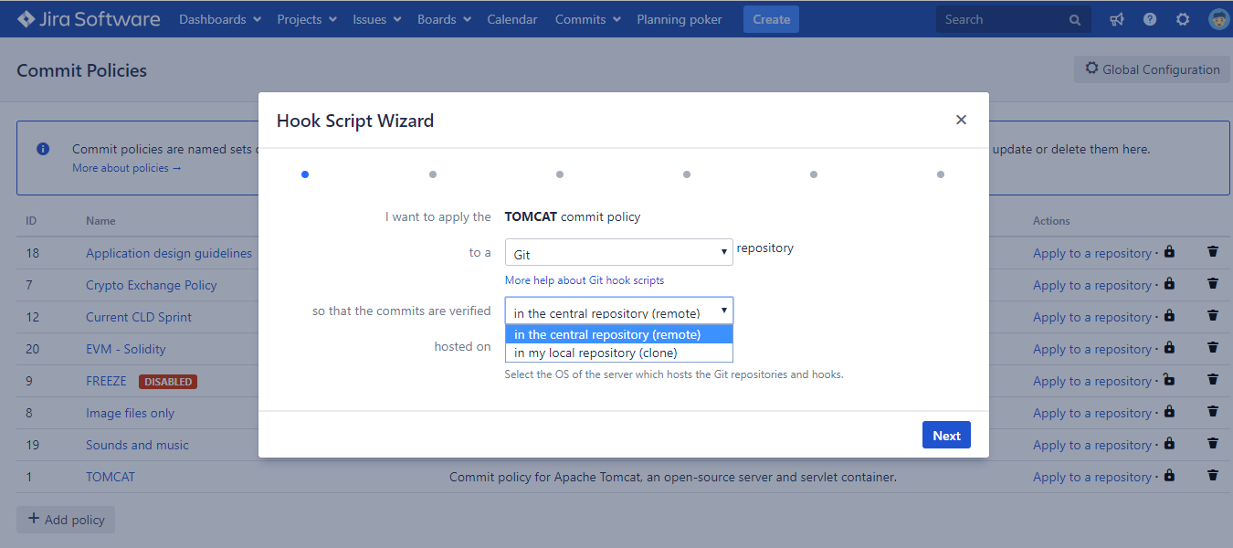
Installing commit policies
Installing and applying commit policies to repositories
Notes:
Then select if you are planning to install this into a central repository or to your local clone.
(For centralized VCS, this option is not offered, for obvious reasons.)

Slide 27
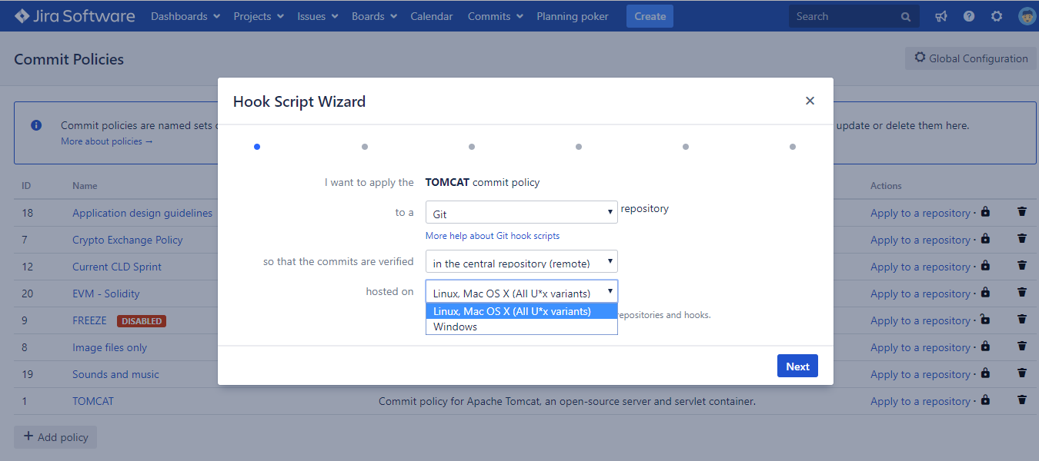
Installing commit policies
Installing and applying commit policies to repositories
Notes:
Then select what operating system hosts the corresponding repository.

Slide 28
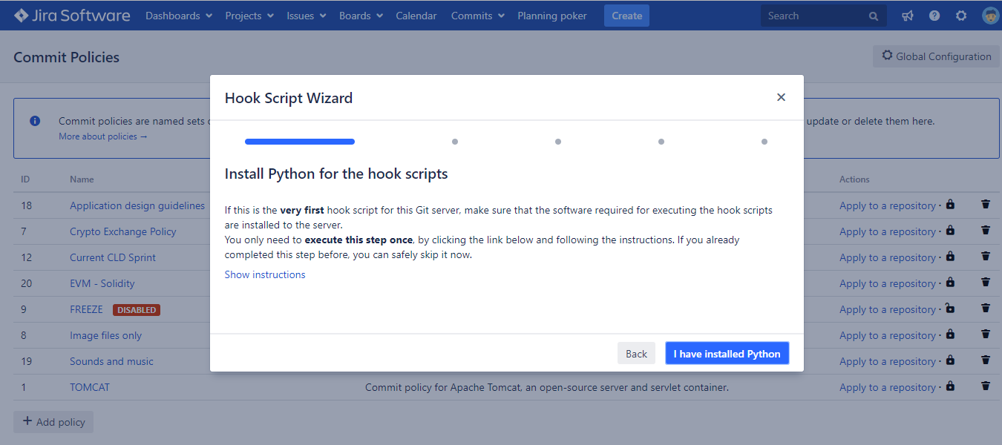
Installing commit policies
Installing and applying commit policies to repositories
Notes:
The hook scripts are developed in the Python programming language, as the most widely used platform-independent interpreter language.
As the next step, the wizard verifies if you have the Python runtime installed on the computer that hosts the repository.
If you don’t, it’s a good time to install it. Note that there are convenient Python installers for every major operating system.
If you do, just confirm you have it installed.

Slide 29
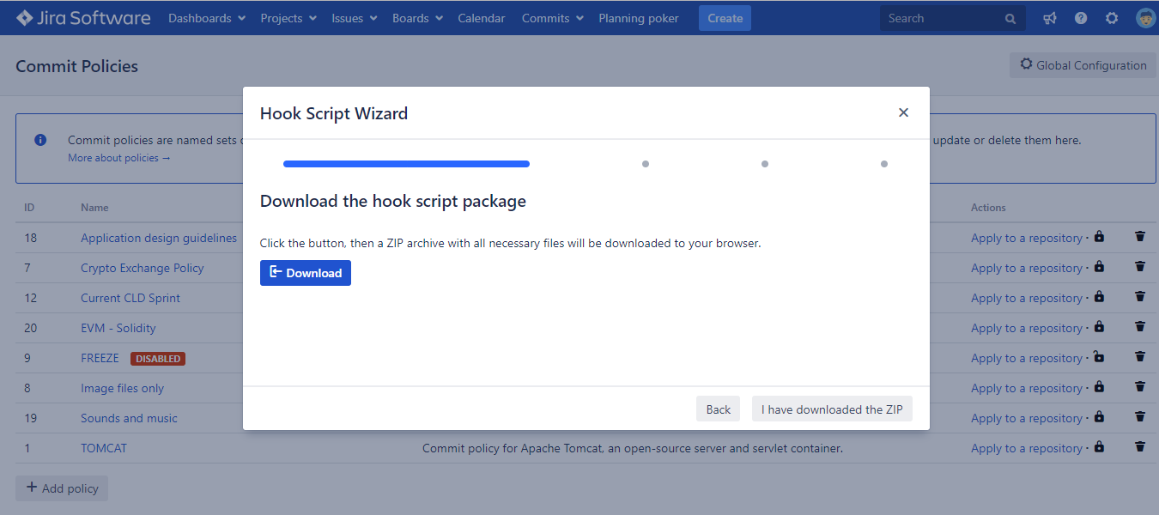
Installing commit policies
Installing and applying commit policies to repositories
Notes:
At this point, your hook script is ready to be downloaded.
It’s actually a script package, that downloads in a ZIP file.
At this screen, hit download
>>NEXT<<

Slide 30
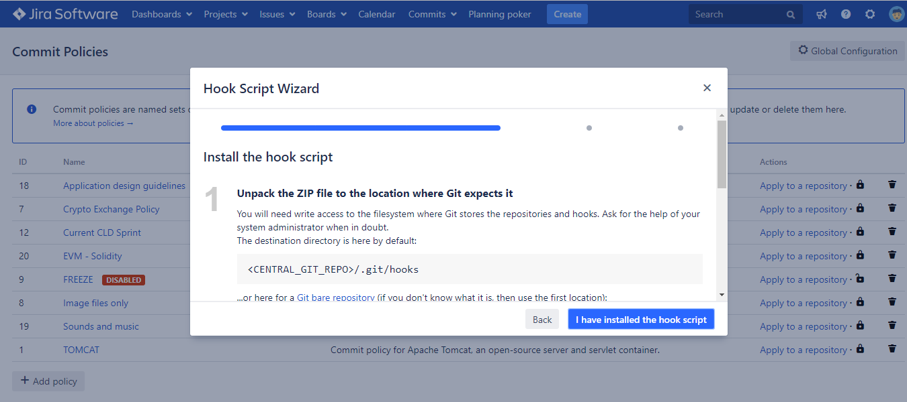
Installing commit policies
Installing and applying commit policies to repositories
Notes:
And install the hook script by unzipping it to the folder in your repository where your VCS expects it

Slide 31
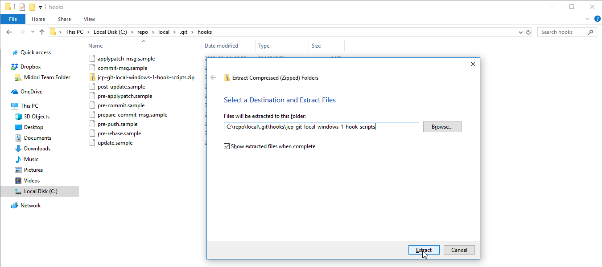
Installing commit policies
Installing and applying commit policies to repositories
Notes:
In this Git repository example, unzip them to the hooks directory.

Slide 32
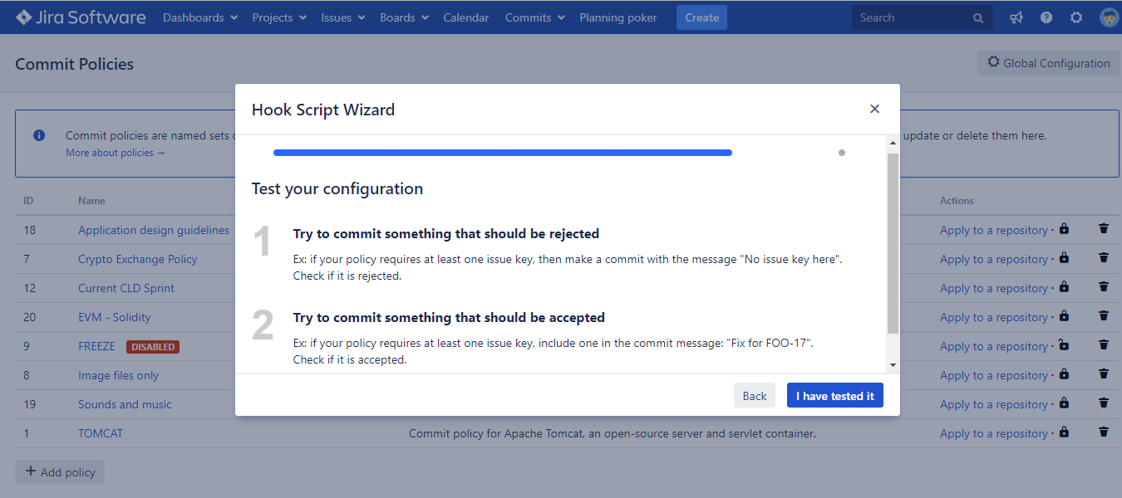
Installing commit policies
Installing and applying commit policies to repositories
Notes:
If the files are in place, you can test your configuration.
You can do that by intentionally committing something that should be rejected, then something that should be accepted.

Slide 33
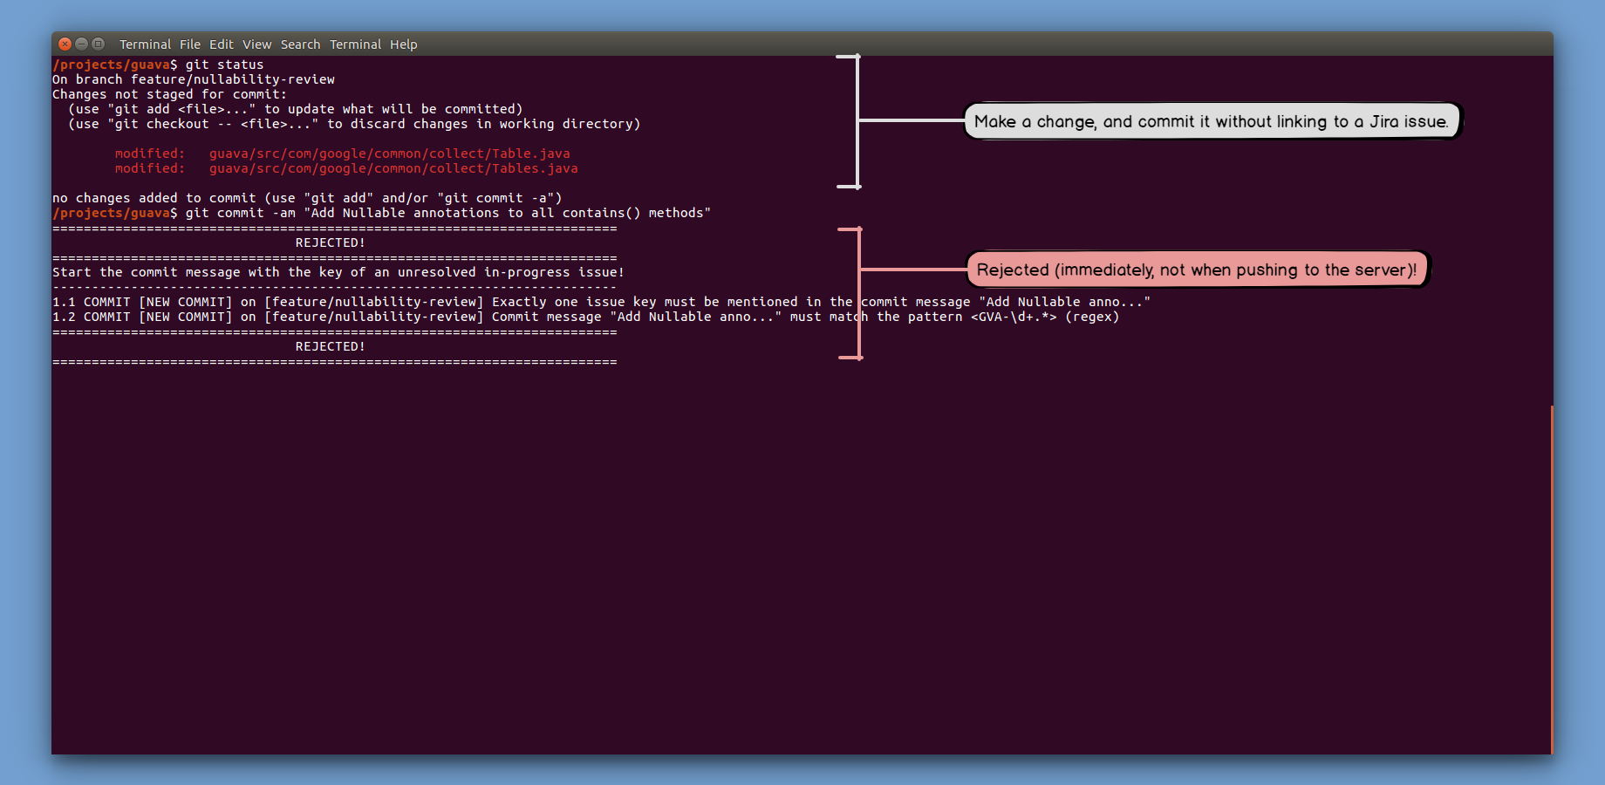
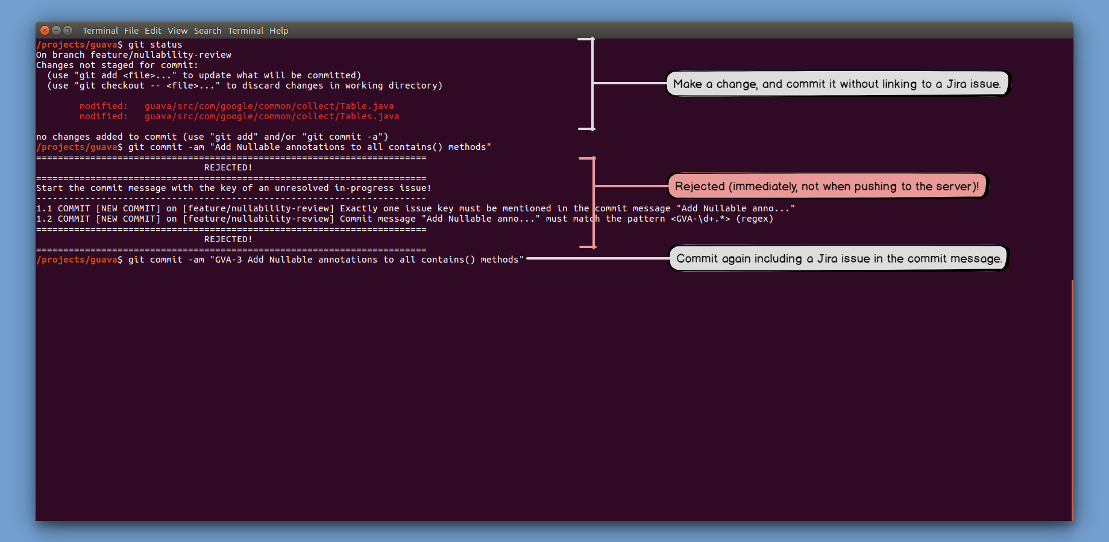
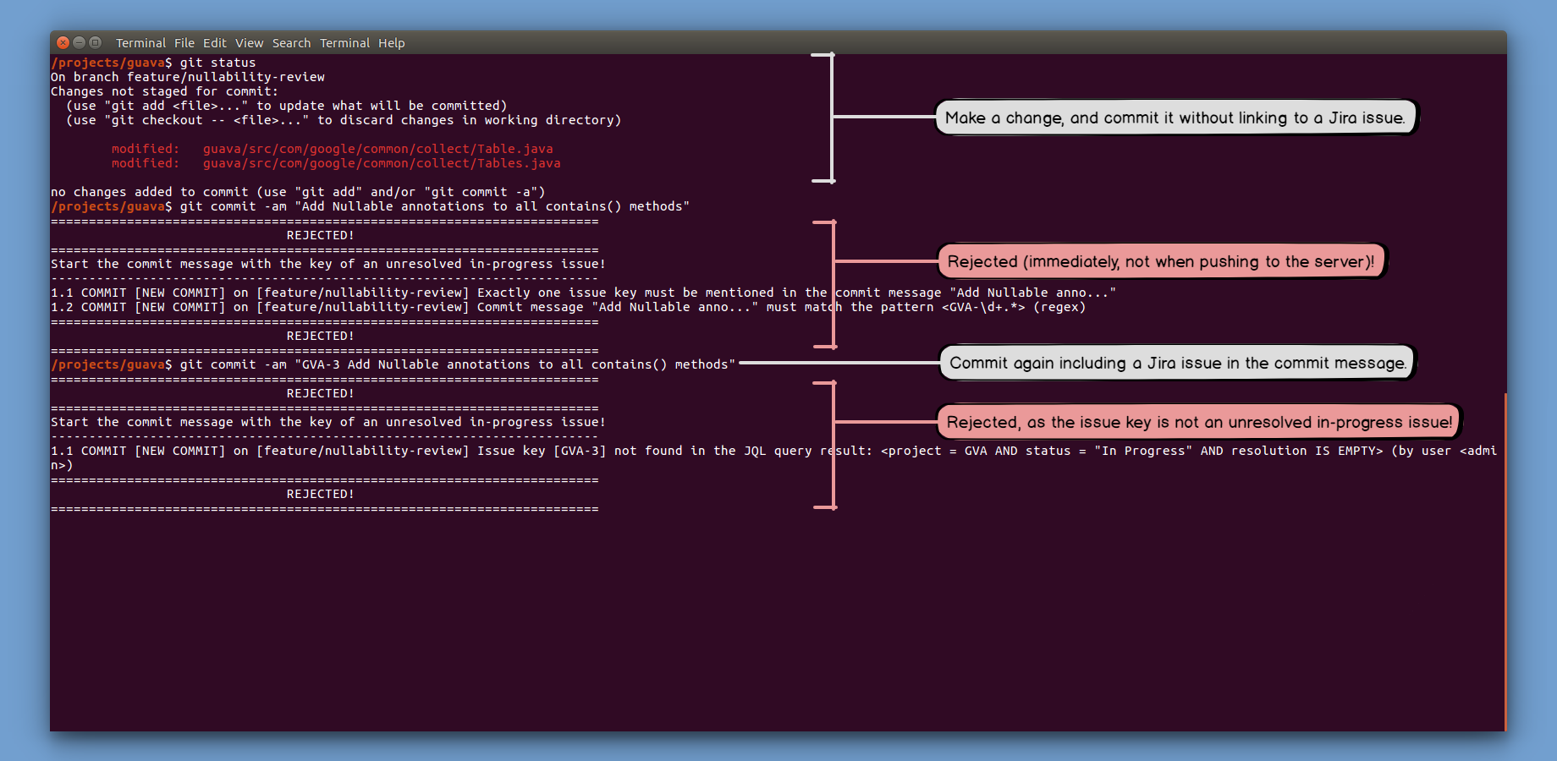
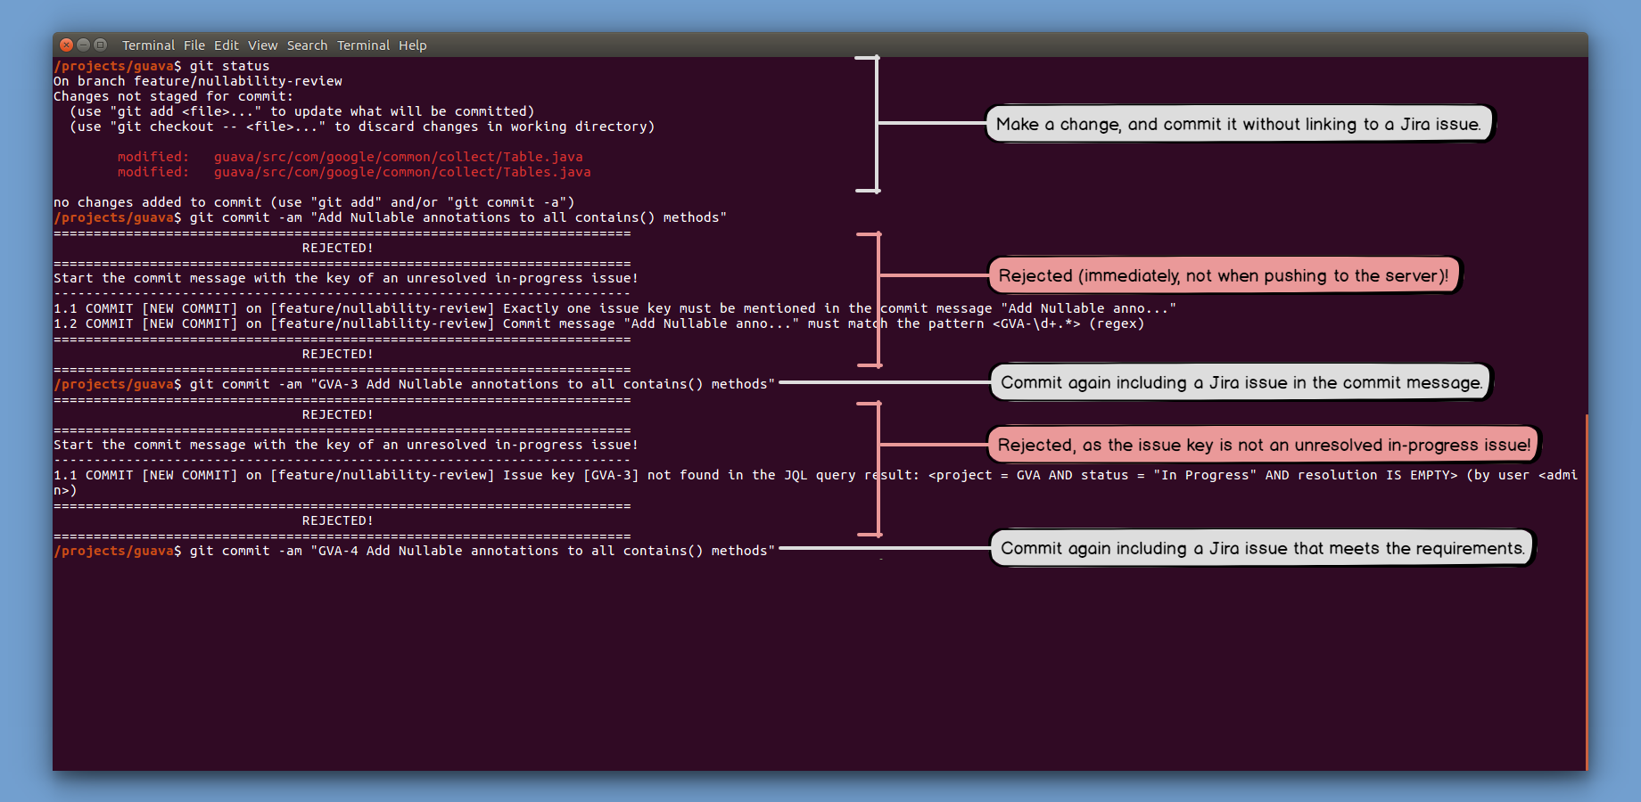
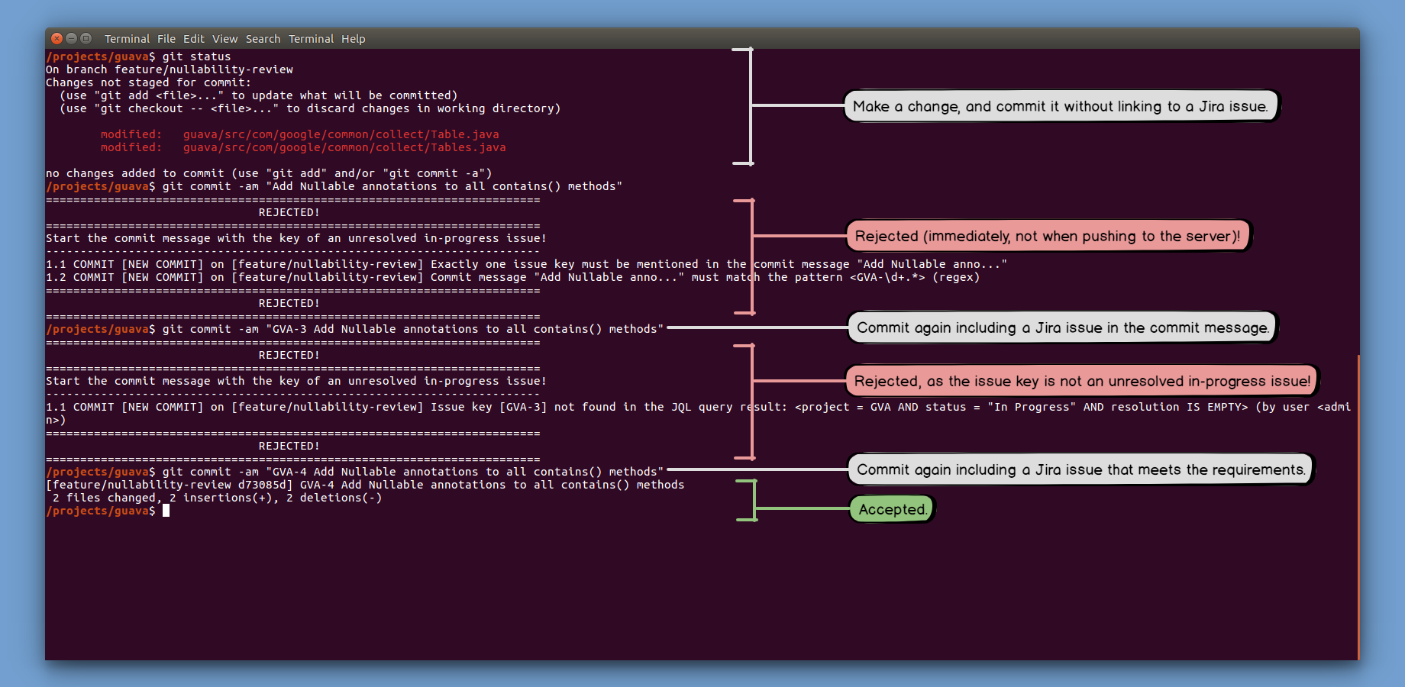
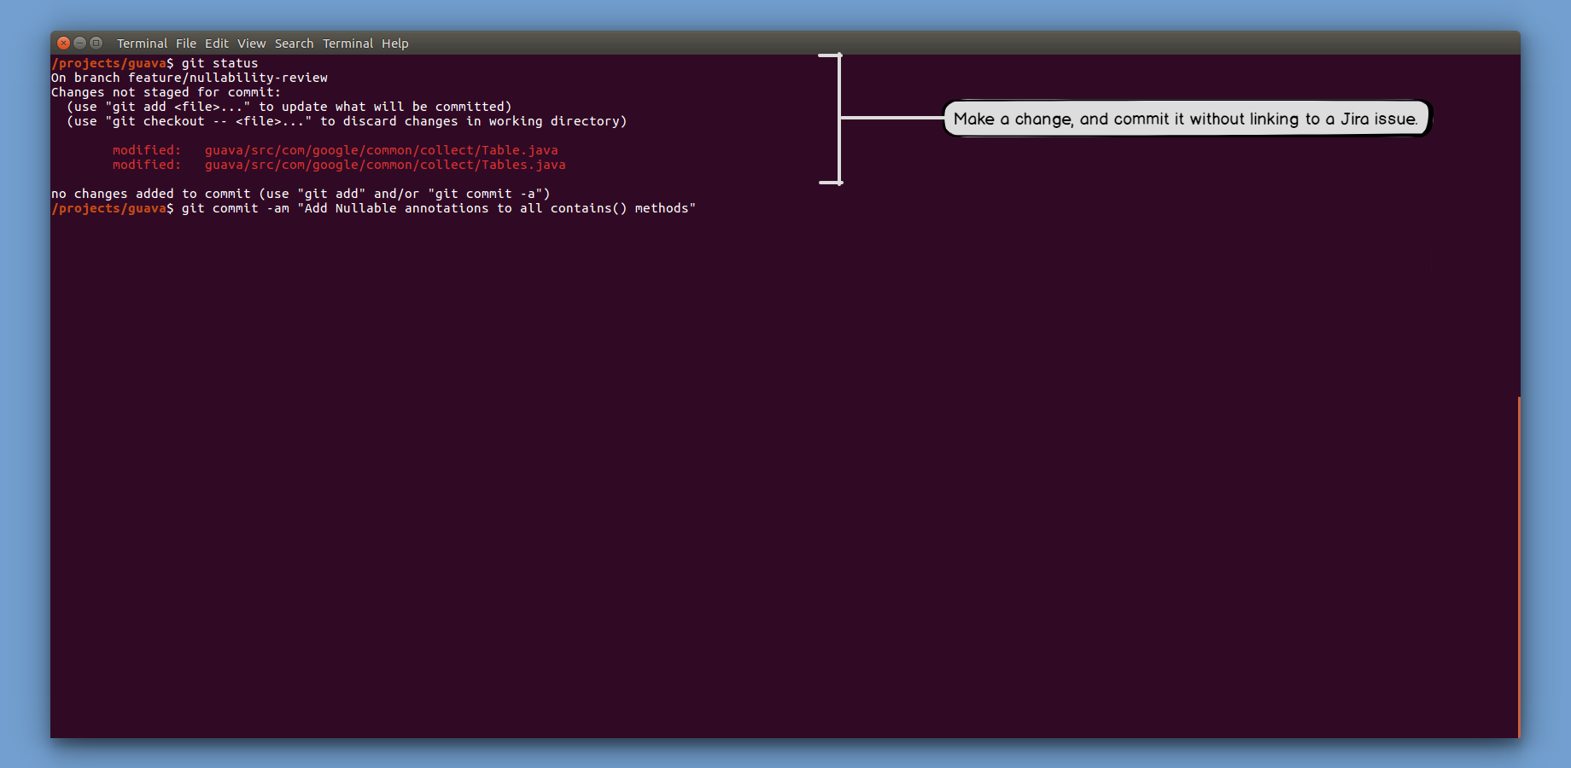
Installing commit policies
Testing your commit rule
Notes:
Let’s look at a quick example here.
Let’s try to commit something to the repository, where we installed a commit policy which verifies if the commit message contains a Jira issue key and if that mentioned issue is an unresolved, in progress issue.
There has been some changes made and first we try to commit these without mentioning a Jira issue.
>>NEXT<<
The commit is rejected immediately.
Note that the commit policy is installed in our local repository, so the commits are rejected immediately.
>>NEXT<<
Let’s add a Jira issue key and commit again.
>>NEXT<<
It’s rejected again.
The rejection message says it should be a unresolved, in-progress issue, so the one we added was clearly the wrong one.
>>NEXT<<
Let’s correct this.
This commit is now accepted as all the rules in the policy are satisfied.

Slide 34
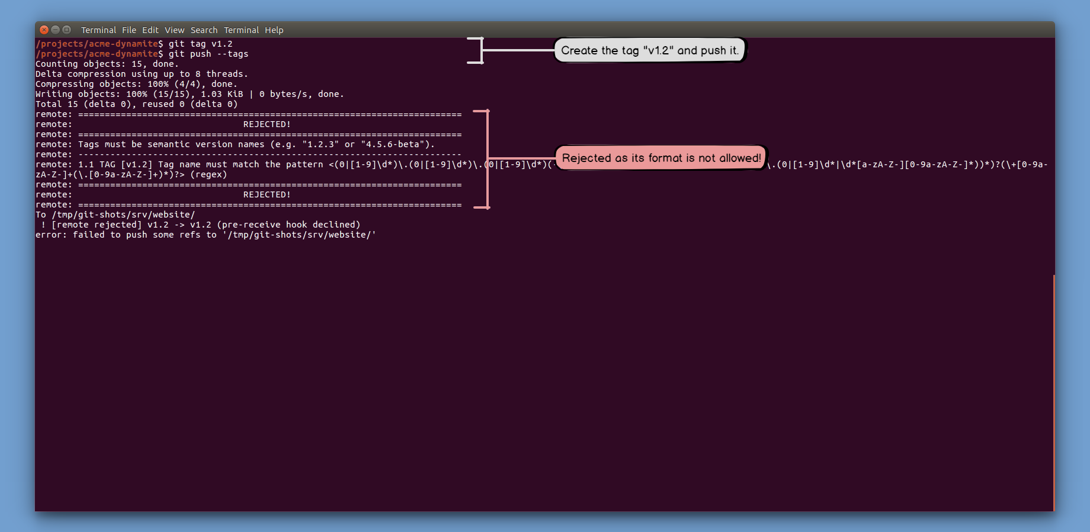
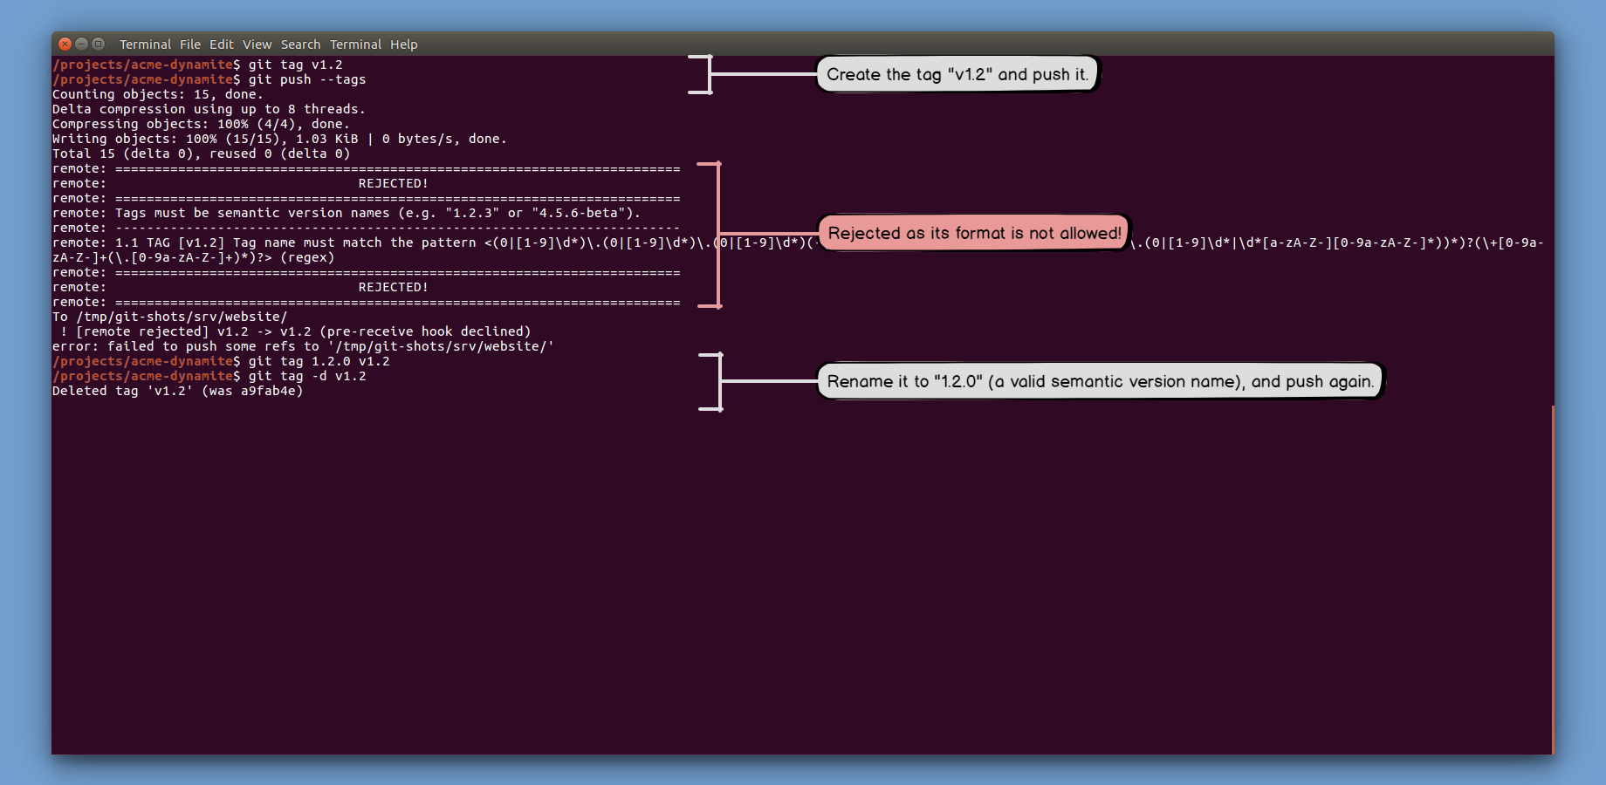
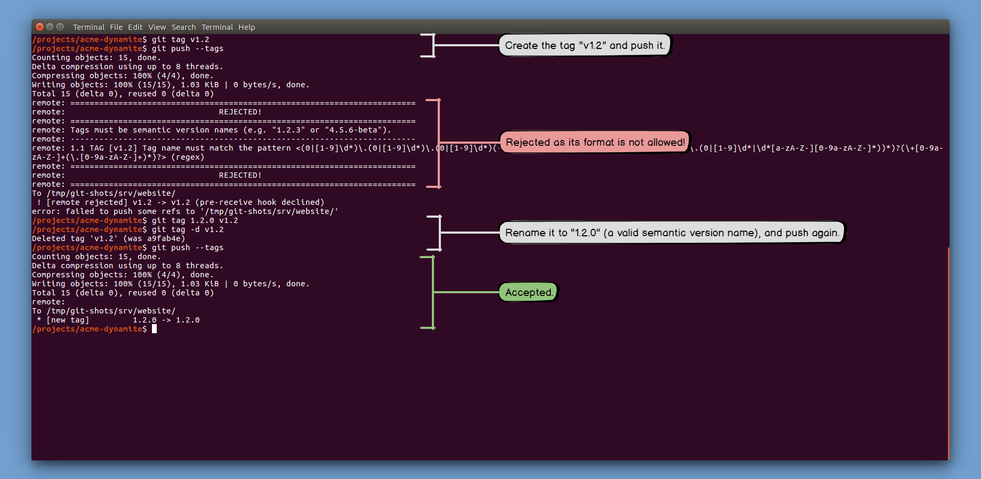
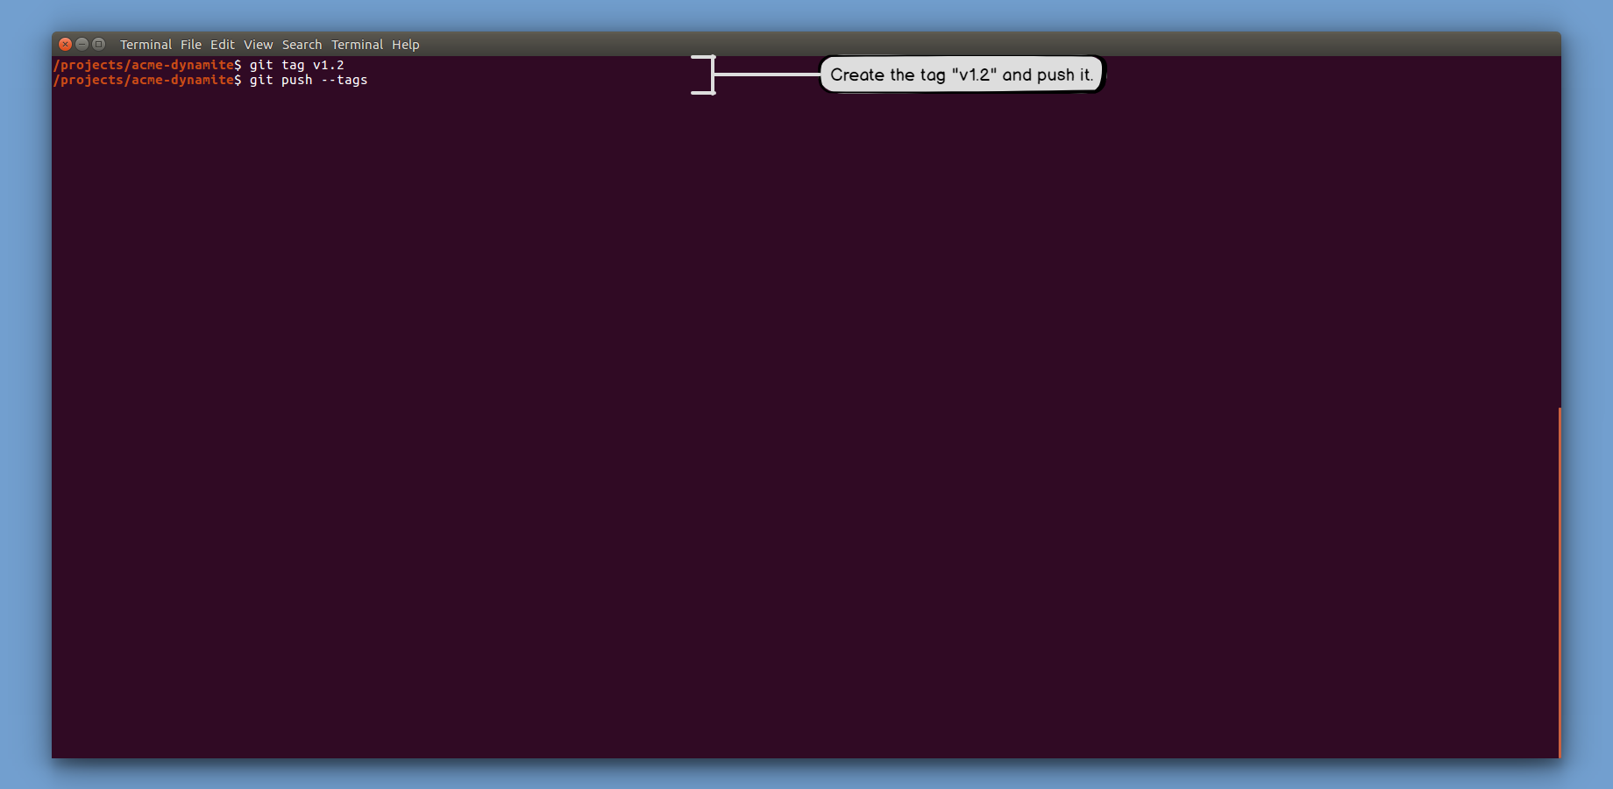
Installing commit policies
Testing your tag rule
Notes:
Here is a quick example for checking tags.
The policy in play here expects us to follow semantic versioning in tag names.
So for example “v3.4.5”.
>>NEXT<<
Try to push a tag to the server that doesn’t respect it.
The commit is rejected as the format is not correct.
>>NEXT<<
Let’s rename the tag.
>>NEXT<<
This attempt is now successful as the rule in the policy is satisfied.

Slide 35
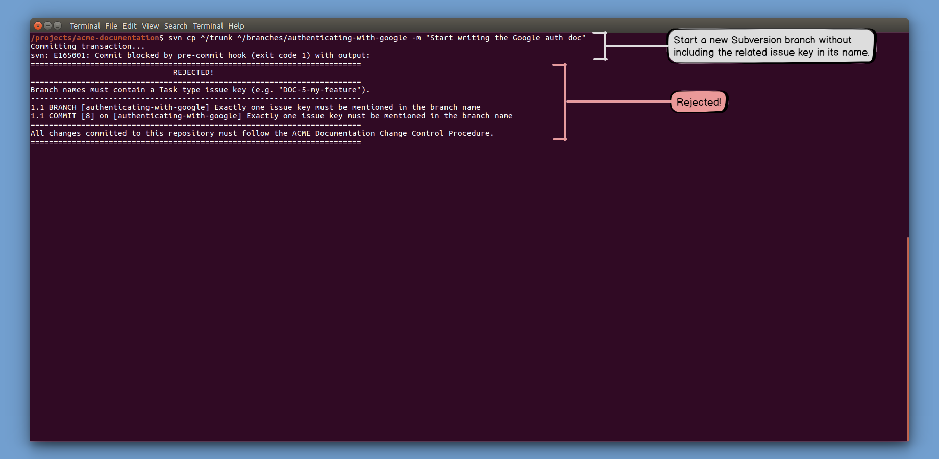
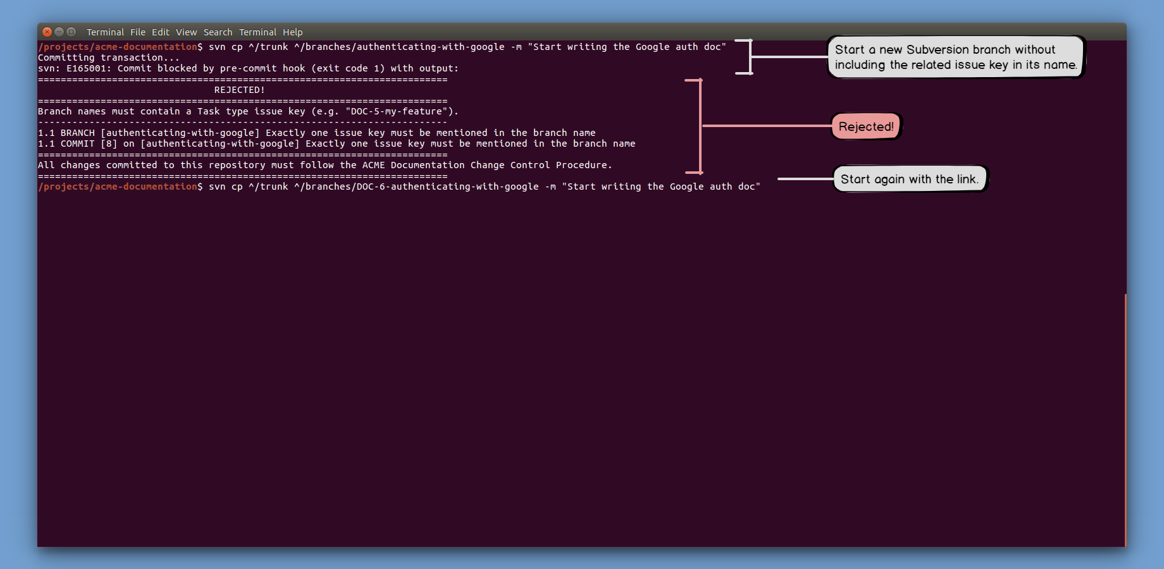
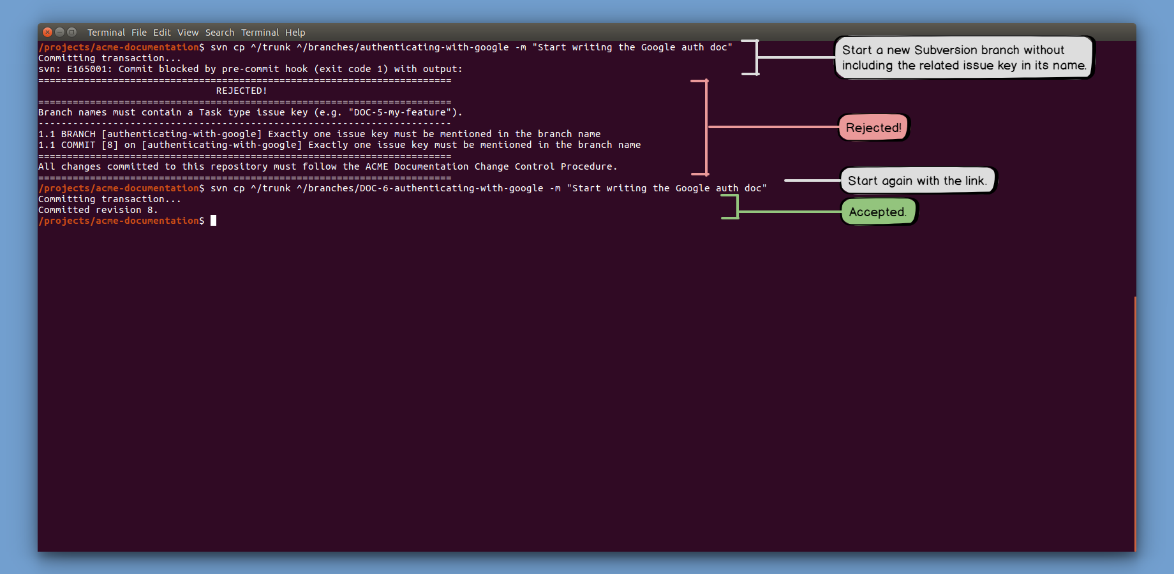
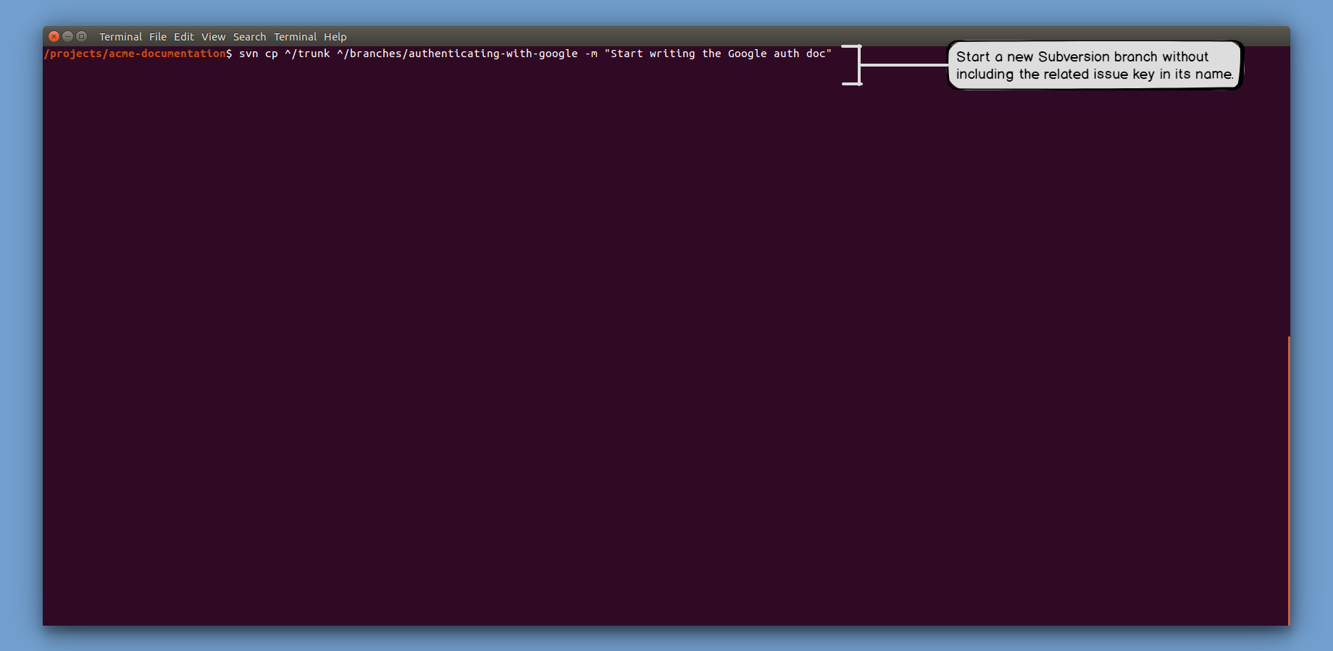
Installing commit policies
Testing your branch rule
Notes:
Look at a similar example for branches under Subversion.
The rule here verifies if the branch name contains the key of a task type issue.
>>NEXT<< Let’s try to commit something to the repository that violates it.
The commit is rejected as we didn’t give an issue key in the branch name.
>>NEXT<<
After we corrected it, the commit is accepted.

Slide 36
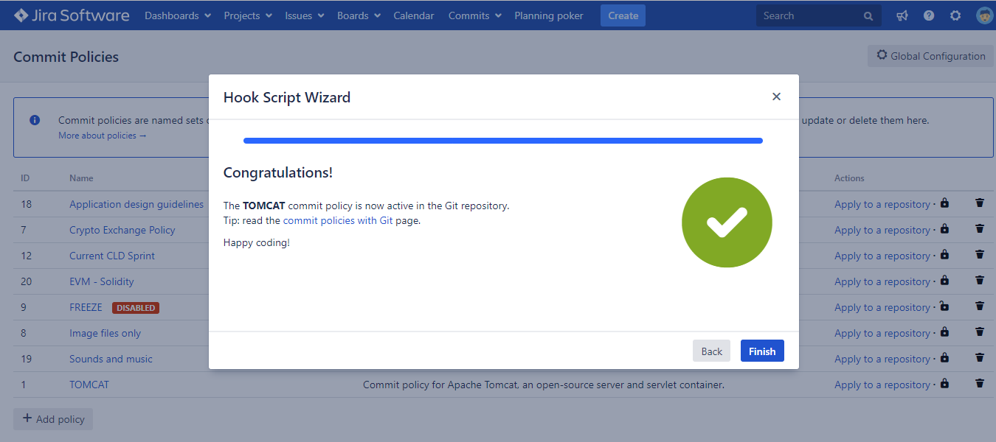
Installing commit policies
Installing and applying commit policies to repositories
Notes:
And with that you tested your policy and you are done!
It’s live in your repository, guarding it from non-compliant commits!
It is important to understand that the hook script does not “contain” the policy, but connects to the Commit Policy app and refers to a policy by the policy ID at every verification.
It means that after installing the hook script, you can freely re-configure the policy in the Commit Policy app any time, and the changes will be immediately reflected in every repo that has a hook script relying on that policy.

Slide 37
How commit policies enable
end-to-end traceability and faster code reviews
Why do you need commit policies?
How do commit policies work?
Defining commit policies
Installing commit policies
Commit policies in any environment
Introducing commit policies to your team
Notes:
Commit Policy for Jira provides a functionality that doesn’t tie you to a specific Version Control System or IDE (Integrated Development Environment).
You can use the app in any scenario, tool or environment you choose.

Slide 38






Installing commit policies
Supported Version Control Systems
Any custom VCS or environment
via REST API
Notes:
It’s compatible with all the major Version Control Systems like Git, Subversion or Mercurial.
It also supports the popular web based Version Control System hosting services, like GitHub, Gitlab, or Bitbucket.
For Bitbucket, it even has a free connector app to ease the integration between Jira and Bitbucket.
Plus, through the public and documented REST API you can implement commit policies in any custom VCS, custom environment or third party application you might use.

Slide 39
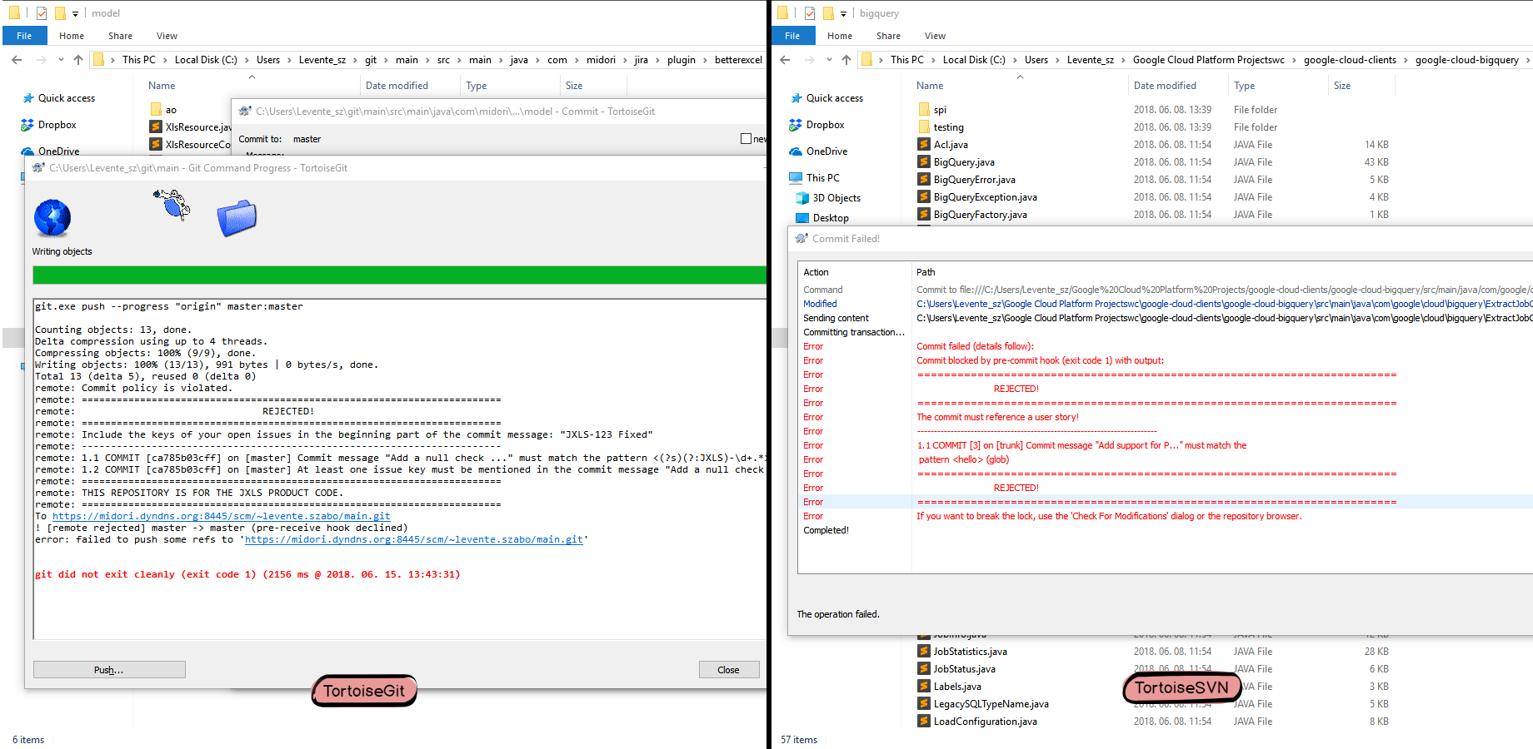
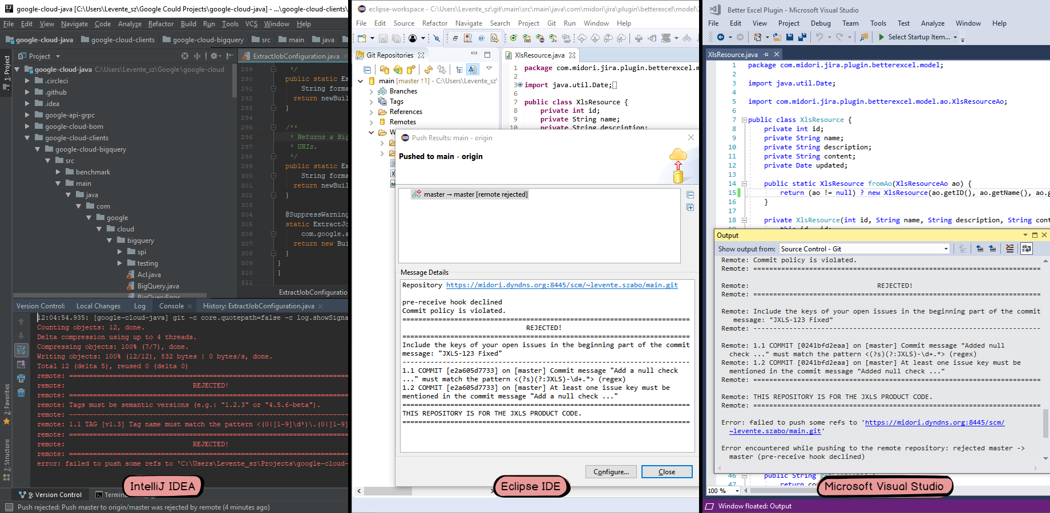
Installing commit policies
Supported clients & IDE integrations
Notes:
It is compatible with every standard VCS client, whether it is a command line client (as you saw before), GUI client (like the free Tortoise family) or IDE integration (in IntelliJ IDEA, Eclipse or Microsoft Visual Studio).

Slide 40
REST API
Integrate with custom VCSs and custom environments
New REST end-points are added to the standard Jira REST API!
For commit verification:
/commit-policy/{policy-id}/verification
For listing existing commit policies:
/commit-policy
For generating hook scripts:
/hook-script/{vcs}/{os}/{policy-id}
– Learn more:
http://www.midori-global.com/products/better-commit-policy-for-jira/documentation/rest-api
Notes:
And as I mentioned, a couple of thoughts about our REST API.
The Commit Policy for Jira REST API extends the standard Jira REST API by adding new end-points.
The end-point extends the built-in functionality, but also reuse what is already available (like authentication).
Here are a couple of the important REST endpoints you can use.
>>NEXT<<
One for commit verification.
>>NEXT<<
One for listing existing policies.
>>NEXT<<
And one for generating hook scripts programmatically.
The REST API allows you to integrate commit verification into any version control system you are using if that is using the standard protocols for code change handling.
To learn more about it, you can find the detailed API documentation on our website.

Slide 41
How commit policies enable
end-to-end traceability and faster code reviews
Why do you need commit policies?
How do commit policies work?
Defining commit policies
Installing commit policies
Commit policies in any environment
Introducing commit policies to your team
Notes:
Now, I hope you feel a bit more familiar with the concept of commit policies and agree that a well organized and efficient developer team can take great advantage of them.
But are the rest of your team also on board with this? How will take this idea back to your developers and introduce it?
I know from experience that developers tend to have a rules aversion problem.
They won’t welcome anything that feels like some kind of rule and is enforced on them.
So I wanted to leave you with a few ideas on how to get your team’s buy-in and have a smooth transition into using commit policies.

Slide 42



Introducing commit policies to your team
Making your job easier by getting everyone on board
Don’t surprise the team with commit policies
Bring real-life examples to support your case
Encourage using local commit verification
Notes:
Communicate the idea of commit policies before roll-out. Make an informal announcement, and choose a casual format, depending on how large the team you need to talk to.
If it’s a smaller team, do it during a coffee break or while grabbing a few beers after work. The less it feels another corporate rule and more like a professional decision on your part, the better.
Don’t be hypothetical and abstract. Prepare and bring real-life examples of occasions when a controlled commit or a clearer change history could have helped to avoid extra work, bad user experience or business loss.
Encourage local commit verification, because the sooner a non-compliant change is caught, the cheaper it is to correct. Local commit verification doesn’t let the developers pile up a bunch of soon-to-be-rejected commits locally, so it reduces frustration when the changes pushed to the server and at code review. And of course, there will be less and less rejected commits, as the team gets used to the rules for the repository.

Slide 43

Introducing commit policies to your team
Use the Team Playbook by Atlassian
Use the 5 “Whys” Analysis
https://www.atlassian.com/team-playbook
Notes:
I recommend to use the Team Playbook by Atlassian.
It’s a great collection of serious games and standalone plays with step-by-step instructions for conducting them.
The “5 whys Analysis” is a good approach to give your team understanding of a problem and its impact.
This will fit the problem of Commit Policies and help them understand why it’s a problem and what can happen if they don’t address this.

Slide 44

Thank you!
Levente Szabo • levente.szabo@midori-global.com
Notes:
And with that, I would like to thank you for your attention and encourage you to reach out to me with any questions or comments, using my email you see on the screen.
>>NEXT<<

Slide 45



Try our other apps, too (free)!
Better PDF Exporter for Jira
Better Excel Exporter for Jira
Better Content Archiving
for Confluence
Easy emailing, sharing, archiving, printing for Jira data
Full-blown native Excel exports, spreadsheet reports and Business Intelligence for Jira
Usage tracking, expiration, review workflow, retention and clean-up for your Confluence pages
Notes:
And if you liked what you heard, give our other apps a try as well. Those cover slightly different aspects of productivity for business users as well as developers.
Better PDF Exporter exports your Jira data to business documents in PDF format.
Better Excel Exporter creates native Excel files and reports from Jira data, that could abe also enhanced with pivot tables and charts to create a real business intelligence solution for Jira.
Better Content Archiving is a Content Lifecycle Management app for Confluence, mainly for large instances. It helps keeping Confluence content always up-to-date and streamlined.

