Slide 1
How to export custom PDF documents from Jira issues and dashboards in zero time
Easy emailing, sharing, archiving, printing for Jira data with Better PDF Exporter
Notes:
Welcome
Hello everyone, and thank you for joining!
My name is Levente Szabo, Customer Success Manager here at Midori and I’d like to welcome all of you to our webinar!
The topic of our presentation today is the way of generating professional PDF documents from Jira.
Regardless if you are a long-time Jira user or just started your journey lately, you probably faced the need of sharing your Jira issues and their contents in some form.
Could be because of a request from someone who didn’t have access to Jira, or during collaboration with someone outside your company.
As a solution to this, I will introduce Better PDF Exporter to you, which is the most feature rich and flexible PDF exporter app on the Atlassian Marketplace.
I will explain the first steps with the app, will talk a bit about administration and customization options and finally we will see what other Jira apps you can use Better PDF Exporter with.
Before we kick off, let me mention a few housekeeping items:
The presentation is recorded and will be available soon after the session concluded
During the presentation you can use the live chat feature to ask questions, or if you are watching the recording, please leave your question as a comment below!
We will tackle the questions at the end, or if won’t have time for all, rest assured that we won’t leave questions unanswered. We will collect all questions and answers, and publish them in a blog post on our blog later on, so feel free to subscribe to that as well.
First off, let’s get started with a little background of Midori, the company behind Better PDF Exporter.

Slide 2
Who is Midori?
What is Better PDF Exporter?
Experience
10+ years in the Atlassian Ecosystem
On the market since 2009
Reliable maintenance, guaranteed support and top-notch docs
Top #2 rated app for Jira
Powering 4000+ customers
Amazon, Airbnb, Boeing, Mercedes, McDonald’s, NASA, etc.
Extremely customizable
Custom content, look & scripted logic
Notes:
Midori
Midori is a long time member of the Atlassian Ecosystem. We’ve been around for more than 10 years, following Atlassian’s journey, using their products and also developing apps for them. >>NEXT<<
We are also Atlassian Verified. It’s an official certificate, that Atlassian gives to app vendors who live up to their high standards of software and support quality. It also means that we keep our apps compatible with the new versions of host applications with quick compatibility releases, and we issue maintenance updates of our own apps whenever needed. >>NEXT<<
Among our customers we have companies of all sizes from startups to worldwide recognized brands, many of them industry leaders.
>>NEXT<<
Now what is Better PDF Exporter and why should you choose it?
First of all, it’s an actively developed, maintained and supported app for the last 9 years. >>NEXT<<
Loved by customers - it’s one of the top rated apps for Jira. Most mentioned among the reviews are the flexibility and the great support. >>NEXT<<
Better PDF Exporter is easy to use both for non-tech savvy, business users, because the typical use cases and report types are covered with built-in templates. At the same time it’s an open canvas for developers, who can customize or build new templates to align PDF exports with business requirements.

Slide 3
How to export custom PDF documents from Jira
Exporting a single issue to PDF
Exporting a list of issues to PDF
Exporting a Jira dashboard to PDF
Managing PDF views
Managing PDF templates
API, REST API, Automation
Integrations with Jira apps
Notes:
What are we going to cover today?
We will start our agenda with the most common contexts for exporting (single and multiple issues)
The feature for exporting dashboards
Then we will clarify what “views” are and how you use them
What are “templates” and how you use those
APIs and automation options to make your work faster and more efficient
Integrations with other apps

Slide 4
How to export custom PDF documents from Jira
Exporting a single issue to PDF
Exporting a list of issues to PDF
Exporting a Jira dashboard to PDF
Managing PDF views
Managing PDF templates
API, REST API, Automation
Integrations with Jira apps
Notes:
Let’s get started with exporting a single issue!

Slide 5
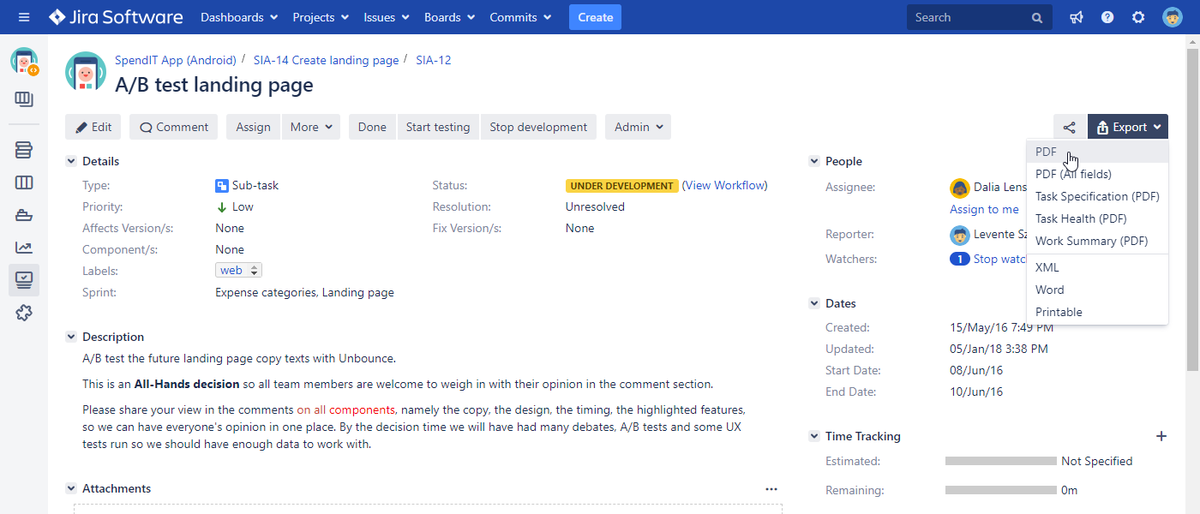
Exporting a single issue to PDF
Multiple customizable export types available from the “Export” drop-down menu
export types
Notes:
After you install the app, your Export menu in Jira will be extended with additional options added by Better PDF Exporter.
>>NEXT<<
As you are looking at this Issue, the export options appear on the existing user interface, that you are familiar with already.
That’s because seamless User Experience is a key design goal. Ideally, you should not be able to notice the difference between a core Jira feature and an app feature. We wanted to fit PDF exporting into the Jira interface as frictionlessly as possible.
These export menu options are also called PDF views (technical name), and we will talk about it in a few minutes.

Slide 6
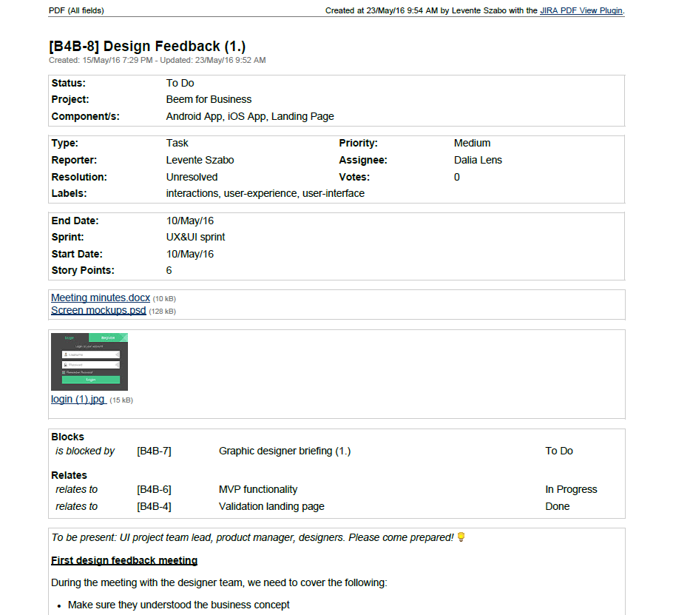
Exporting a single issue to PDF
All system and custom fields, file attachments, images, worklogs, comments, change history exported
Standard fields
Custom fields
Attachments with image thumbnails
Issue links
Formatted description
Notes:
If you choose to export a single issue, by selecting one of the export options, you’ll get a PDF exported into your browser window.
>>NEXT<<
Better PDF Exporter will export all system fields and it also supports custom fields, >>NEXT<< the exported PDF will also hold images or other files types attached >>NEXT<< to the issue. These attachments just get embedded in the PDF.
>>NEXT<<
You also have your issue links exported, and the issue description and comments, keeping all rich formatting it had on the web.
You could export fields that are managed by other apps. So if you have a Gliffy diagram, or a Table Grid Editor section, your PDF will have that, too. I’ll talk more about integrations a bit later.
Let me also note here, that this example was created with the most basic template that exists.
It can be customized to support literally any layout.
You can add or remove content sections, change the look of the PDF by adding your own branding, for instance.

Slide 7
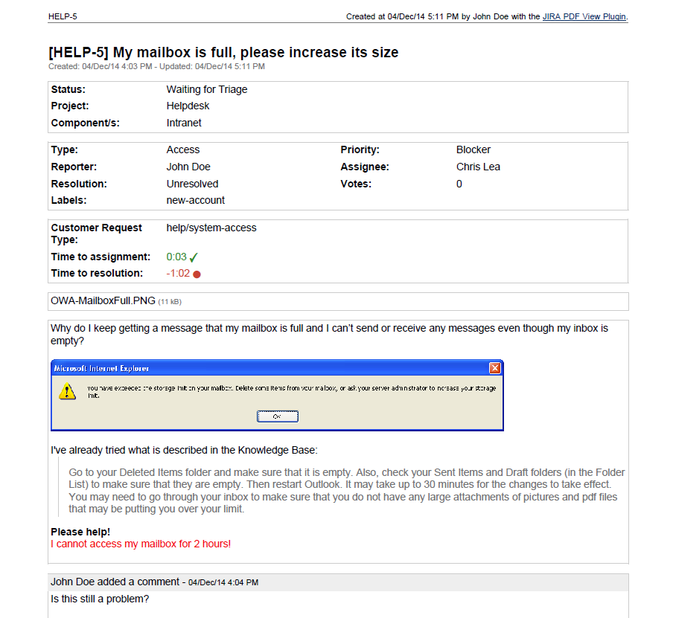
Exporting a single issue to PDF
Integrated with all Atlassian applications (Jira Core, Jira Software, Jira Service Desk)
Jira Service Desk custom fields
Notes:
PDF exporting also works with other Jira applications, like Jira Software or Service Desk. This example is a single issue export again, but it demonstrates the integration with Jira Service Desk.
It’s an export of a single Service Desk ticket.
On the PDF, you have the Jira Core fields, >>NEXT<< but also the custom fields coming from Service Desk, with request type and SLA information.

Slide 8
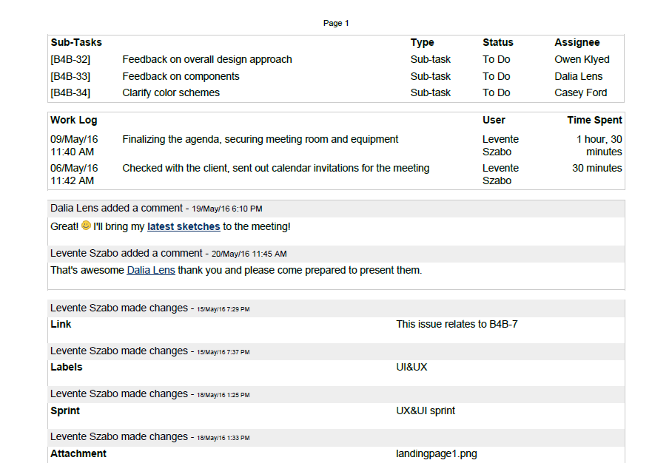
Exporting a single issue to PDF
All metadata including subtasks, worklogs, comments, change history exported
Sub-tasks
Work logs
Formatted comments
Change history
Notes:
You can decide to include more metadata into a PDF export, including >>NEXT<< sub-tasks, >>NEXT<< work logs, >>NEXT<< comments or even >>NEXT<< the full history of an issue.
The rule of thumb is that if the information is available in Jira or even in an external database or API, you can insert that into the PDF, too.

Slide 9
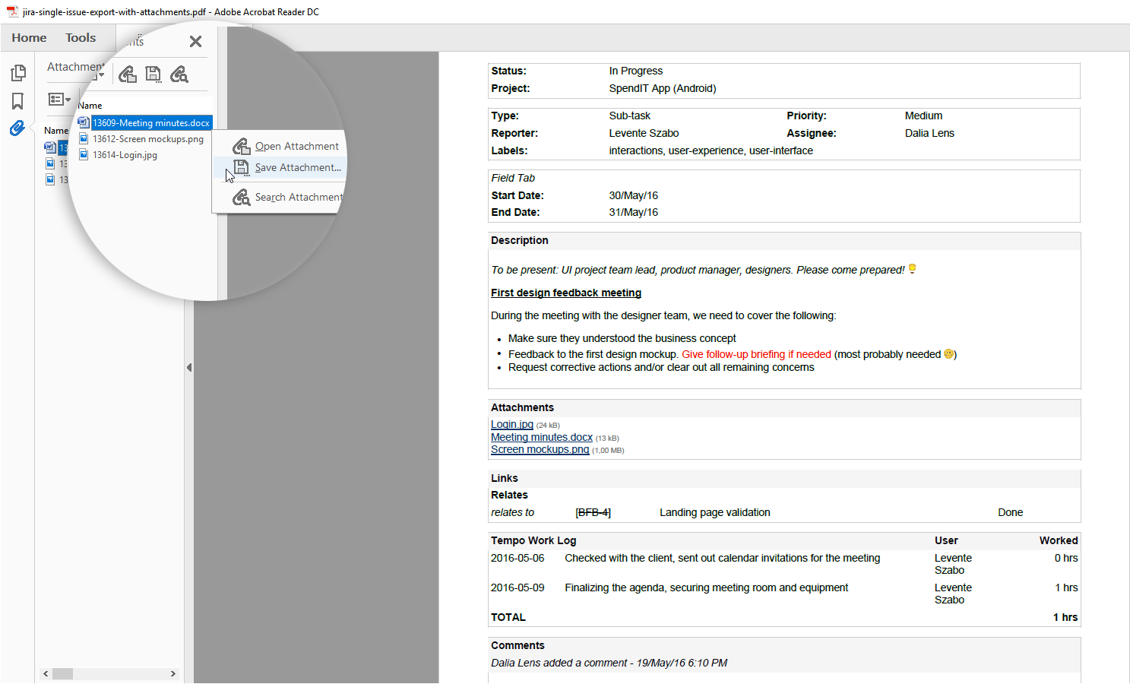
Exporting a single issue to PDF
Issue attachments can be embedded in the exported PDF file
Adobe Reader’s toolbar
for embedded files
Original issue attachments embedded in the PDF file
Notes:
The PDF file format has this great ability to embed files and handle them as integral part of the document. >>NEXT<<
You can take full advantage of this when exporting PDF documents from Jira, >>NEXT<< and embed issue attachments into your PDF. This is useful for a number of things, like embedding the logfile in a bug export, but especially important if you are using PDF export to archive Jira issues. That way you can move literally all issue data into a document management system for long-term storage.

Slide 10
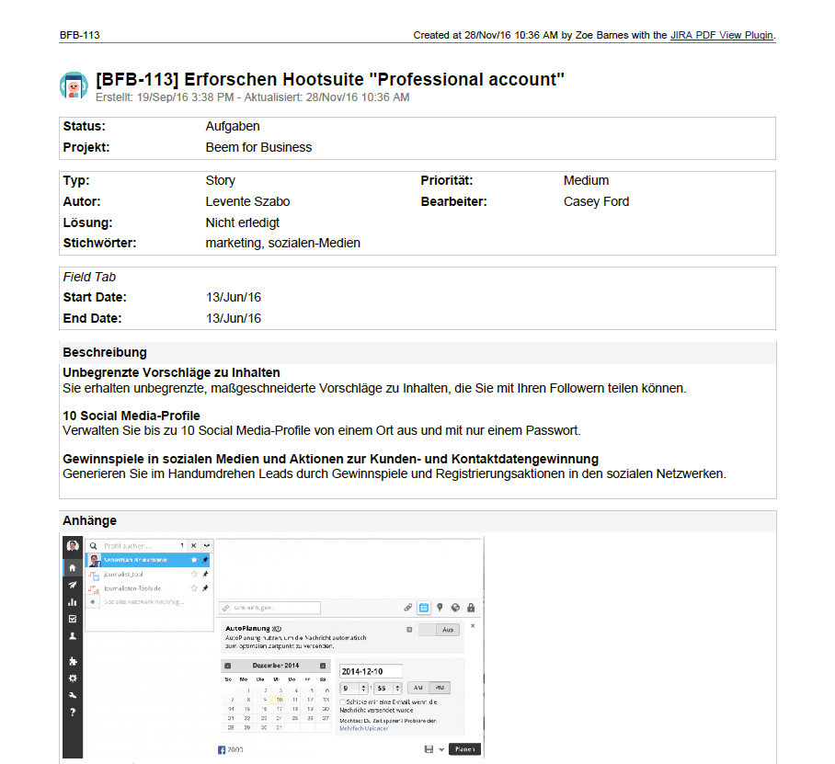
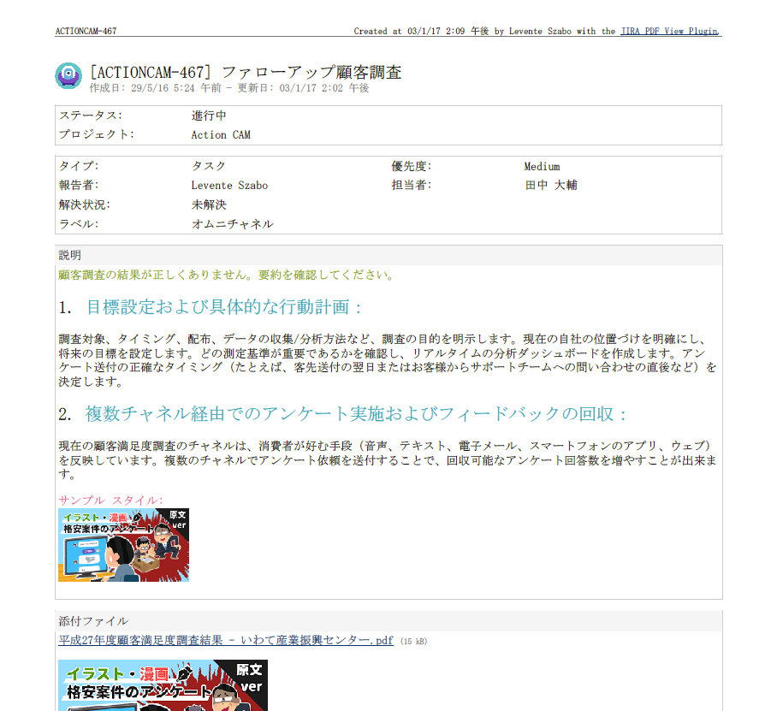
Exporting a single issue to PDF
Better PDF Exporter speaks your language and supports your character set
Notes:
Another frequently surfacing concern is language support.
In case you use Jira in a language other than English, we also have you covered. >>NEXT<<
Better PDF Exporter works with 100% Unicode internally, therefore it supports any language.
By tweaking just a simple setting, you can define the special character set to be used with Asian languages or other languages with special characters in the exported PDF documents.

Slide 11
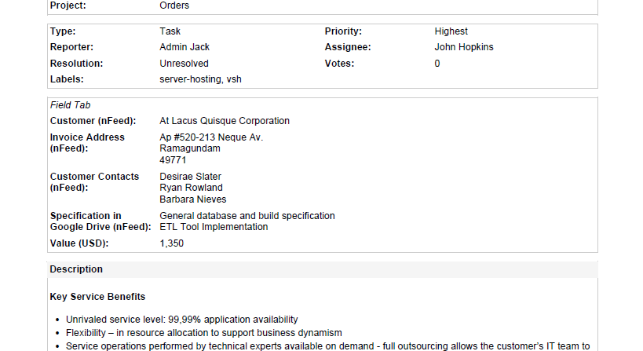
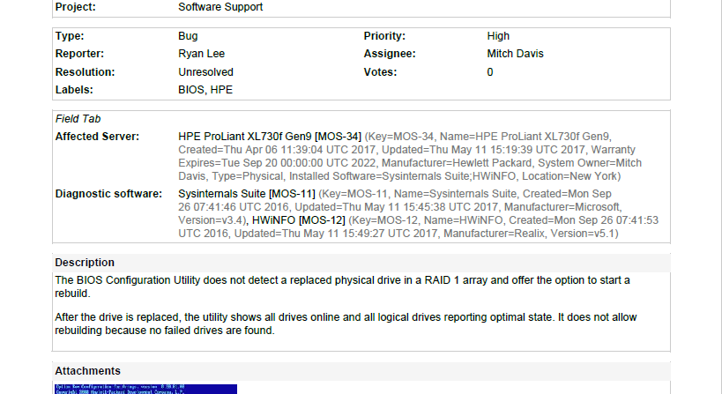
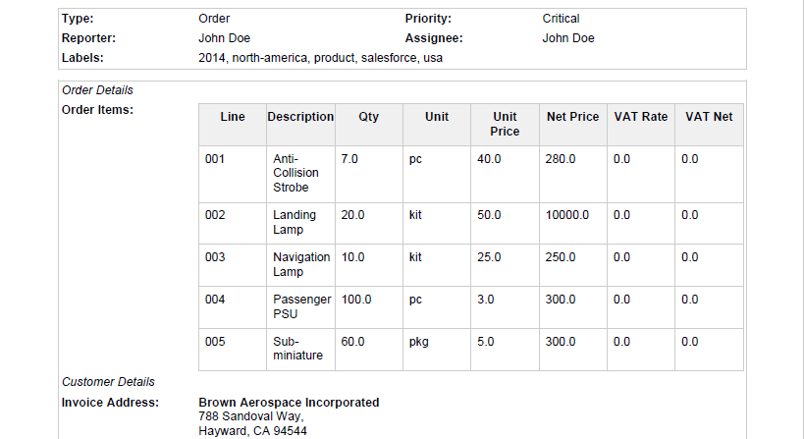
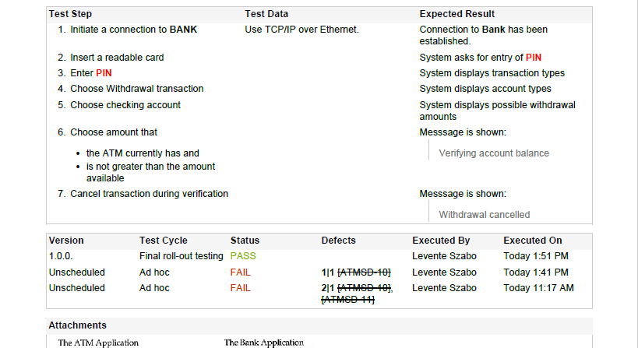
Exporting a single issue to PDF
Integrated with many popular third-party apps (Tempo, Insight, nFeed, JEditor, Zephyr, etc.)
nFeed
custom fields
Insight custom fields
Table Grid Editor custom field
Zephyr custom fields
Notes:
As already mentioned, in addition to the data stored in Jira itself, Better PDF Exporter can export the data stored in third party Jira apps like >>NEXT<<
nFeed, >>NEXT<<, Insight, >>NEXT<< Table Grid Editor, >>NEXT<< or Zephyr.
You’ll be able to export those custom fields, too.

Slide 12
How to export custom PDF documents from Jira
Exporting a single issue to PDF
Exporting a list of issues to PDF
Exporting a Jira dashboard to PDF
Managing PDF views
Managing PDF templates
API, REST API, Automation
Integrations with Jira apps
Notes:
So far, we worked in the Issue Details screen and focused on a single issue.
Now, let’s see what we can do with multiple issues!

Slide 13
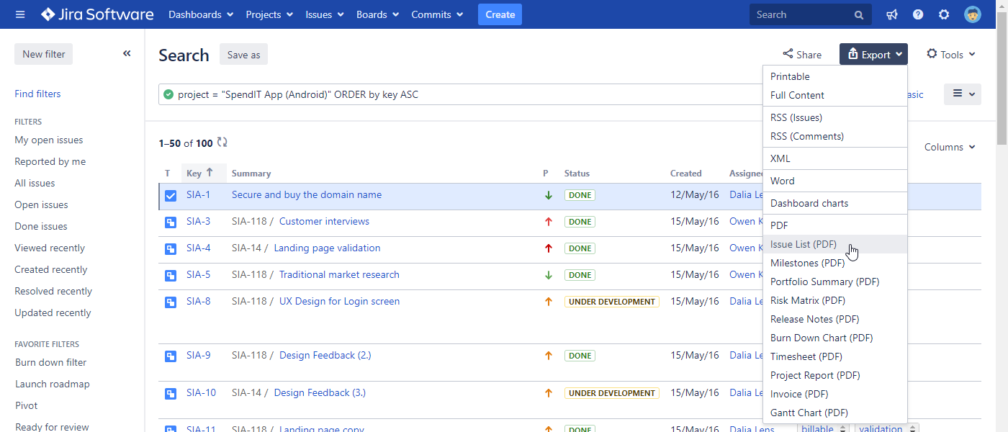
Exporting a list of issues to PDF
Available from the “Export” menu in Issue Navigator, Jira Software boards, Jira Service Desk queues
export types
Notes:
If you pull up the Issue Navigator screen, you’ll find that those new options have been >>NEXT<< added to this Export menu, too, like Issue List (PDF) or Project Report, or Gantt chart (PDF).
When you click these, all the issues currently in the Issue Navigator will be exported to one PDF document.
Again, it is not only the visible page, but all issues, the currently applied JQL query has returned.
Jira has an upper limit, on how many issues can be exported, it will allow max 1000 issues by default, but this is configurable.

Slide 14
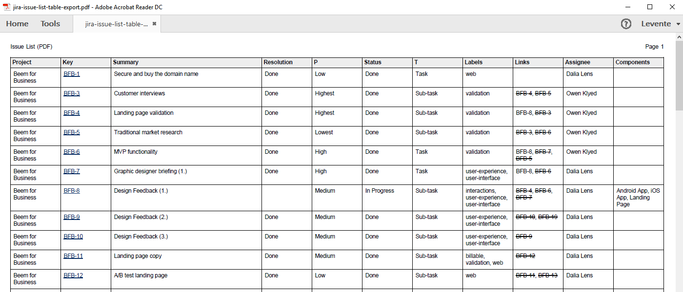
Exporting a list of issues to PDF
Scales to tens of thousands of issues and tens of thousands pages per PDF file
Notes:
In its simplest form, this is what a list of issues looks like on PDF.
Exporting a lot of issues is typically a resource intensive process.
We invested heavily into improving the scalability of app, and depending on the template, we can confidently say that it is possible to generate 50-100 thousand pages long documents, containing even 50 thousand issues in the same PDF file.
Let me stop here for a thought about scalability and large PDF exports.
Scalability depends a lot on the template itself, therefore, if you are planning to export a tremendous amount of issues (tens of thousands), then consult with the Better PDF Exporter documentation first. We compiled a good list of tips on the “Performance tuning” page, that will serve you pretty well.
Before doing large exports, think about it if a 50K pages long document is even practical in your use case. Because in our experience, creating more, but smaller exports are way more practical.

Slide 15
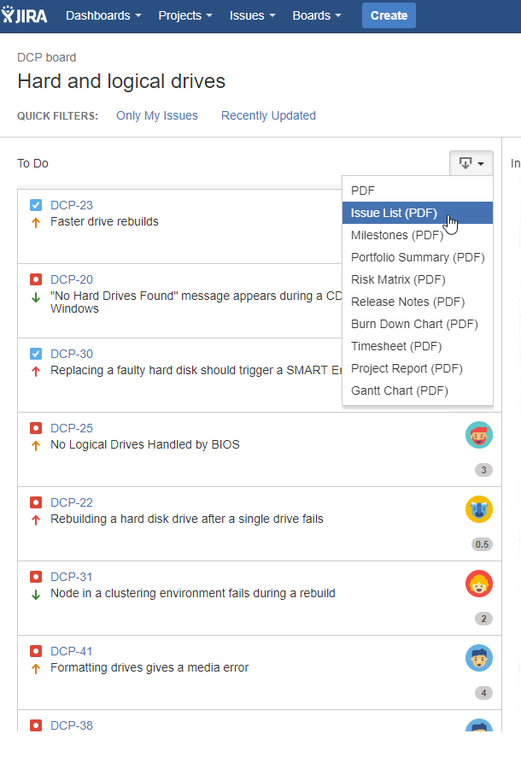
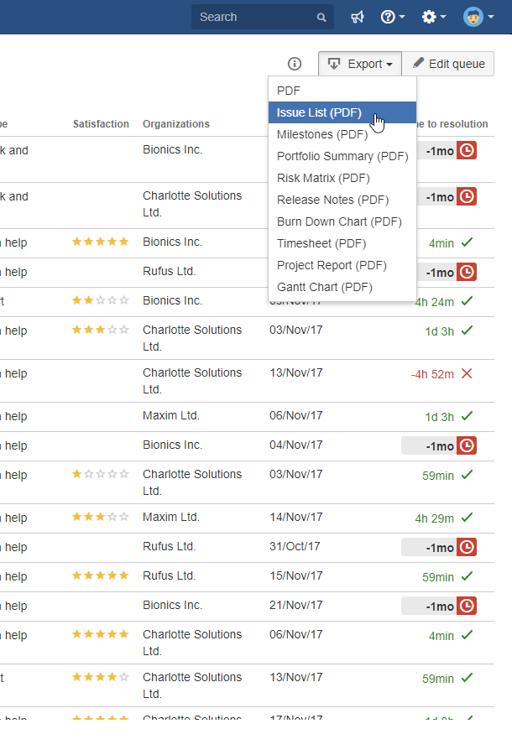
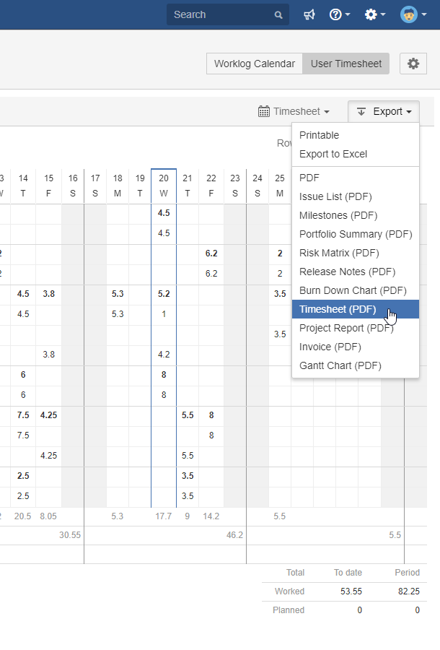
Exporting a list of issues to PDF
Typical Jira contexts where you work with a list of issues
Jira Software boards
Jira Service Desk queues
Tempo timesheets
Notes:
A list of issues is sometimes not just a simple list of issues.
There are also a few typical contexts where you want to work with a list of issues, like >>NEXT<< Agile board (columns), >>NEXT<< Service Desk queues, or >>NEXT<< Tempo Timesheets and more. The good thing, is that Better PDF Exporter appears in these scenarios as well, adding the appropriate export menu option, according to the context.

Slide 16
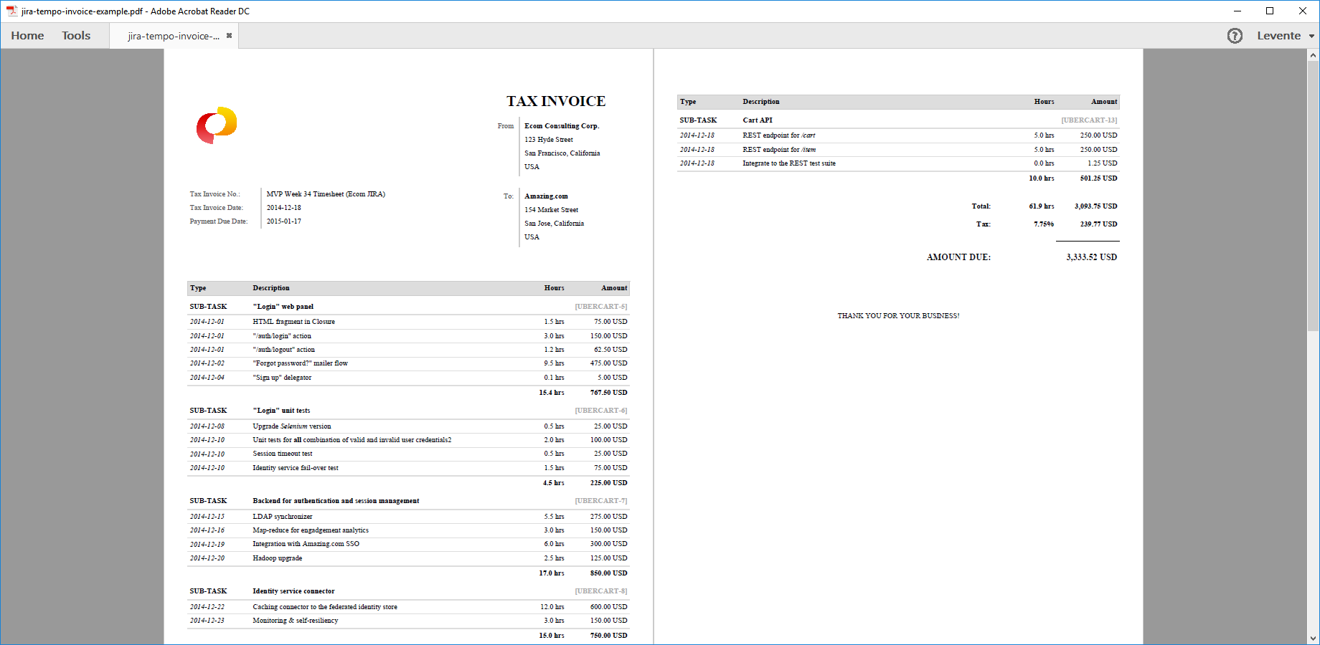
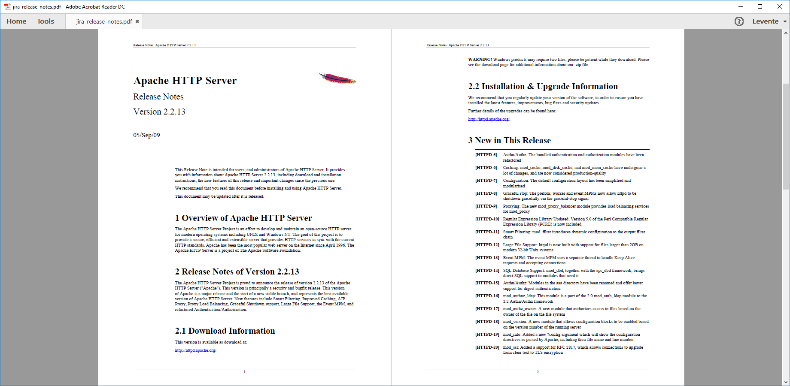
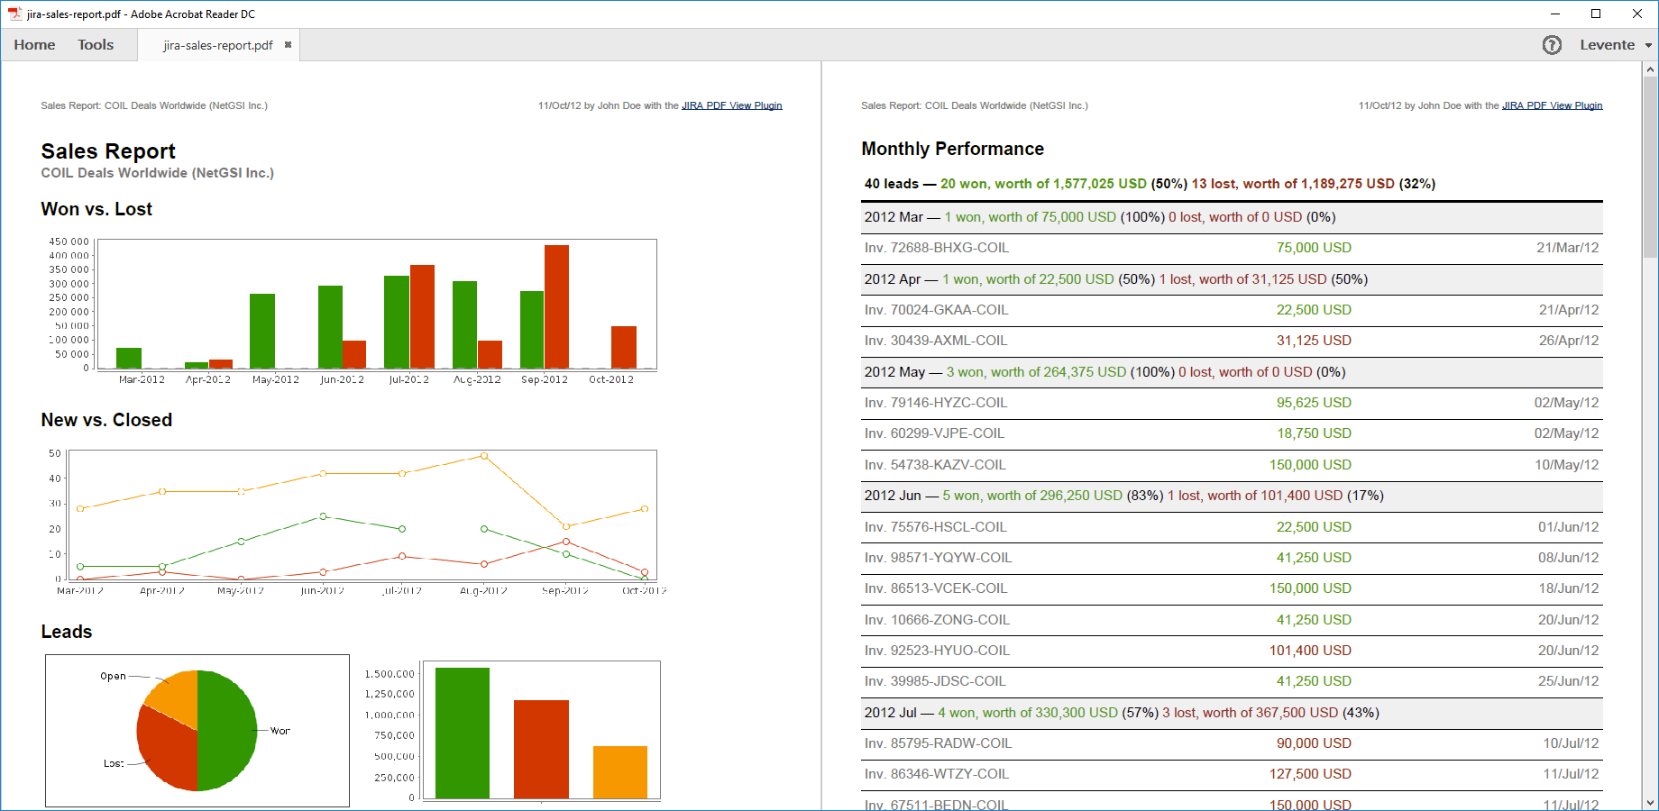
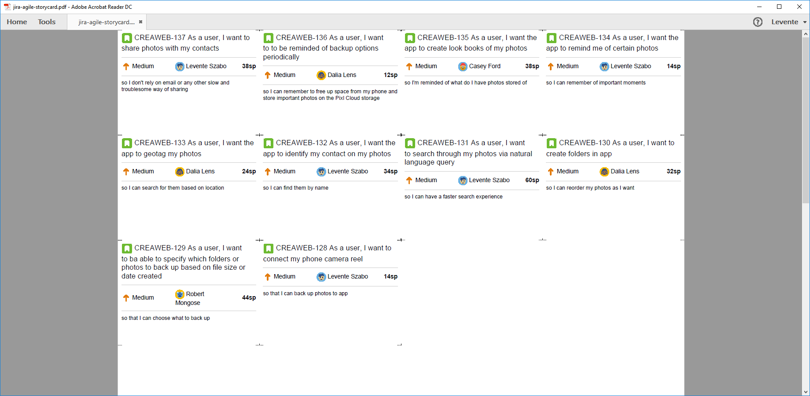
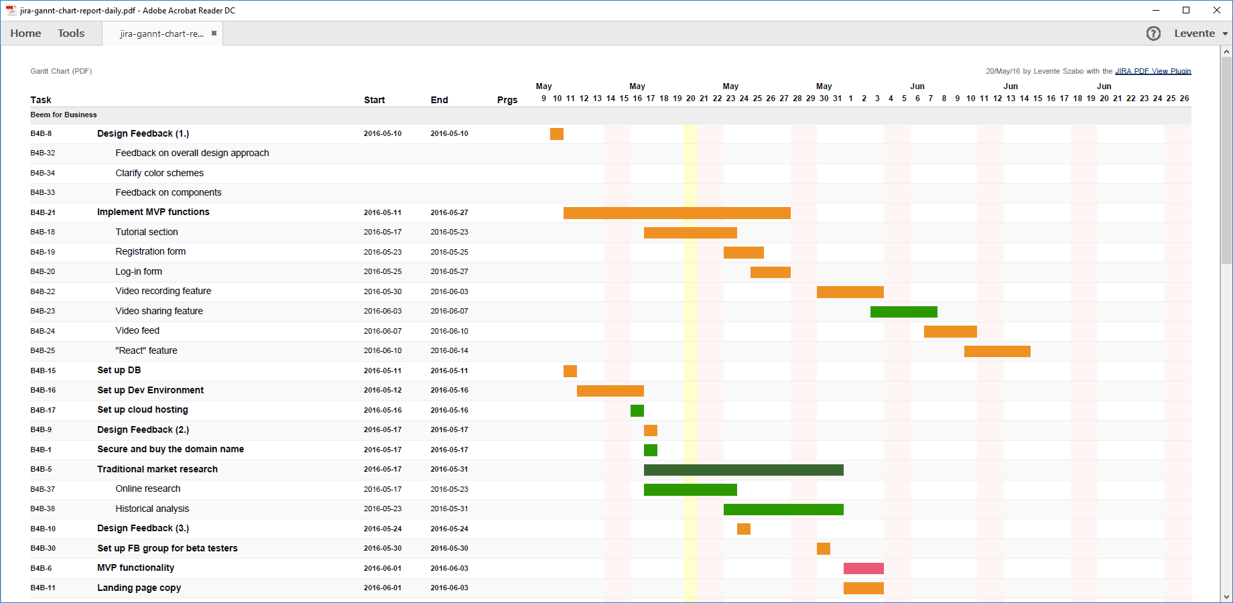
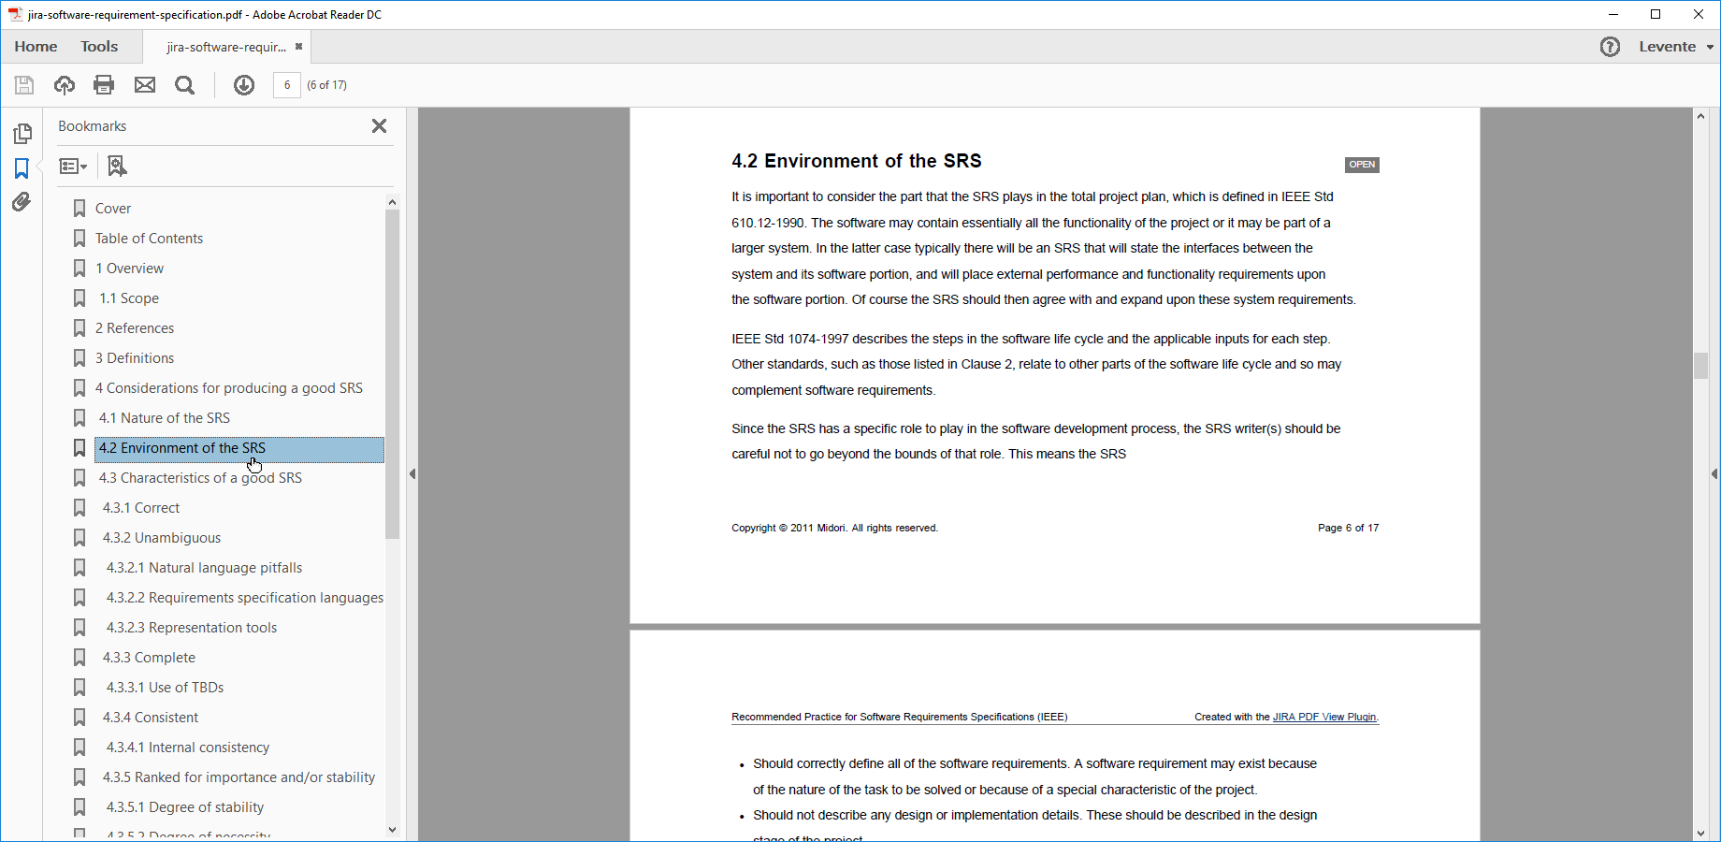
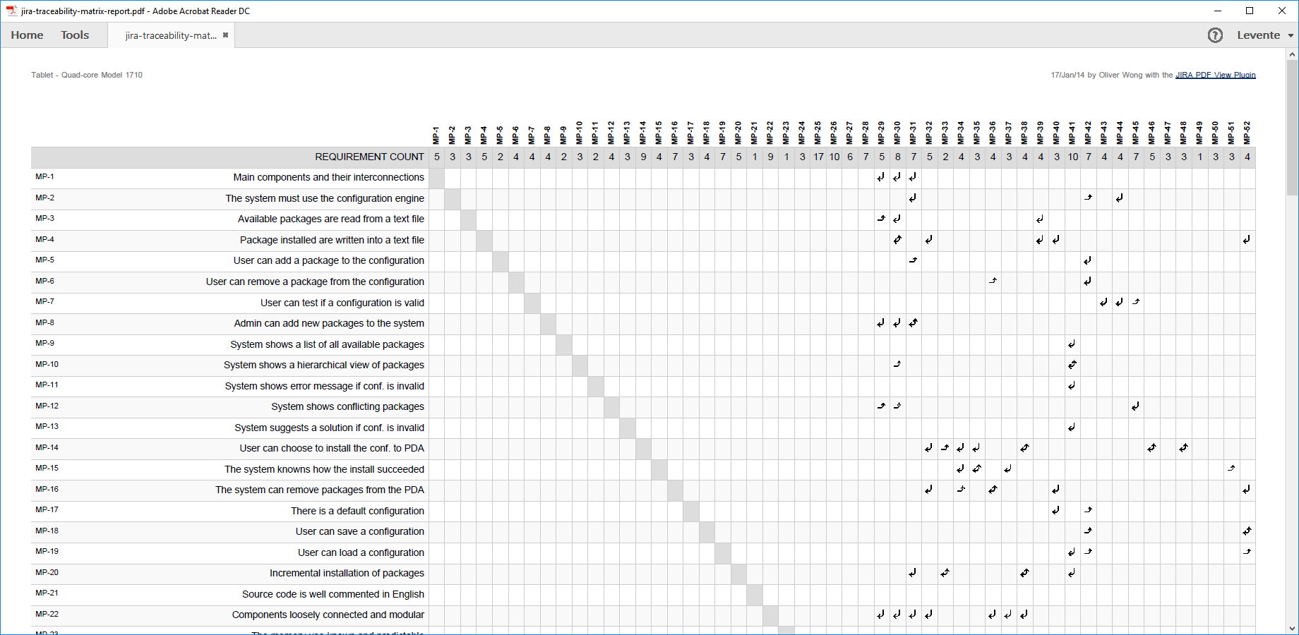
Exporting a list of issues to PDF
List of issues turned into a detailed invoice with the right template
Requirements specification
Traceability matrix
Custom report
Release notes
Gantt chart
Story cards
Invoice
Notes:
And also, when you export issues from these complex screens, you are also creating complex documents. The following examples I think really help to understand the level of PDF View’s flexibility. These will really show what you can do with a simple list of issues. By customizing the content, layout and logic of a document, you can take a list of issues and create a >>NEXT<< ready-to-print invoice that summarizes your logged hours, >>NEXT<< a release notes that includes only issues that have been resolved since the last release, >>NEXT<< story cards from the current sprint, a requirements specification, >>NEXT<< that clearly outlines what needs to be done, >>NEXT<< a traceability matrix that makes it easy to track what feature has been added and when, >>NEXT<< a custom report using any Jira data, >>NEXT<< or a Gantt chart, that takes into account the start and end dates of a Jira issue's progress.
These are really good examples of how you can represent a list of issues for different business purposes.

Slide 17
How to export custom PDF documents from Jira
Exporting a single issue to PDF
Exporting a list of issues to PDF
Exporting a Jira dashboard to PDF
Managing PDF views
Managing PDF templates
API, REST API, Automation
Integrations with Jira apps
Notes:
Our next stop is exporting Jira dashboards!

Slide 18
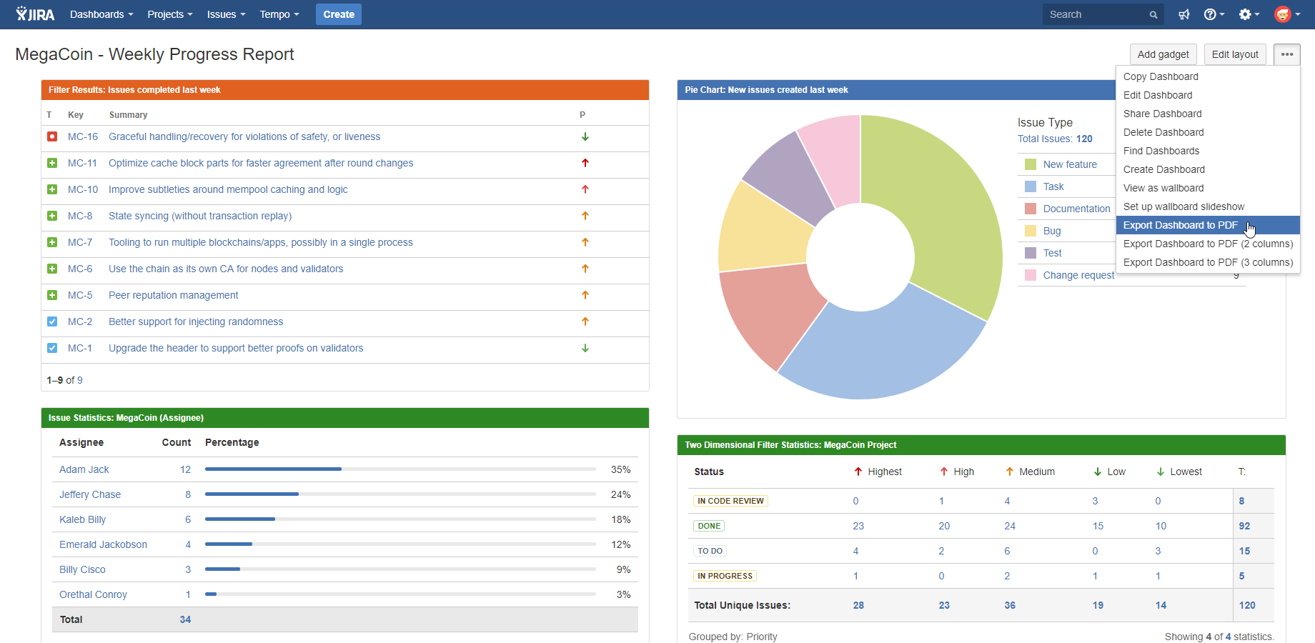
Exporting a Jira dashboard to PDF
Export Jira dashboards to PDF for sharing with the outside world, archiving, printing, etc.
Notes:
I think exporting a Jira dashboard is a particularly exciting feature, because it opens up new options for sharing key information. And it’s also something you can’t do with Jira itself or with other PDF exporting apps.
I’m sure know, dashboards are these nicely customizable spaces, that you just look at and you understand the current status of any ongoing project or effort. The different reports in Jira all have their own gadgets on the dashboard. This way you can put together a full project report, because a gadget can contain graphical chart or some other type of key data in a quick-to-understand format.
But on the negative side, dashboards are difficult to share outside the Jira web interface. They cannot be natively exported, they are difficult to print in good quality (browsers have difficulties with layouting the dashboard page to printed pages), and exporting them to image files has a number of drawbacks: text cannot be copied after being converted to an image, and links will no longer work either.
Better PDF Exporter takes your Jira dashboard and export it to a PDF document.

Slide 19
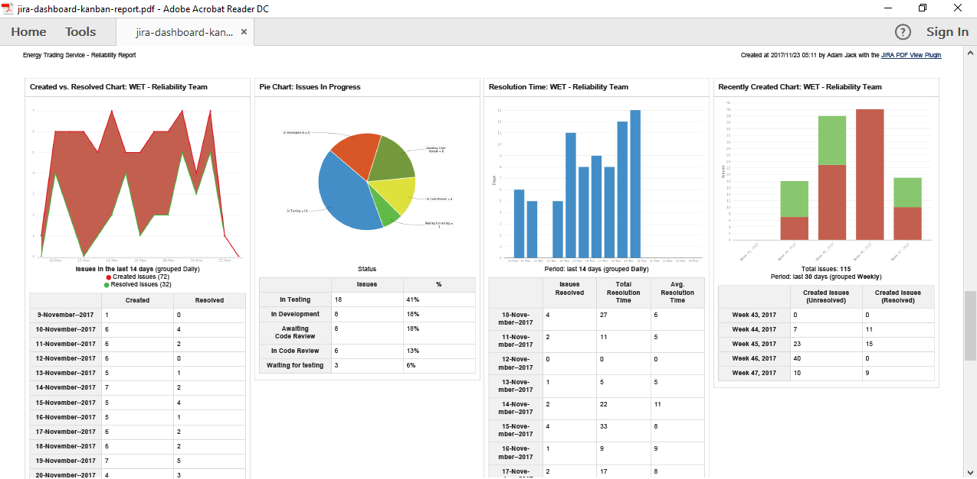
Exporting a Jira dashboard to PDF
Embed Jira reports in gadgets, then export the dashboard to PDF to create complex reports
Notes:
PDF files created from dashboards can be shared, emailed, archived, printed or even further edited, just like any other electronic business document.
They are also highly customizable by modifying the template (more on that later): not only you can show or hide certain gadgets, add your company branding (logo and colors), or change the layout, you can also mix Jira gadgets with any other type of information within the same PDF.
All in all, you can get professional reports from Jira dashboards, customized to your exact needs, with a single click.

Slide 20
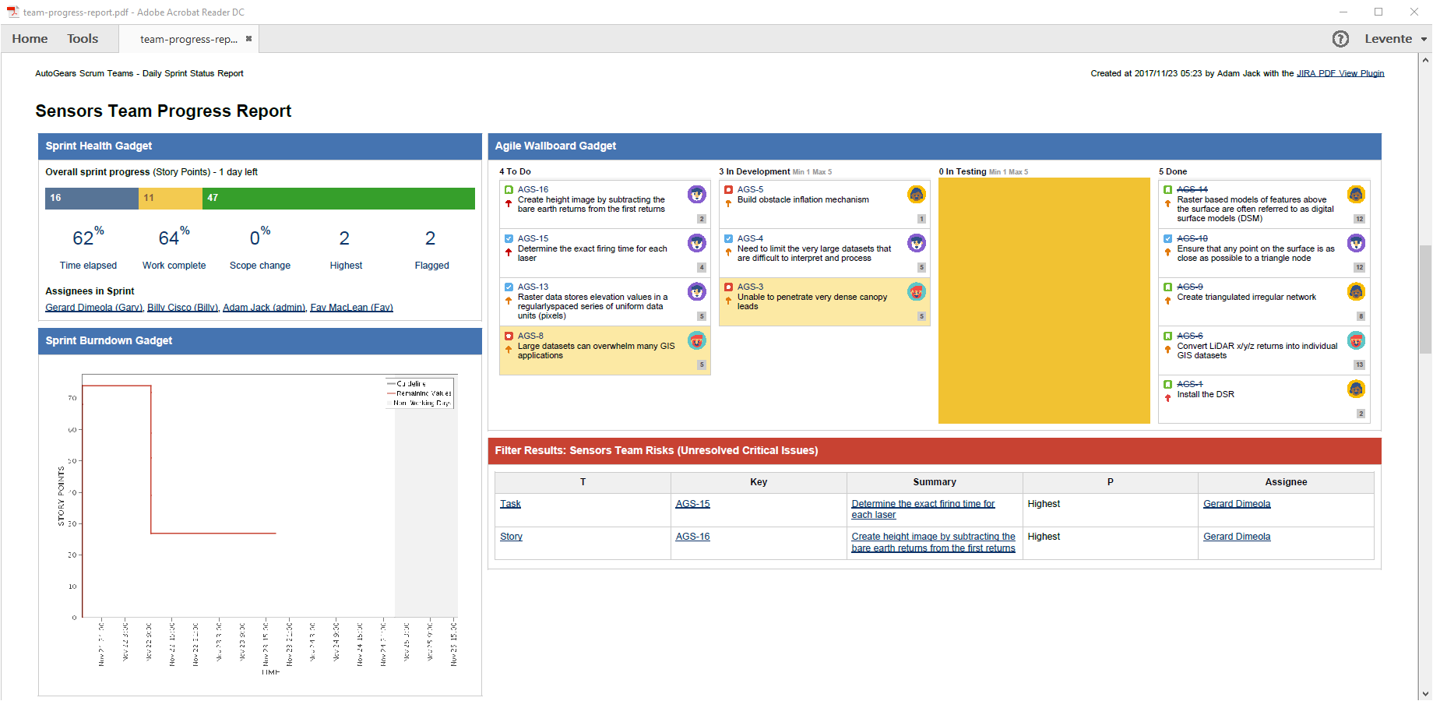
Exporting a Jira dashboard to PDF
Create Scrum or Kanban reports by exporting Jira Software gadgets to PDF
Notes:
Not only core gadgets, but Jira Software specific gadgets, like Sprint Health, Burndown Chart can be exported as well, or even the complete Scrum or Kanban board, as you can see on this example PDF.

Slide 21
How to export custom PDF documents from Jira
Exporting a single issue to PDF
Exporting a list of issues to PDF
Exporting a Jira dashboard to PDF
Managing PDF views
Managing PDF templates
API, REST API, Automation
Integrations with Jira apps
Notes:
Let’s get into the matter of what are “views” and how you use them

Slide 22
Managing PDF views
Concepts
What are
the PDF views?
How do
the PDF views work?
How to create, delete, rename, reorder PDF views?
The options that appear in the “Export” drop-down menus.
Each PDF view has a name plus a position in the “Export” menu.
You can select which Jira screen should offer this.
Each PDF view renders a PDF template.
Just go to Administration → Add-ons → PDF Views.
Notes:
PDF views are the export types or menu options that appear in the Export drop-down menus, the elements of those Export menus. They have their names and positions in the menu.
You can refine which Export menus in which Jira screen should offer which view. For example, a “story card” export may make sense in a Scrum board and in Issue Navigator, but not in a Service Desk queue.

Slide 23
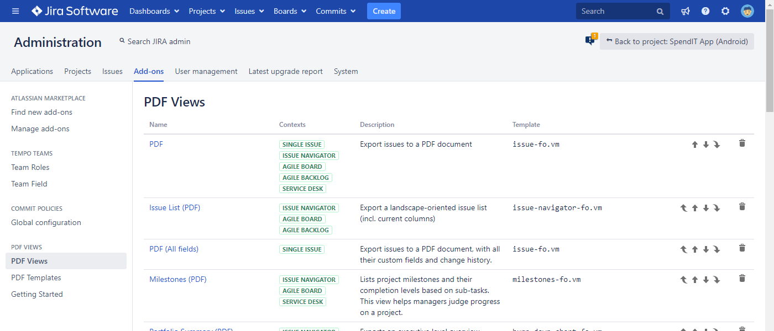
Managing PDF views
PDF views are managed in the Jira admin interface
Notes:
Each PDF View is linked to a PDF template, so here you control what template, or in other words what type of document should a view create.
Here you can also reorder them, which order will be reflected in the Export menus.
PDF Views can be managed in the Add-ons section of the Jira administration interface.

Slide 24
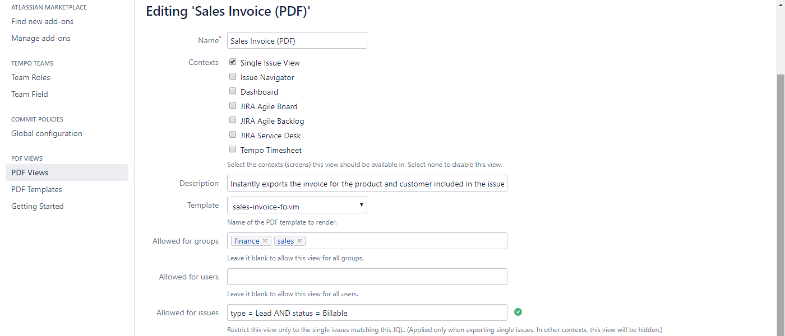
Managing PDF views
Easily configure the PDF views
visibility of this export type
Notes:
You have a couple of options when you are editing a PDF view.
First, you can add it an intuitive and descriptive name. Keep in mind that the name of the view will appear in the Export drop-down menus, so here you are basically editing the menu options. Try keeping the name really short, concise and intuitive for your users.
>>NEXT<< At the context section, you can define the Jira contexts or screen, where you want to export option to be visible.
The description will appear in the administration view only, as a quick reminder about what the export option is for.
>>NEXT<< Then you are defining a template, that the view will render.
>>NEXT<< Finally, you can control the visibility of the view. You can also thing about it as a “security” option. You can hide a specific export option from users or group that never need to use it, or allow the export type only for specific issues that you define using JQL.
TODO re-add all red boxes?!

Slide 25
How to export custom PDF documents from Jira
Exporting a single issue to PDF
Exporting a list of issues to PDF
Exporting a Jira dashboard to PDF
Managing PDF views
Managing PDF templates
API, REST API, Automation
Integrations with Jira apps
Notes:
We mentioned PDF templates already a couple of times now, it’s time to get to the bottom of it.

Slide 26
Managing PDF templates
Concepts
What are
the PDF templates?
What are Groovy scripts used for?
How to edit
the PDF templates and scripts?
Templates define the look and the content of what to export to PDF.
Scripts are executed while generating the PDF document to:
do custom processing
access Jira internals
integrate with external sources
implement any logic
plus more
Just go to Administration→Add-ons and use the online editor.
Notes:
The templates are the brain of your PDF exports. PDF templates are written in an XML based markup language for document formatting, called XSL Formatting Objects or “FO” for short.
It is very similar to HTML.
FO has the concept of pages, blocks, bullet lists, so the basic building blocks of documents.
Using these building blocks, you can define or modify the layout and content of an exported PDF.
The FO language lacks a few things, like the easy to use if-then logic, so we combine it with Velocity.
Velocity is already the standard templating language used in Jira for example for notification emails. So it’s nothing new that we introduce.
If a template requires more complex business logic, like some calculation or loading information from an external database, then it can be accompanied by a Groovy script, which does the heavy lifting.
>>NEXT<<
-----------------------------------------------
PDF templates are written in the language called XSL Formatting Objects or “FO” for short, which is a standard XML based markup language for document formatting.
It is very similar to HTML.
FO has the concept of pages, blocks, bullet lists and so, but it does not have easy to use if-then logic or for-each iteration.
Therefore, we use a unique combination of FO and Velocity.
Velocity is the standard template language used by Jira for notification emails, as an example, and it is super easy to use for those parts which are not easy in FO.
So, in our case, FO gives the formatting, while Velocity gives the logic.
It may sound complicated, but it isn’t.
Important: you are not starting from scratch.
Better PDF Exporter comes with many built-in templates, that you can use right away. They cover the typical use cases as they are.
If you don’t like something, you can customize the template. Or make a copy and customize the copy.
If a template requires more complex business logic, like some calculation or loading information from an external database, then it can be accompanied by a Groovy script, which does the heavy lifting.
This set of technologies lead to infinite flexibility.
Being able to adjust the finest details makes you able to create PDF exports virtually without limitation.
And while it doesn’t hurt if you are familiar with Velocity, basic changes can still be made easily by anyone.
There are parameters in the templates are really easy to modify (like changing colors of elements or alignment of text) and many templates have “true” or “false” switches that are really easy to control.
If you want to hear more in-depth about templating in Better PDF Exporter, let me know in the chat, so we can reach out or if there is demand, organize a separate webinar just on templating.

Slide 27
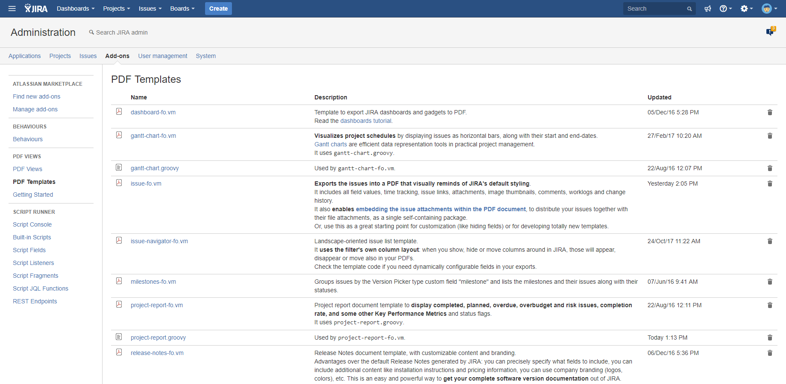
Managing PDF templates
PDF templates and scripts are managed in the Jira admin interface
Notes:
When you open up the Templates section, you find the list of your existing templates, with a description and a timestamp of the last updated date.
It’s important to remember, you are not starting from scratch.
Better PDF Exporter comes with many built-in templates, that you can use right away. They cover the typical use cases as they are, so if those fit your use case, than you might not need to customize template at all.
If you don’t like something, you can customize the template. Or make a copy and customize the copy and keep the original.
>>NEXT<<

Slide 28
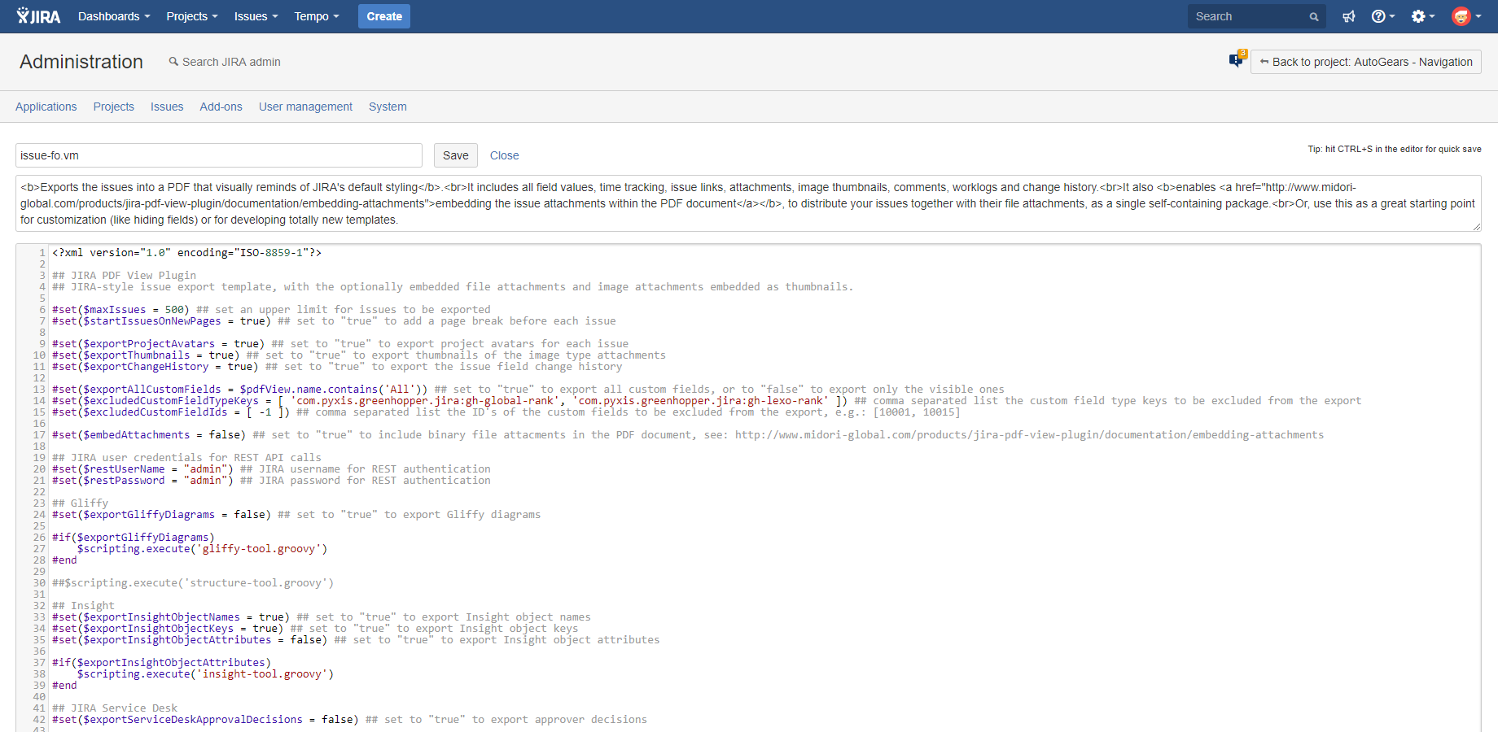
Managing PDF templates
Quickly edit scripts and templates in the web based editor
Notes:
If you click on a template, it opens up a built-in editor, where you can make your changes, save them, and those changes are ready to be tested or used immediately.
This set of technologies are the key behind infinite flexibility.
Because you being able to adjust the finest details makes you able to create PDF exports virtually without limitation.
And while it doesn’t hurt if you are familiar with FO and Velocity, basic changes can still be made easily by anyone.
There are parameters in the templates that are really easy to modify (like changing colors of elements or alignment of text) and many templates have “true” or “false” switches that are really easy to control.
If you want to hear more in-depth about templating in Better PDF Exporter, let me know in the chat, so we can reach out or if there is demand, organize a separate webinar just on templating.

Slide 29
How to export custom PDF documents from Jira
Exporting a single issue to PDF
Exporting a list of issues to PDF
Exporting a Jira dashboard to PDF
Managing PDF views
Managing PDF templates
API, REST API, Automation
Integrations with Jira apps
Notes:
Now let’s see what options are there to take some weight off of your shoulders using APIs and automation.

Slide 30
API, REST API, Automation
Multiple ways to automate PDF exporting and integrate that to your processes
PDF rendering engine
All Jira data
Web UI
(Export menus)
Java API
(for anything on the JVM)
REST API
(for HTTP)
Browser
Automation for Jira
ScriptRunner
Your Jira app
Your HTTP based integration
Your rules
Your scripts
Notes:
So far, I mentioned situations where your users want to get a PDF export on a case-by-case basis, manually.
>>NEXT<<
The way they go about it is they open Jira in the browser, select the data to export, open the “Export” menu and create the PDF.
It’s probably the most common, but definitely not the only option to use Better PDF Exporter!
Since the very beginning of building this app, we always wanted to integrate the capability of PDF exporting to Jira workflows and offer other types of automatic processes.
As a result, today we offer multiple ways for integration.
>>NEXT<<
First, our Java API is a “classic” in-process interface that Better PDF Exporter provides for any other program running within the same Jira.
>>NEXT<<
For example, the Java API is the interface used by the highly popular app Automation for Jira to generate, save or email PDF files.
We will discuss it in details in just a second.
>>NEXT<<
Also, the Java API is used by another super-popular Jira app called ScriptRunner.
If you’re not familiar with it, ScriptRunner can run scripts within Jira, written in Groovy, the standard scripting language of the Jira Virtual Machine.
These scripts add new workflow post functions, periodic jobs and similar new features to Jira.
>>NEXT<<
And, of course, the Java API can be used by any other Jira app.
>>NEXT<<
Our second API for the outside world is the REST API.
If you are familiar with the concept of REST, this is an integration method that relies on the HTTP protocol, the standard protocol that powers the Internet.
In a nutshell, the REST API allows external systems to connect to Jira, request it to render a PDF document then return that to the caller over the Internet in a standard and secure way.
A few more details on this later.
>>NEXT<<
--------------------------------------------------
First, our Java API is a “classic” in-process interface that the Better PDF Exporter provides for any other program running on the same Java Virtual Machine (JVM), so basically any code that runs “within Jira”.
Most typically these are other Jira apps written in Java, but technically speaking, this can be any code written in a language that can run on the JVM.
For example, the Java API is the interface that is used by the highly popular app Automation for Jira to generate PDF files and email or save those.
We will discuss it in details in just a second.
Also, the Java API is used by another super-popular Jira app called ScriptRunner.
If you’re not familiar with it, ScriptRunner can run scripts within Jira, written in Groovy, the standard scripting language of the JVM.
These scripts can augment Jira in form of workflow post functions, periodic jobs and so on.
And now, you can generate PDF files in these Groovy scripts.
Also note that these scripts are a great example that shows that the Java API is actually not “Java-only”.
We will also discuss it in details later.
And, of course, the Java API can be used by any other Jira app.
Our second API for the outside world is the REST API.
If you are familiar with the concept of REST, this is an integration method that relies on the HTTP protocol, the standard protocol that powers the Internet.
In nutshell, the REST API allows external systems to connect to Jira, request it to render a PDF document then return that to the caller over the Internet in a standard and secure way.
More details on this later.

Slide 31
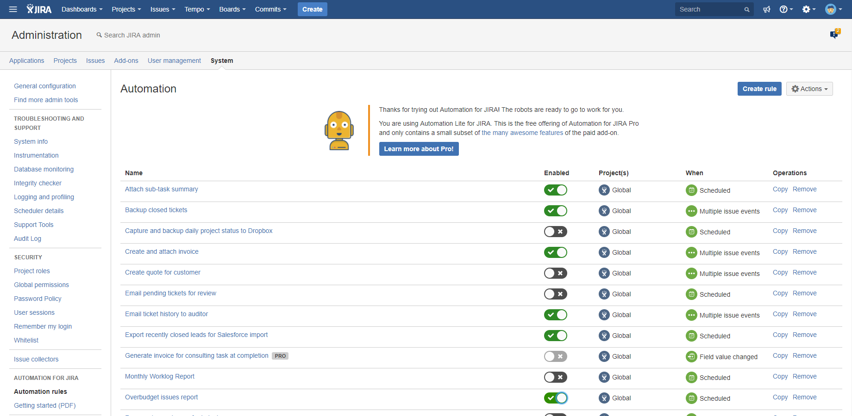
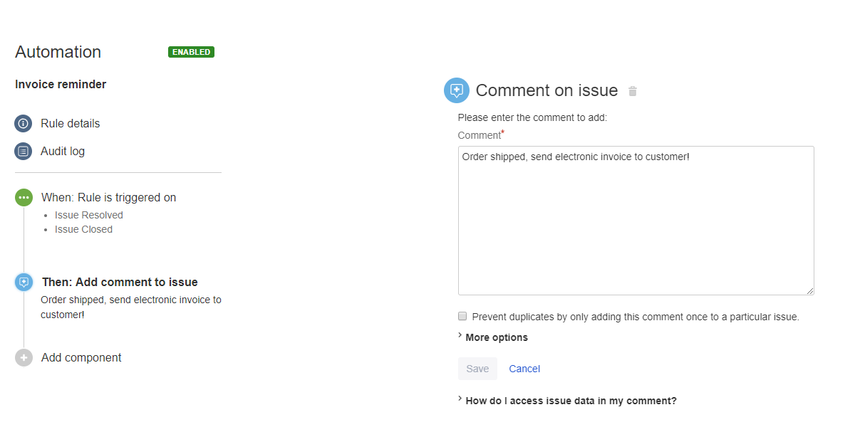
Better PDF Automation for Jira
Free app bridging Better PDF Exporter and Automation for Jira
Notes:
For most automation use cases, we recommend to use Automation for Jira.
This is a very popular Jira app, developed by our friends at Codebarrel.
You should know, that this app has both a free and a paid and supported version, but Better PDF Exporter supports both.
Automation for Jira allows implementing automation by defining so-called automation rules. >>NEXT<<
Each automation rule contains a trigger (when to start the rule) and one or more actions (what to do when executing the rule).
To extend the available automation actions, we offer a free app intuitively called Better PDF Automation, which bridges Automation for Jira and Better PDF Exporter.
So, you need 3 apps: Automation for Jira to manage the automation rules, Better PDF Exporter to generate the PDF files, and Better PDF Automation to connect these two.

Slide 32
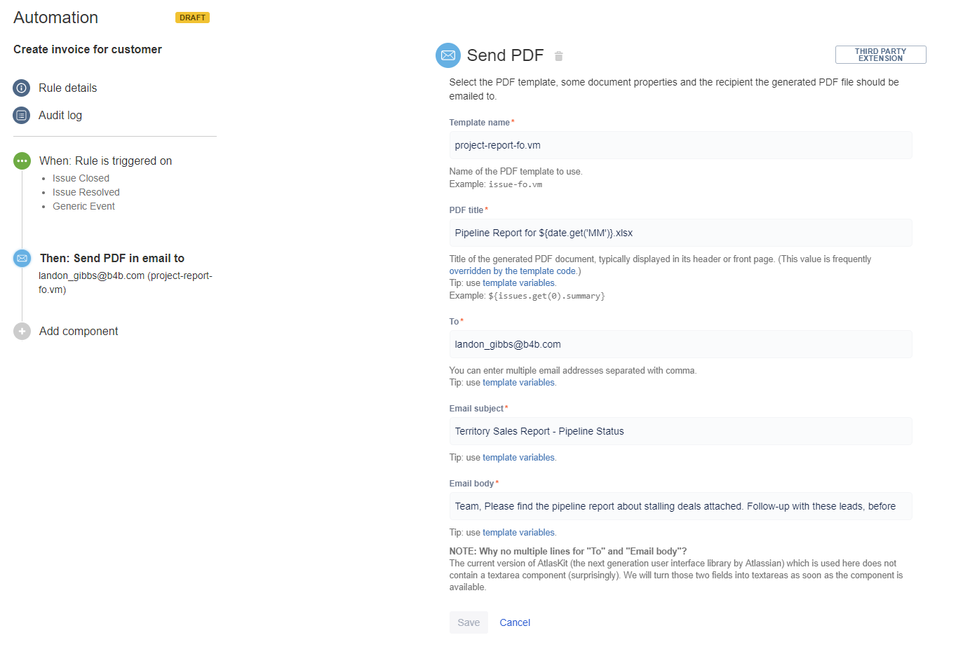
Better PDF Automation for Jira
Free app bridging Better PDF Exporter and Automation for Jira
Notes:
As I said, Better PDF Automation for Jira is like a “bridge” app, and it offers 3 new automation actions that you can add to automation rules:
“Send PDF“ action - This action allows you to send the generated PDF document via email. You can set recipients, and also the subject and body of your emails, and send those emails automatically.
“Save PDF“ action - Which saves the generated PDF on the server filesystem or to a network drive (like Google Drive or Dropbox) mounted into that
“Attach PDF“ action - Which let’s you define a Jira issue to attach the exported PDF to as an attachment
Overall, Automation for Jira offers a friendly and straightforward interface to implement business automations in Jira.

Slide 33
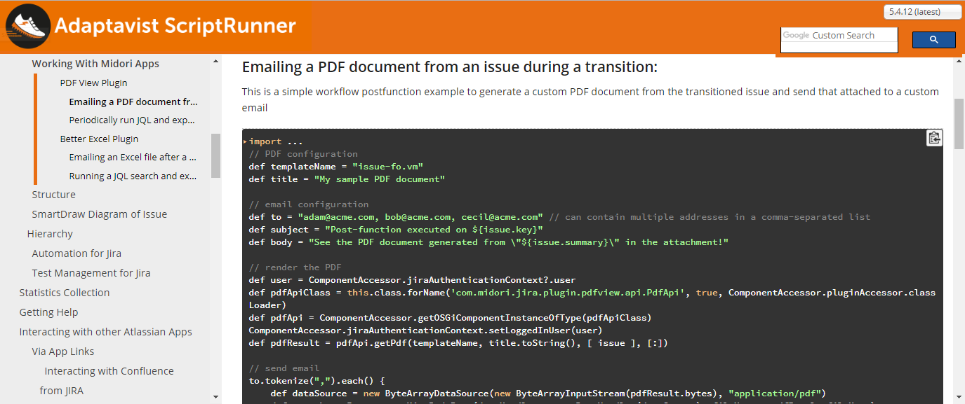
ScriptRunner
Write powerful workflow post-functions, services, etc. in Groovy to automate PDF generation
Notes:
If your use case needs an alternative to defining user-friendly automation rules, then you have the option of writing your own automation logic in Groovy scripts.
ScriptRunner, a Jira app developed by Adaptavist, allows running these Groovy scripts as workflow post-functions, services (periodic jobs) and in many other extension points.
The advantages and disadvantages are similar to the ones we mentioned at the templates.
Scripts are flexible, but you need to write or at least manade code.
The good news is that similarly to our templates, you can find complete working code examples in the Better PDF Exporter section of the ScriptRunner documentation. You can just copy and paste these.
So, if you are comfortable with managing short Groovy snippets or you require more flexibility than what the automation rules offer, we strongly suggest checking out ScriptRunner.
--------------------------------------------
Coding is difficult, right?
Well, look at the code sample in the slide.
Although the bottom part of the code didn’t fit the screenshot, you can implement a configurable workflow post-function that renders a PDF document from a template and the issue updated by the workflow, then email the file attached to a customizable email, in about 15-20 lines of code.
Not that scary, right?
And, here comes the real power of scripts, you can modify the logic in any way you can imagine.
So, if you are comfortable with managing short Groovy snippets or your requirements require more flexibility than what the automation rules offer, we strongly suggest checking out ScriptRunner. If you do so, you can find complete working code examples in the Better PDF Exporter documentation.

Slide 34
REST API
Call RESTful end-points and the PDF will be returned in the HTTP response
For issues:
/pdf/pdf-view/{pdf-view-id}/render
http://jira.mycompany.com/rest/.../pdf/pdf-view/7/render?context=SINGLE_ISSUE_VIEW&jql=key+%3D+DEMO-4
http://jira.mycompany.com/rest/.../pdf/pdf-view/7/render?context=ISSUE_NAVIGATOR&jql=project+%3D+DEMO&tempMax=100
For dashboards:
/pdf/pdf-view/{pdf-view-id}/dashboard/{dashboard-id}/render
http://jira.mycompany.com/rest/.../pdf/pdf-view/10/dashboard/10100/render
– Learn more:
http://www.midori-global.com/products/better-pdf-exporter-for-jira/documentation/rest-api
Notes:
As I promised, a couple of more thoughts about our REST API. I’m gonna keep it really short, but it belongs to the full picture.
First off, Better PDF Exporter REST API extends the standard Jira REST API by adding further endpoints to that.
It also means that you can freely combine Better PDF Exporter REST calls with Jira REST calls.
In its current form, Better PDF Exporter offers two REST endpoints as you can see here.
>>NEXT<<
The first endpoint is for issues. It renders a PDF document by running the passed JQL and merging the resulted issues with the PDF template specified by the PDF view ID.
In the first example, the view with the ID 7 will merge its template with the issue DEMO-4.
In the second example, the same view is asked to merge its template with all issue of the DEMO project, but not more than 100.
>>NEXT<<
The second endpoint is for dashboards. It renders a PDF document from the passed view and the passed dashboard ID.
The example will render the view with the ID 10 with the dashboard with the ID 10100.
It is really that simple.
You can use it for a million things, calling it from an external system, automation script, etc.
>>NEXT<<
If you want to read more on this, you find everything in our documentation’s API section.
Finally, let’s see our REST API in short.
First off, please note that the Better PDF Exporter REST API extends the standard Jira REST API by adding further endpoints to that.
It also means that you can freely combine Better PDF Exporter REST call with REST calls.
Most typically, you login to the REST API and give the authentication context (current user and their permissions) also for the Better PDF Exporter REST API.
Our REST API is fully standard, so if you have ever worked with any REST API, it will sound very familiar to you.
If you never, believe me, it is super-easy to use.
In its current form, Better PDF Exporter offers two REST endpoints as shown in this slide.
The first endpoint renders a PDF document by running the passed JQL and merging the resulted issues with the PDF template specified by the ID of the PDF view.
In the first example, the view with the ID 7 will merge its template with the issue DEMO-4.
In the second example, the same view is asked to merge its template with all issue of the DEMO project, but not more than 100.
The second endpoint renders a PDF document from the passed view and the passed dashboard ID.
The example will render the view with the ID 10 with the dashboard with the ID 10100.
It is really that simple.
You can use it for a million things, calling it from an external system, automation script, etc.

Slide 35
How to export custom PDF documents from Jira
Exporting a single issue to PDF
Exporting a list of issues to PDF
Exporting a Jira dashboard to PDF
Managing PDF views
Managing PDF templates
API, REST API, Automation
Integrations with Jira apps
Notes:
Now let’s see what integrations are available!

Slide 36
Integrations with Jira applications
Better PDF Exporter support all Jira editions
Notes:
We put great efforts into building out integrations.
Obviously, it integrates with all Jira editions like >>NEXT<< Jira Core, >>NEXT<< Software and >>NEXT<< Service Desk.
As for deployment options, it supports the Jira Server and Data Center and it’s not a secret that we are currently working on a version for Jira Cloud.

Slide 37
Integrations with Jira apps
Better PDF Exporter integrates with the most popular Jira apps
ScriptRunner
Zephyr
nFeed
Automation for Jira
Tempo Timesheets
Gliffy
Insight
Table Grid Editor
JEditor
New integrations coming...
+more
Notes:
Furthermore, we build integrations with the most popular Jira apps. These apps complement our functionality in a very logical and useful way, and we also build integrations with apps that were demanded by our customers.
It means that with Better PDF Exporter you can export your Insight assets, Zephyr tests, Gliffy diagrams or create Tempo Timesheet reports easily, just to mention a few.

Slide 38
Thank you!
Levente Szabo • levente.szabo@midori-global.com
Notes:
And with that, I would like to thank you for your attention and encourage you to reach out to me with any questions or comments, using my email you see on the screen.
>>NEXT<<

Slide 39
Try our other apps, too (free)!
Better Excel Exporter for Jira
Better Content Archiving
for Confluence
Better Commit Policy for Jira
Full-blown native Excel exports, spreadsheet reports and Business Intelligence for Jira
Verify the changes committed to Git, Bitbucket, GitHub, GitLab, Subversion & Mercurial against configurable rules
Usage tracking, expiration, review workflow, retention and clean-up for your Confluence pages
Notes:
And if you liked what you heard, give our other apps a try as well. Those cover slightly different aspects of productivity for business users as well as developers.
Better Excel Exporter is very similar to what you just heard, but instead of PDF, it exports your Jira data to real Excel files.
Archiving Plugin is a Content Lifecycle Management app for Confluence, mainly for large instances. It helps keeping Confluence content always up-to-date and streamlined.
Commit Policy Plugin helps developers be more productive and compliant. The app verifies commits against configurable rules, so the code change history is always consistent and easy to follow.

