Slide 1


How to keep your Confluence up-to-date
with content lifecycle rules
Manage quality, expiration, usage and archiving of your Confluence content
Notes:
Welcome
And thanks for joining in!
My name is Levente Szabo, Customer Success Manager here at Midori and I’ll be your host for today’s webinar about content lifecycle management in Confluence.
Confluence is gaining foothold in the enterprise content management space pretty fast.
Teams are relying on information captured, edited and stored in Confluence for their daily jobs, and they expect the system to be reliable and the information to be relevant all the time.
Our experience is that they keep creating content and take the access to this content for granted, but don’t think about how Confluence will perform in a few weeks or months, if they keep up the current speed of creating content, adding attachments, adding users and so on.
When talking with teams, we often ask: “you sure that everyone on the team is following if the content they created is still relevant? The answer is never a resounding yes.
So what happens with outdated content then?
Teams tend to realize that they have a problem only when Confluence already has a lot of outdated content.
They only think about doing something, when they notice something strange is going on with Confluence.
When they stumble into too much stale information that looks like relevant, but then it turns out it hasn’t been updated in 2 years.
A Confluence full of unmanaged, unowned content costs you time and money, as team members take more time finding relevant content and the chances of using or making decisions on outdated information increases.
Every content management system needs Content Lifecycle Management, and for Confluence, it’s Better Content Archiving.
In this webinar I’ll walk you through the main concepts of this Confluence app and how you can use its features to implement automated content quality and lifecycle checks for your company Confluence.
Before we start, a few usual housekeeping notes:
This presentation is recorded and will be available soon after.
During the presentation you can use the live chat feature to ask questions, or if you are watching the recording, please leave your question as a comment below!
We will answer the questions at the end, or if won’t have time for all, please still submit them as comments anyway, and we answer them in a follow-up blog post on our blog. So if you haven’t already, free to subscribe to that as well on our website.
Before we dive in the middle of things, let’s get started with a little background of Midori, the company behind Better Content Archiving.

Slide 2



Who is Midori?
What is Better Content Archiving?
Experience
10+ years in the Atlassian Ecosystem
On the market since 2008
Top Vendor
(earlier was called “Atlassian Verified”)
Reliable maintenance, guaranteed support and top-notch docs
Top rated app for
Confluence Server and Data Center
Content Lifecycle Management
for Confluence
Usage monitoring, automation of content review
and archiving
Powering 4000+ customers
Apple, Boeing, Salesforce, Oracle, SAP, SONY, etc.
Notes:
Midori
We are Midori, a long time member of the Atlassian Ecosystem. We’ve been around for more than 10 years, working with Atlassian products and also developing apps for them. >>NEXT<<
We are also a Top Vendor. It’s an official certificate, that Atlassian gives to app vendors who live up to their high standards of software and support quality. It also tells customers that our apps are always compatible with the latest Atlassian host applications and we issue maintenance updates whenever needed. >>NEXT<<
Among our customers we count many global companies from industries like technology, healthcare, entertainment as well as government organizations
>>NEXT<<
Now what is Better Content Archiving and why should you choose it?
First of all, it’s an actively developed, maintained and supported app for 10 years. >>NEXT<<
It’s loved by customers - it’s one of the top rated apps for Confluence. In the reviews they often mention how important the app is in an enterprise environment and how great the support is >>NEXT<<
Better Content Archiving is the Content Lifecycle Management solution for Confluence. It automates the daunting and in large instances, impossible task to monitor pages and spaces and report content quality. It’s scalability is proven, as many large enterprises are already using it in their huge Confluence Server and Data Center instances.

Slide 3
How to keep your Confluence up-to-date
with content lifecycle rules
What is content lifecycle?
Configuring lifecycle rules
Running the lifecycle job
Understanding your content quality
Notification emails to stakeholders
Browsing archived content
Restoring archived content
Notes:
What are we going to cover today?
First things first, I want to clarify the basic concept of content lifecycle. What is content lifecycle and why does it matter to your company?
Then we will turn to Better Content Archiving app, to see how it uses content lifecycle rules - What are the actions you can control by configuring lifecycle rules
We will see how you can use the app and run the lifecycle job
Understanding the state of your content quality
We will see how notifications and reporting works
How does archiving happen, and how you can browse the archived content
Restoring content from the archives when needed

Slide 4
How to keep your Confluence up-to-date
with content lifecycle rules
What is content lifecycle?
Configuring lifecycle rules
Running the lifecycle job
Understanding your content quality
Notification emails to stakeholders
Browsing archived content
Restoring archived content
Notes:
Let’s go ahead and get started!
What is content lifecycle and why does it matter to your company?

Slide 5
What is content lifecycle?
Why managing the lifecycle of different content types matter
The Life Cycle of Content
Capture information
You can take notes
and compile research
in your ECM system
Delete old content
ECM systems
automatically delete
old, unused content
to save space
Publish content
You can use your ECM
system to publish
content on your
website or on
your intranet
Archive content
ECM systems
backup and archive
content automatically
so you never lose it
Source: https://www.atlassian.com/software/confluence/ecm/guide
Notes:
In an enterprise environment, a content management system or ECM for short, is a collaborative and digital space, where a company's information is accessible to teams to support processes and business goals and everyday work in general. It also makes sure that this information is as useful as possible at any point throughout the content lifecycle.
Therefore, Content Lifecycle Management is part of the essential tools that fully enable an ECM system.
If you are using Confluence, Better Content Archiving is the app that adds the Content Lifecycle Management functionality to it.
Managing the content lifecycle is about defining the distinct stages or phases a certain type of content spans from creation to long-term archiving or deletion.
But you can’t put all types of contents under the same lifecycle scheme.
There is information that’s evergreen and needs updating rarely, like an office building floor plan, meeting notes or a core business process documentation. Others are quicker to go stale, like a quarterly financial report or a Christmas party to-do list.
You need to apply different content lifecycle rules to these different types of contents, so they are updated on time or archived after they are not useful.
To understand this better, let’s look at these typical stages of a piece of content’s life cycle. I will use the concept diagram from the Enterprise Content Management Guide by Atlassian. >>NEXT<<
First you capture the information in some way. You jot down some meeting minutes on a Confluence page, or work on a process documentation, the point is that when you hit save, the cycle starts there. And it might not be very visible, but many things happen here, that’s important from a lifecycle point of view: one more page is added to the space, the new page gets a creation date, gets a page owner, who is also the last modifier at that point, and so on. These are all recorded by Better Content Archiving to be used when calculating content quality and to be considered later when you want to apply a lifecycle rule to the space.
See, Content Lifecycle Management doesn’t only start when you already have so much outdated content, that you HAVE to do something. Lifecycle management starts right at the creation of content, better yet, when launching the whole ECM system.
>>NEXT<< Then, when you hit save or publish, the next and most important phase starts. The content becomes live. And whether you can keep all live content also relevant will determine if your Confluence is lean and useful or just a growing pile of outdated pages. This is where lifecycle rules can help. You can use these rules to define when should a certain type of content appear as expired and if you want to notify someone beforehand or just archive it silently in the background. You can set rules to get notified about live content that no one has looked at recently, so you can decide if it should stay or be archived, and many more.>>NEXT<<
Then, when a piece of content has reached its defined end of life, it’s time to remove it from the fresh contents. Better Content Archiving offers so called strategies for this: you can decide to build an archive counterpart of a fresh space, where you can store content long-term. >>NEXT<<
Or you can use a strategy to delete it from Confluence and remove the clutter permanently.
Let me bring a few of more lifecycle examples, to make it easier to understand:
Think about a monthly sales report that needs an update by the Sales Manager every 30 days. So this content type lives on longer, but needs a monthly update. You can have a rule that notifies the sales manager if the reports is not updated on time
On the other hand, a quarterly goal list is not relevant when the quarter is over. It can be archived in the beginning of the the new quarter.
Or think about product manual pages that are not viewed by anyone for 500 days. It’s either hard to find or no one needs it. Point is, this must be reported to the Technical Documentation leader.
I’m sure your company’s intranet is full of content of all types. Intranet content created more than 3 years ago and not visited for at least a year can be silently archived, clearing the really old and uninteresting stuff.
All these scenarios and more are supported via straight-forward lifecycle rules, that are executed periodically in the background.
If you are new to the topic of ECM, I suggest checking out the Enterprise Content Management Guide from Atlassian, at the website you can see in the corner.

Slide 6
Key benefits of Better Content Archiving
Why managing Confluence content lifecycle makes a difference
1. Saves your company money by automating the quality control of Confluence content
“[...]As an Atlassian Consultant, I have seen the app help different customers minimize the effort required for managing their content.” - Dennis (Atlassian Consultant)
2. Helps your team be more productive by clearing obsolete content from Confluence
“We had been needing a solution like the Better Content Archiving app for years, as our knowledge repository surged past 1 million pages and 1,000 spaces.” - PayPal (customer)
3. Maximizes your investment in Confluence by boosting user adoption
“Better Content Archiving takes the pain out of ensuring that large Confluence instances stay fresh, which aids user adoption and discovery of good content.” - Appfire (customer)
Notes:
Let’s look at the key benefits of Better Content Archiving in summary and why it worth it to have this app in your Confluence instance. To put these into context I also used the words of our actual customers, so you hear the benefits backed up by their opinion.
It saves money. Instead of having someone manually track content and pages over their lifecycle and try to keep them up-to-date, you are automating the process and only involve people when necessary. As Dennis from an Atlassian Solution Partner said, many of his customers were able to reduce efforts it takes to manage Confluence content.
It saves time. The more people creating more content leads to more outdated content getting in the way when users are searching for information. Better Content Archiving continuously clears these off the way, as it did for PayPal, where they manage millions of pages in Confluence.
Connected to the above reasons, it allows Confluence to live up to its full potential and help you scale it when your team grows. You invested in Confluence to support your team not just in this quarter and the next, but many years to come. But a growing user base has its consequences, like decreasing user experience and lower engagement. Better Content Archiving keeps your Confluence content in shape so your users will stay satisfied with the system and efficient in their jobs.

Slide 7
How to keep your Confluence up-to-date
with content lifecycle rules
What is content lifecycle?
Configuring lifecycle rules
Running the lifecycle job
Understanding your content quality
Notification emails to stakeholders
Browsing archived content
Restoring archived content
Notes:
Let’s dive into lifecycle rules and see what actions can you control with lifecycle rules

Slide 8
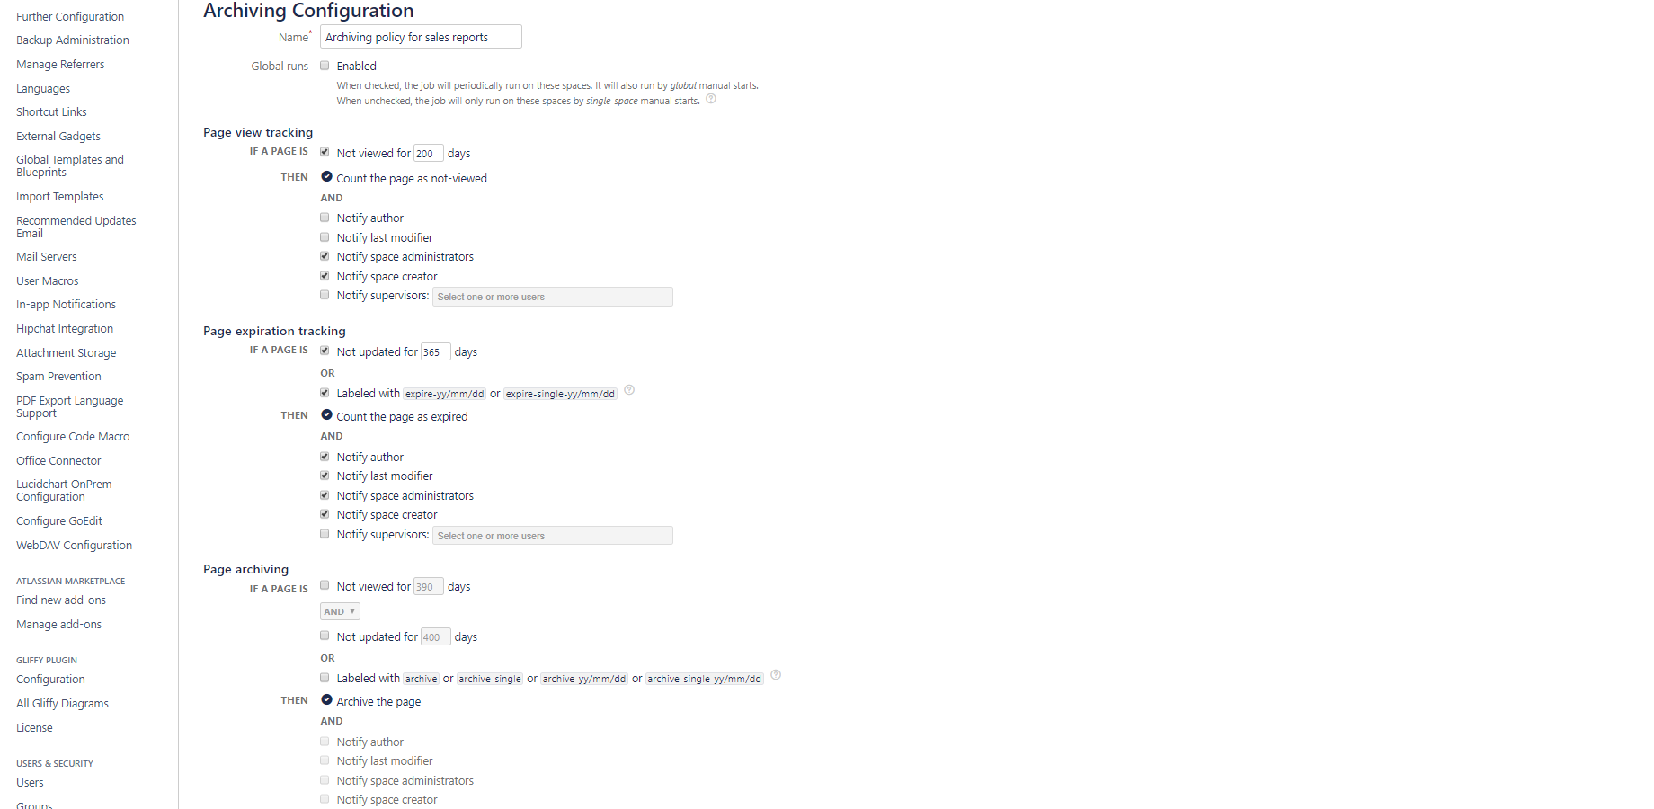
Configuring lifecycle rules
Customize your rules for page view tracking, page expiration tracking and content archiving
Notes:
Archiving rules are collected in a so called archiving configuration.
An archiving configuration can be global or space-specific.
You can also decide that certain spaces never need to be checked.
You can “blacklist” spaces, which means that those spaces will be completely ignored by the Better Content Archiving app.
A global configuration is like a shared configuration: you set it once and then apply it to many spaces.
It makes administration easier as it handles similar spaces under one common configuration.
A space specific configuration is only valid for that particular space.
Within an archiving configuration, you can add a name and specify rules for page view tracking, page expiration tracking and page archiving. Let’s see what these mean:>>NEXT<<

Slide 9
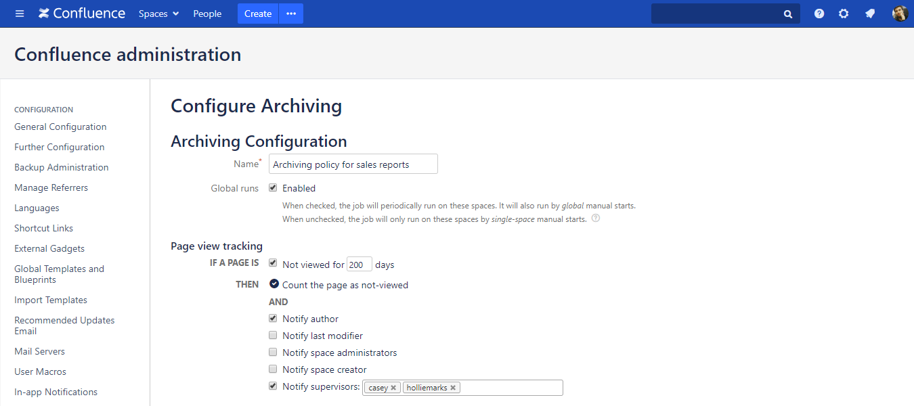
Configuring lifecycle rules for page view tracking
Define the rules for tracking and reporting not viewed pages
Notes:
When you pull up an archiving configuration for editing, first you need to name it.
The name should indicate the purpose of the rule or the type of content it manages.
In our example here, it’s the archiving policy for sales reports.
It indicates that it manages report type documents and archives them when the predefined requirements are met.
If we called it the Update reminder policy for user manuals, that would indicate a different type of rule set, that only reminds people to update content.
The Global run checkbox lets you decide whether those spaces this configuration is applied to should be processed by the scheduled or manual global runs.
We will discuss these options in detail later.
>>NEXT<<
The next is setting up a rule for page view tracking.
The page "view age" is calculated from the current date minus the last view date of a page. It’s calculated in milliseconds and displayed in days.
If you leave it unchecked, that simply turns view tracking off for the spaces that this configuration is applied to.
If you use it, you can define the number of days after which a page is considered “not viewed”.
Then you can decide who need to know if a page is not viewed. These users will receive email notifications with the list of not-viewed pages when the lifecycle job runs.
>>NEXT<<

Slide 10
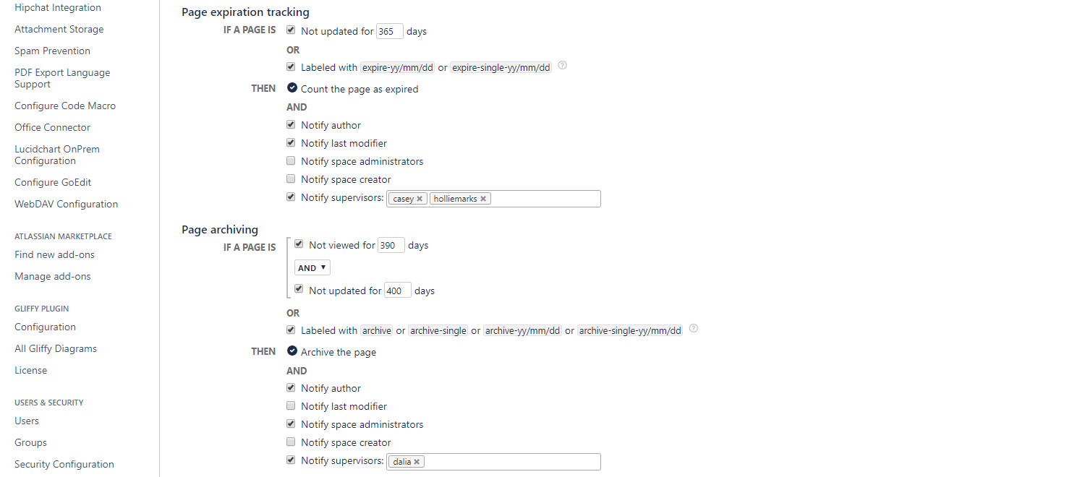
Configuring lifecycle rules for page expiration tracking
Define the rules for tracking expired pages and content archiving
Notes:
The next is setting up a rule for page expiration tracking.
If a page is expired, it means that no one made any updates to it for a while.
The "Update age" is calculated from the last modification date of the page or from the last modification date of its newest attachment, whichever is newer.
So this means that if you add a new attachment to a page, that is an update, too.
Also, if you update a child page, the app counts the parent page updated as well.
That’s because if your content is organized in a logical tree structure, it makes sense.
For example, if you have a page called “Financial Reports” and every report is a child page, updating a report should propagate up the parent page, indicating that it’s indeed being updated.
If you uncheck it, updates won’t be tracked on the space that you apply this configuration to.
If you use it, you can set the days after this page will be considered and reported expired.
Alternatively, you can use labels to control expiration manually.
For example, you can add a label with a specific date, to make sure that that page will expire exactly on that day.
This should be used only if there is fitting use case which relies on precise expiration dates.
You can find a full list of labels you can use for control expiration manually in the app documentation on our website.
Then, you decide who should be notified when the app finds expired pages.
>>NEXT<<
The next is setting up a rule for page archiving.
Obviously, if you leave this part unchecked, you can use this configuration just to notify people of not viewed and expired content, but no action will be taken, nothing will be archived.
If you use it, you can define a rule for when to archive a page.
You can use only the view age, and define the number of days of being not viewed and archive after that.
Similarly, you can tie archiving to expiration and define the number of days for that.
You can also combine these two, and set a combination with an OR or AND operator.
In this example, pages that haven’t been viewed for 390 days AND also haven’t been updated for 400 days are to be archived.
Here you also have the option to apply labels on a page to define exactly when should a page be archived or on the contrary, you can exclude a page or page tree from archiving.
If you are interested, find the full list of labels in the documentation on our website.
Then finally, decide who should be notified when pages are being archived.

Slide 11
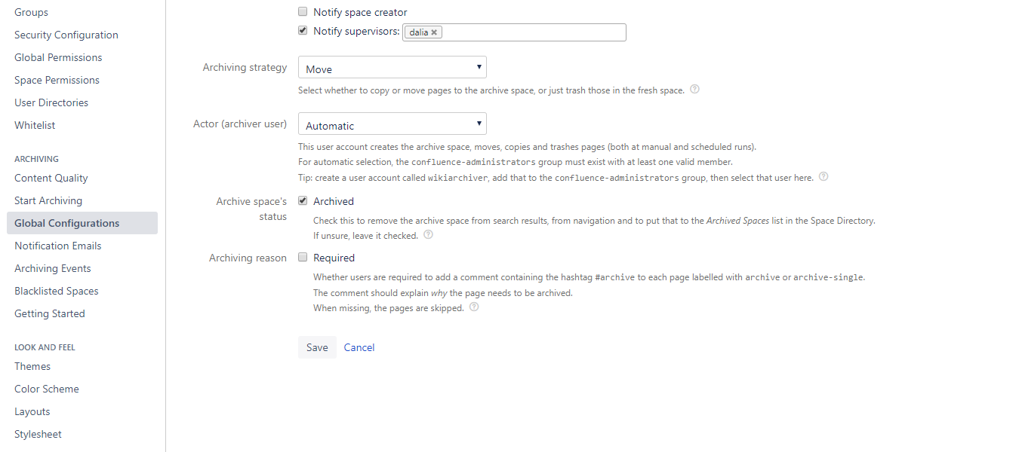
Configuring lifecycle rules for content archiving
Finalize and save the archiving configuration
Notes:
At the end of the configuration panel, you can set up a few further things.
You can define the archiving strategy.
Strategies are ways of how the app approaches the content clear-up and preservation.
There are 3 different strategies:
The Trash strategy is the simplest, and as it’s name tells it, not focuses on keeping the content. Use this if you only want to free up space and absolutely sure you won’t need information later. If you use this strategy, all pages that are to be archived, will in reality be trashed using the native Delete feature of Confluence. Those pages are available and can be restored as long as the Trash is not emptied permanently.
The Copy and Trash is a strategy that archives pages by copying those to an archive space and trashing them in the original space. This was the strategy the app originally supported, and it can still be useful in certain use cases.
The default and most recommended strategy though that fits a true lifecycle management purpose is the Move strategy. When there are pages to archive, this strategy creates an archive space. There will be only one archive space for a current space. Then the pages are moved to the archive space, preserving all their meta information (versions, comments, attachments, labels, etc.).
Then you can set the Actor or archiver user. As you noticed, archiving involves taking a few key actions like moving pages, copying pages, deleting pages and so on. All these operations require a valid Confluence user account with the sufficient permissions.
As archiving is typically executed as a background job, when there is no "currently logged-in user, you need to pre-select one.
All archiving operations, including moves, copies, trashes will be executed on his behalf.
We recommend avoiding confusion by creating a separate user with a descriptive name, like Confluence Archiving or Wiki Archiver, so when others look at the notification emails or archiving events they know what happened.
Confluence spaces themselves also can have a space status called “archive”. As the next option, you can select if you want to set the status of your newly created archive space as archived or keep it current. The default is to set it to archive status and there is really no real reason to change it.
Finally you can turn on archiving reasons.
It gives you an option to require users who added a label to archive a given page to also give a reason in the comments, why that page needs to be archived.
Their comment needs to contain #archive otherwise the page will be skipped and not archived.

Slide 12
How to keep your Confluence up-to-date
with content lifecycle rules
What is content lifecycle?
Configuring lifecycle rules
Running the lifecycle job
Understanding your content quality
Notification emails to stakeholders
Browsing archived content
Restoring archived content
Notes:
Now moving on comes the interesting part. Running the lifecycle job

Slide 13
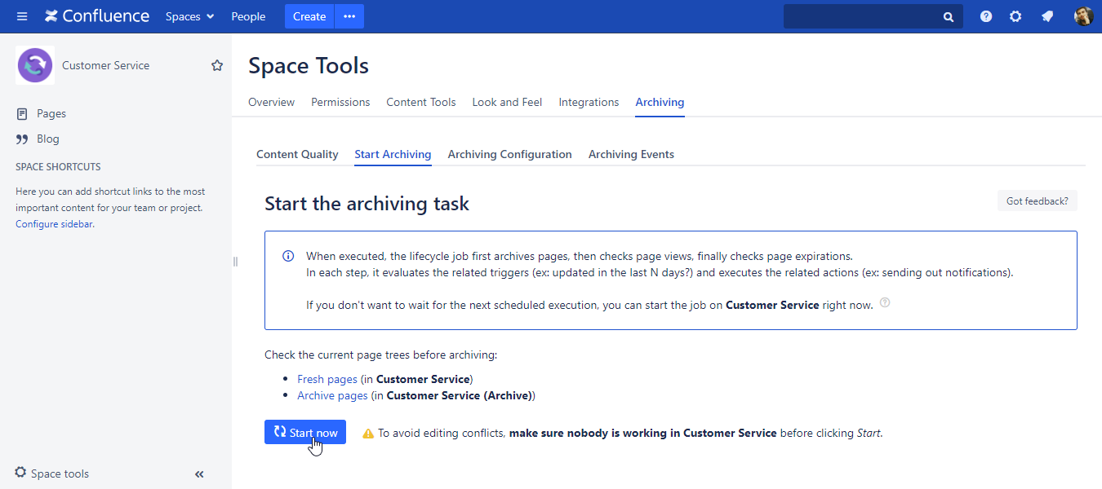
Running the lifecycle job
Execute the lifecycle job manually
Notes:
The lifecycle job is a scheduled, or manually started process inside Confluence.
When the lifecycle job runs, it actually makes the lifecycle rules come to life and execute the archiving configurations on your space or spaces
You can start the lifecycle job globally, so on all archiving-enabled (or in other words, not blacklisted) spaces at the same time.
Or if you want to start it only on just one specific space, open the Archiving menu option under Space Tools and select Start Archiving.
This executes the archiving configuration that is applied to that space.
>>NEXT<<

Slide 14
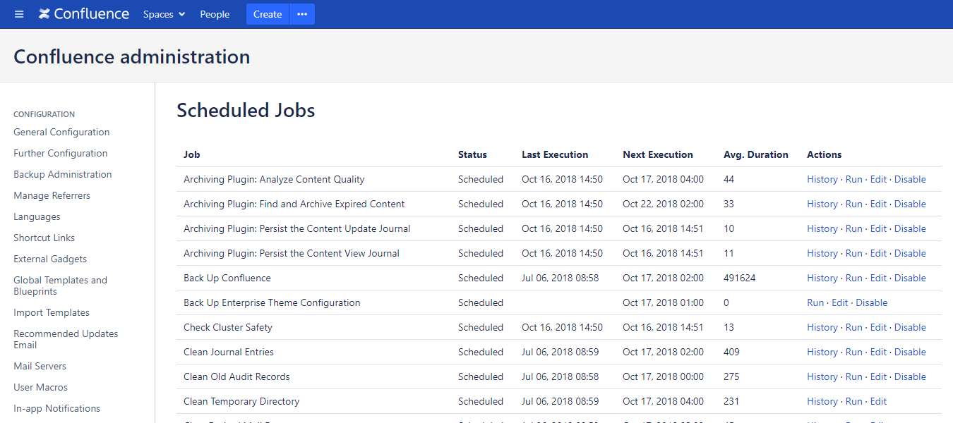
Running the lifecycle job
Execute the lifecycle job automatically (by a schedule)
Notes:
The most typical, however, is when archiving is scheduled to happen automatically at a predefined frequency, preferably outside working hours.
For example 2 am in the morning on every Monday, which is also the default schedule.
You can find the Confluence scheduled jobs in Confluence administration and the archiving related jobs will be there.
You can flexibly change the schedule to run every night, once a month or whatever your team prefers.
>>NEXT<<
Select the one that says Find and Archive expired content and hit edit to adjust the schedule.

Slide 15
How to keep your Confluence up-to-date
with content lifecycle rules
What is content lifecycle?
Configuring lifecycle rules
Running the lifecycle job
Understanding your content quality
Notification emails to stakeholders
Browsing archived content
Restoring archived content
Notes:
Better Content Archiving gives you several different ways to understand the current state of your content quality, so you know what you have to work with.
Let’s see what these are.

Slide 16
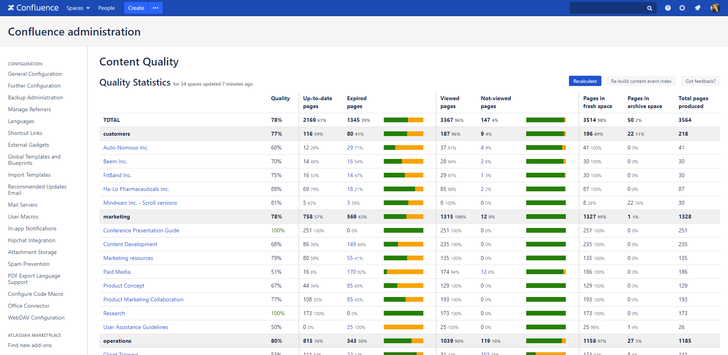
Understanding your content quality
Global report about the current state of your Confluence content
Notes:
Analyze Content Quality is another job, that’s responsible for calculating the content quality statistics.
It’s recalculated regularly automatically, and you can refresh it manually anytime as well.
This is the most comprehensive and telling overview you can get on all the spaces in your instance, except the blacklisted ones.
>>NEXT<<
Confluence allows you to categorise your spaces in the Space details menu.
The app uses these categories to nicely group the spaces in the statistics table.
>>NEXT<<
In every line is a space where you find their metrics.
Remember that every finding here is based on the archiving configuration currently applied to each space.
It’s pretty straight-forward:
>>NEXT<<
Up-to-date pages tells you how many pages are up-to-date and their ratio to all pages in the space
>>NEXT<<
Then you have the expired pages and their ratio to all pages in the space
>>NEXT<<
Then you have can see the number of viewed pages and their ratio to all pages in the space
>>NEXT<<
Then you have the not viewed pages and their ratio to all pages in the space
>>NEXT<<
Then finally you have the quality figure, which is the average of the up-to-date pages and viewed pages percentages.
This gives you a good indication at a glance about what’s going on in a single space, in a space group or globally in your Confluence instance.

Slide 17
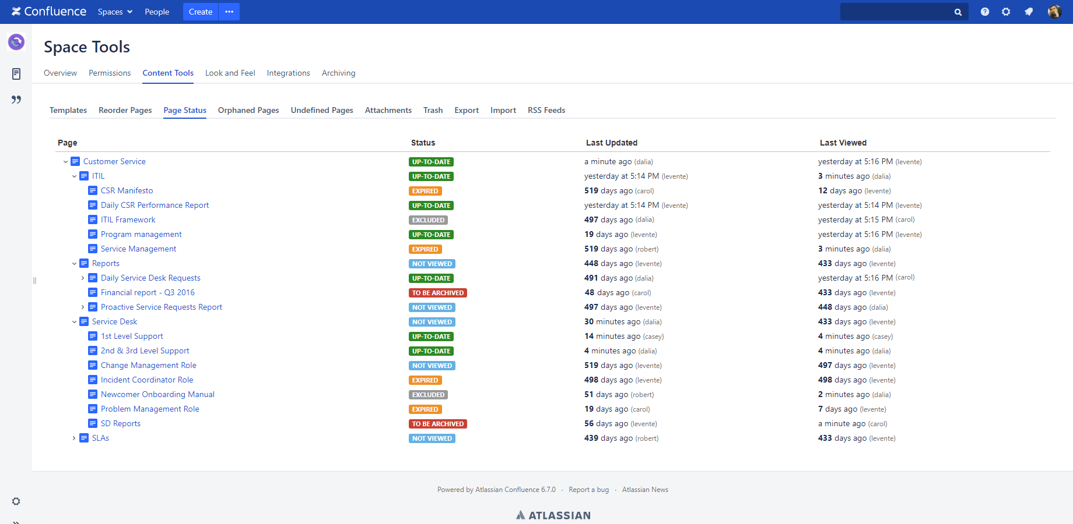
Understanding your content quality
View the status of the pages in a space
Notes:
If you want to go deeper to the space level, you have a similar analytics option to monitor the status of each page in a space.
This is a tree view to check their current status, last updated and last view dates.

Slide 18
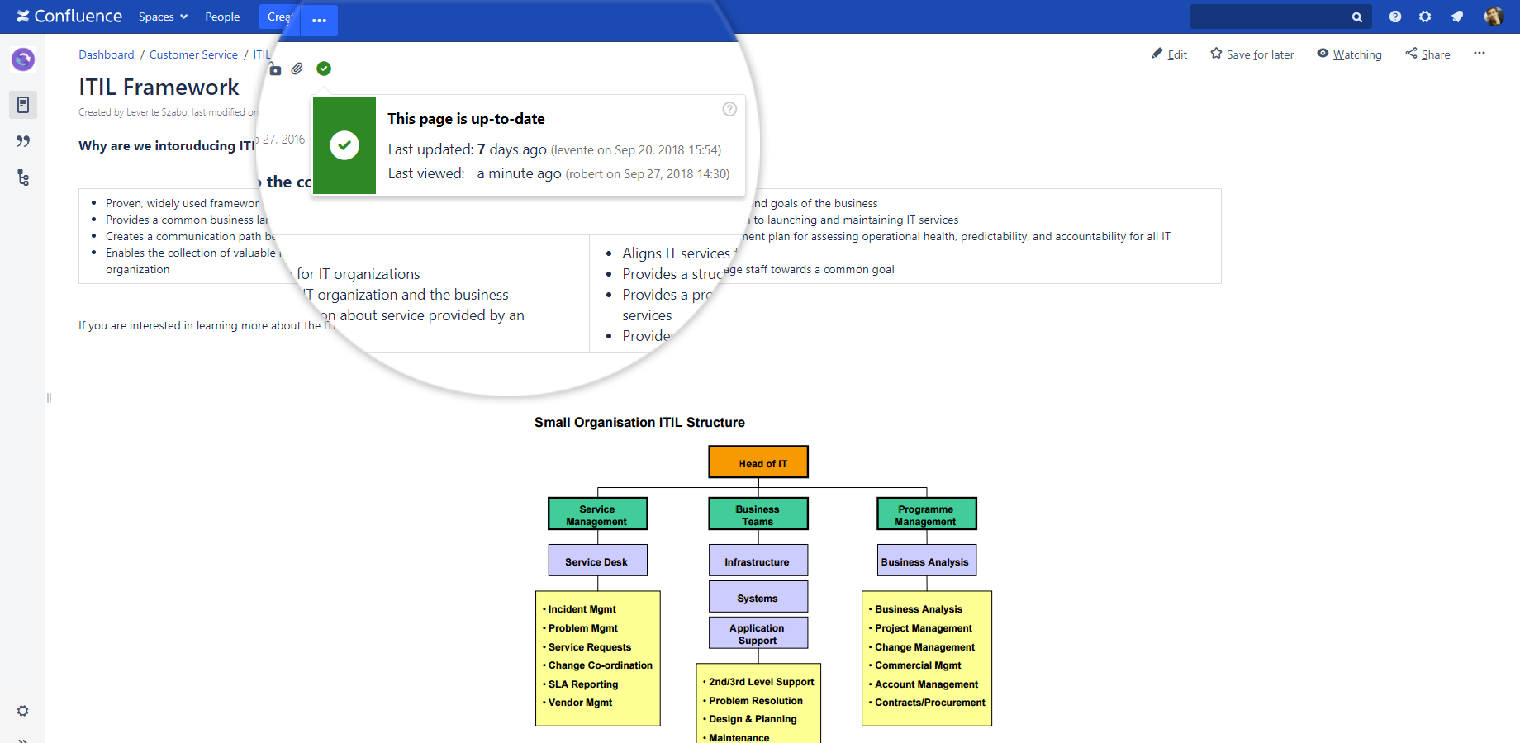
Understanding your content quality
View the status of a single page
Notes:
If you are on an individual page, you have the page status indicator at the top of the currently viewed page.
It also displays the last updated date and last view date for the page.
It also indicates if the page is blacklisted or otherwise excluded from lifecycle checks, for example by a “noarchive” label.

Slide 19
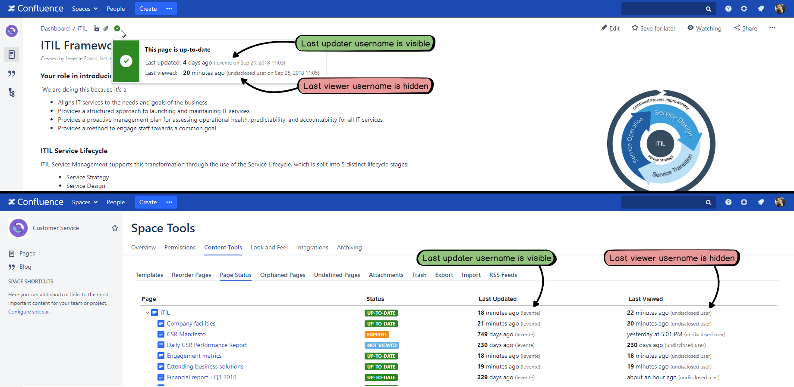
Understanding your content quality
Keep data security regulations (GDPR) by hiding usernames
Notes:
As you noticed, these content status and quality indicators and metrics also contain information about the user who viewed or edited a page for the last time.
Many of our customers told us that strict local regulations on personal identity, data security and now due to the GDPR, showing user names is a show stopper for them, meaning they couldn’t use the app legally.
To address these needs, the visibility of usernames are configurable and can be hidden in the content quality reports and status indicators.
The steps of how to hide usernames can be found under the “Configuration” section of the Documentation on our website.

Slide 20
How to keep your Confluence up-to-date
with content lifecycle rules
What is content lifecycle?
Configuring lifecycle rules
Running the lifecycle job
Understanding your content quality
Notification emails to stakeholders
Browsing archived content
Restoring archived content
Notes:
Let’s see the notifications and how reporting content to stakeholders works.

Slide 21
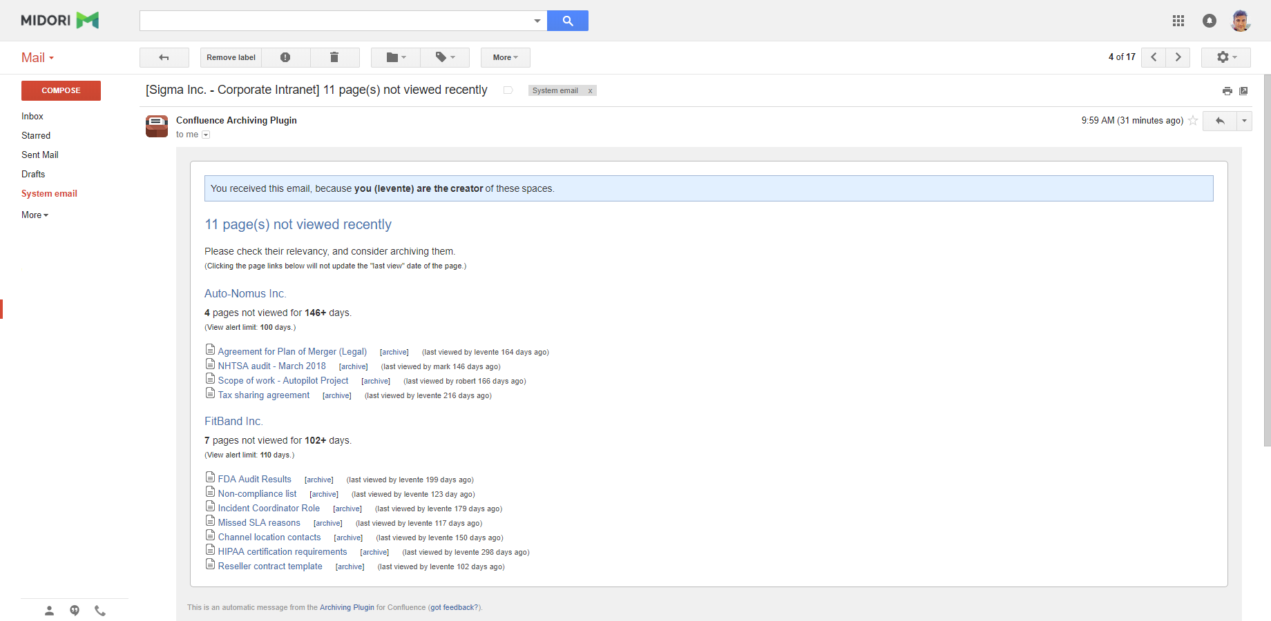
Notification emails to stakeholders
Reporting not viewed pages to stakeholders (page owners, space admins, last modifiers, etc.)
Notes:
Besides archiving, notifying stakeholders of content status is an equally important leg of content lifecycle management.
As we looked at it earlier, you can set up who should be notified of what actions in email.
In this example, the currently not viewed pages are reported.
The email also states why someone is receiving this email, so for example because they are the last modifiers, creators of pages or supervisors for a space.
The email body is clearly structured, grouping the affected pages by spaces.
It’s important that if you click on a page’s link in this email, that visit will not update the page view status, so you can take a look without making unintended updates.

Slide 22
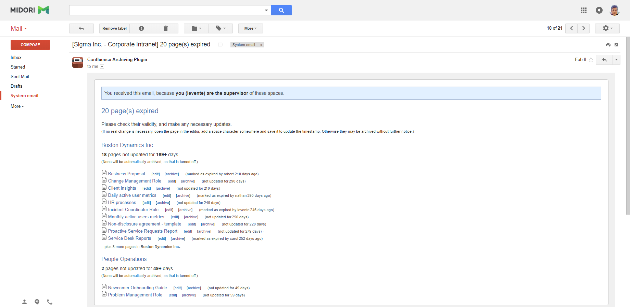
Notification emails to stakeholders
Reporting expired pages to stakeholders (page owners, space admins, last modifiers, etc.)
Notes:
Similarly, this example email reports expired pages, also showing how long has each page not been updated.

Slide 23
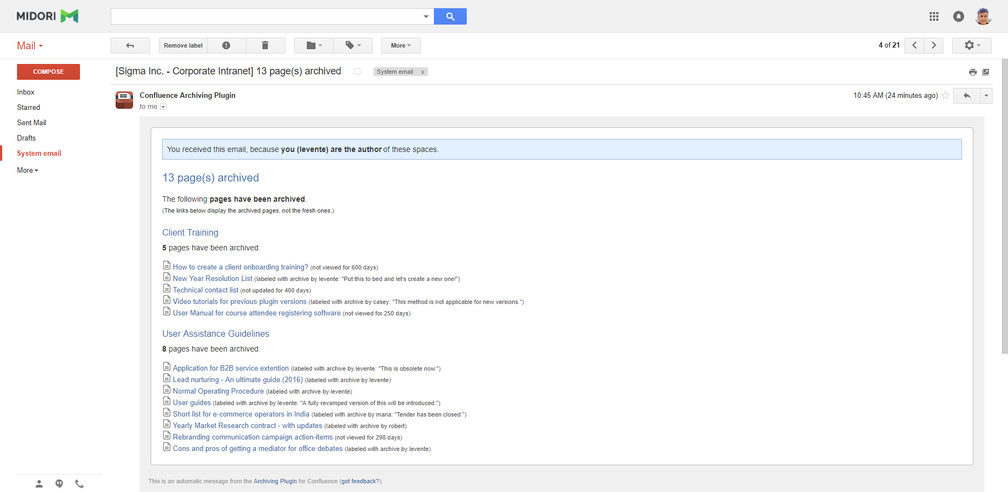
Notification emails to stakeholders
Reporting archived pages to stakeholders (page owners, space admins, last modifiers, etc.)
Notes:
When reporting archived pages the email structure is the same.
The only additional information could be the “archiving reason” if it was required for a page.
That way you are instantly informed why a particular page needed to be archived.

Slide 24
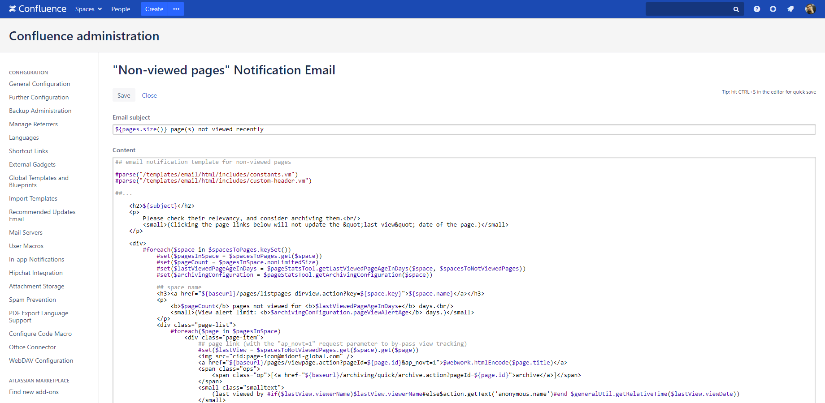
Configuring lifecycle rules
Customize the notification emails sent out to stakeholders
Notes:
The notification emails come with a default content for every occasion.
These contain the basic, most important information about lifecycle actions, but they can also be fully rewritten and customized.
If your internal process requires additional data or you team has other preferences, you can add those to the emails.
You can add more detailed explanation about what this email is about, add further instructions if needed and of course, you can translate it to your own native language.

Slide 25
How to keep your Confluence up-to-date
with content lifecycle rules
What is content lifecycle?
Configuring lifecycle rules
Running the lifecycle job
Understanding your content quality
Notification emails to stakeholders
Browsing archived content
Restoring archived content
Notes:
Now let’s take a look at how does archiving happen, and how you can browse the archived content

Slide 26
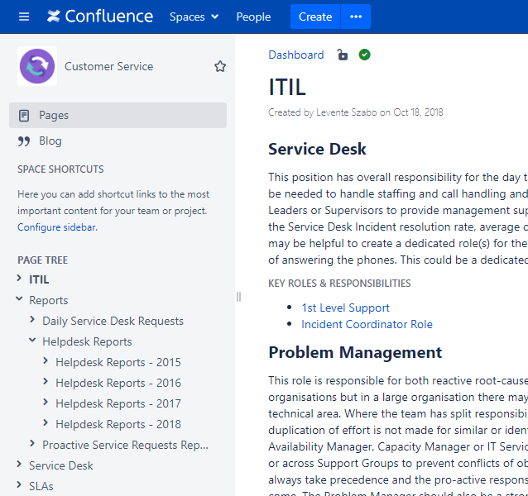
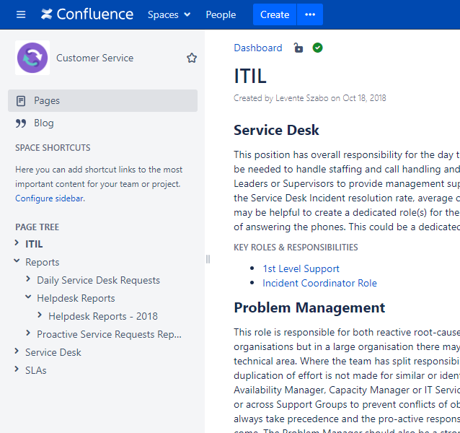
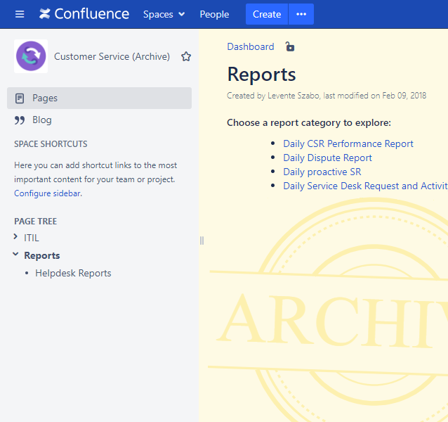
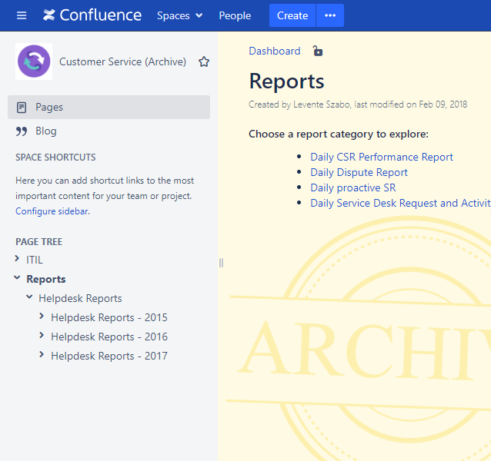
Browsing archived content
One archive space is created for every current space
Notes:
Here I would like to give you a simplified overview of how archiving happens with the Move strategy and how can you access your archived content.
In this example we have a fresh Confluence space called Customer Service.
>>NEXT<<
Under Reports, we have a section for Helpdesk reports, collected there through the years.
We created a content lifecycle rule to archive reports in this space that haven’t been updated in the past 3 years.
When the lifecycle job runs, the app removes the pages >>NEXT<< that are ready to be archived according to the archiving configuration.
It also checks if there is already an archive space for this current space.
If there isn’t one, it creates one using the space’s name and adding the (Archive) postfix to it.
If there is already an archive space, it alway uses that for archiving. >>NEXT<<
And moves the now archived content to exactly the spot in the hierarchy as it was in the current space. >>NEXT<<
The app preserves the space hierarchy by recreating the original space structure in the archive space.
It does it by also copying parent pages as well just for placeholders.
Archive spaces are just like regular spaces in Confluence, only their visibility is more restricted.
They can be found under the Archive spaces section in Confluence.
Archive pages don’t show up on the full search results page in Confluence, unless you explicitly search for archive pages.
For security reasons, when you create an archive space with Better Content Archiving, only read-type permissions are copied over, meaning that non-admin users can’t edit archive pages.
The point is to discourage making updates in the archive space.
Space administrators can re-add write-type permissions in the usual way, if that's needed for some reason.
So in summary: archived content is still accessible to any user if they need to look up something, but those are not in the way when working in fresh spaces.

Slide 27
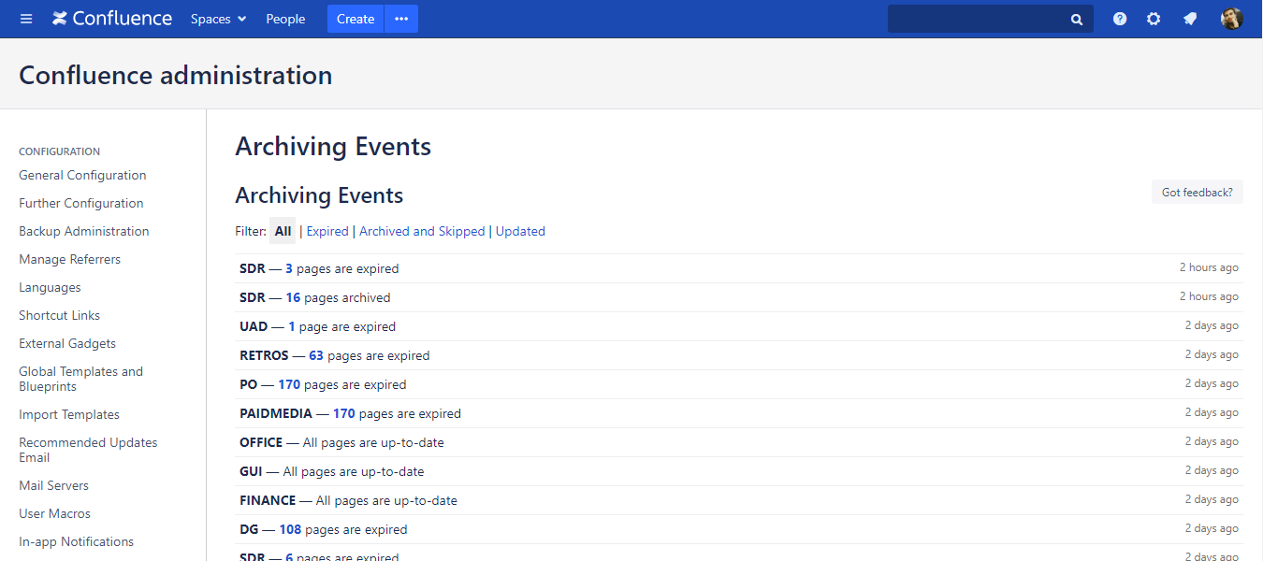
Browsing archived content
Browse archiving events for audit reasons
Notes:
As Better Content Archiving runs in your Confluence, many lifecycle events happen.
These events are listed under the Archiving Events menu.
You can precisely follow and supervise what action was taken by the app and when as each action is timestamped.
So if you need information retroactively for audit or other reasons, you have all the data you need.

Slide 28
How to keep your Confluence up-to-date
with content lifecycle rules
What is content lifecycle?
Configuring lifecycle rules
Running the lifecycle job
Understanding your content quality
Notification emails to stakeholders
Browsing archived content
Restoring archived content
Notes:
Lastly, a few thoughts on restoring content from the archives

Slide 29
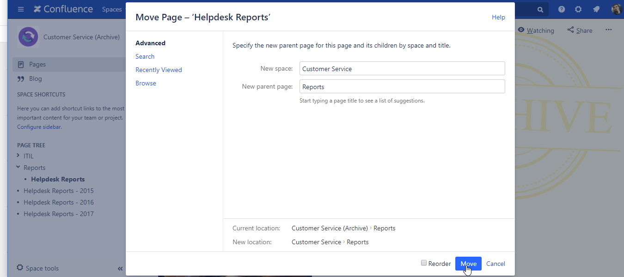
Restoring archived content
Easily move archived content back to a fresh space when needed
Notes:
If you chose the most common and recommended strategy, the Move strategy for archiving, the app basically uses the native move feature built into Confluence.
Therefore, restoring pages from an archive space takes only another simple page move.
You can use Confluence’s move feature to take the archived page or a family of pages and move back to the current space, effectively restoring them.
If you used the Copy and Trash strategy, you can restore the pages from the Trash or similarly, move back from the archive space to the current space.
In case of the Trash strategy, simply restore pages from the trash if that wasn’t emptied yet.

Slide 30
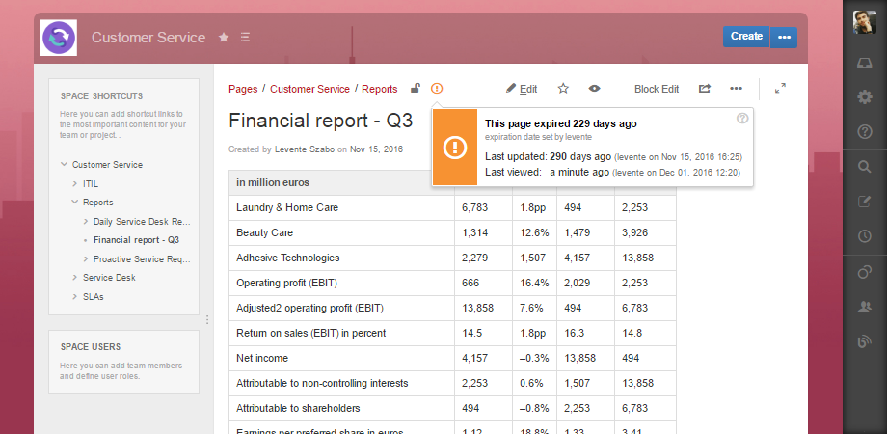
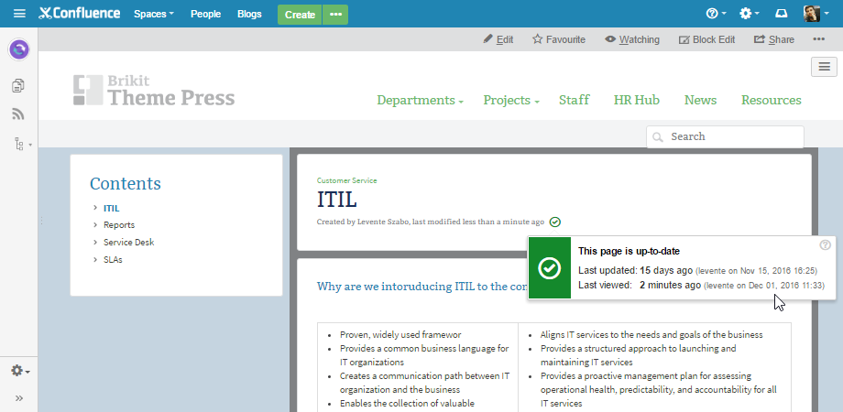
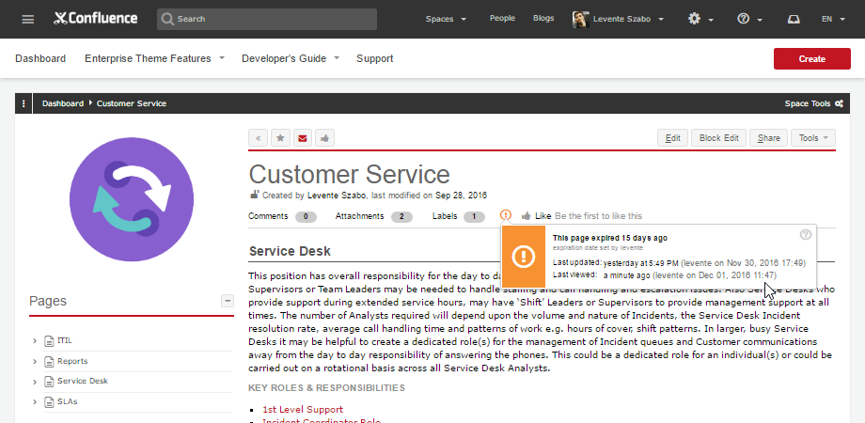
Integrations with theming apps
Better Content Archiving supports all popular Confluence theme apps
Enterprise Theme by bitvoodoo
Brikit Theme Press by Brikit
Refined Theme by RefinedWiki
Notes:
Another way Confluence users enhance the user experience is by using different theme apps.
>>NEXT<<
If you are also using one of these app, you can be rest assured that Better Content Archiving is compatible with them.
>>NEXT<<
RefinedTheme, Enterprise Theme and Brikit Theme Press are the more popular ones, but you can find a full list of compatible apps on our website.

Slide 31
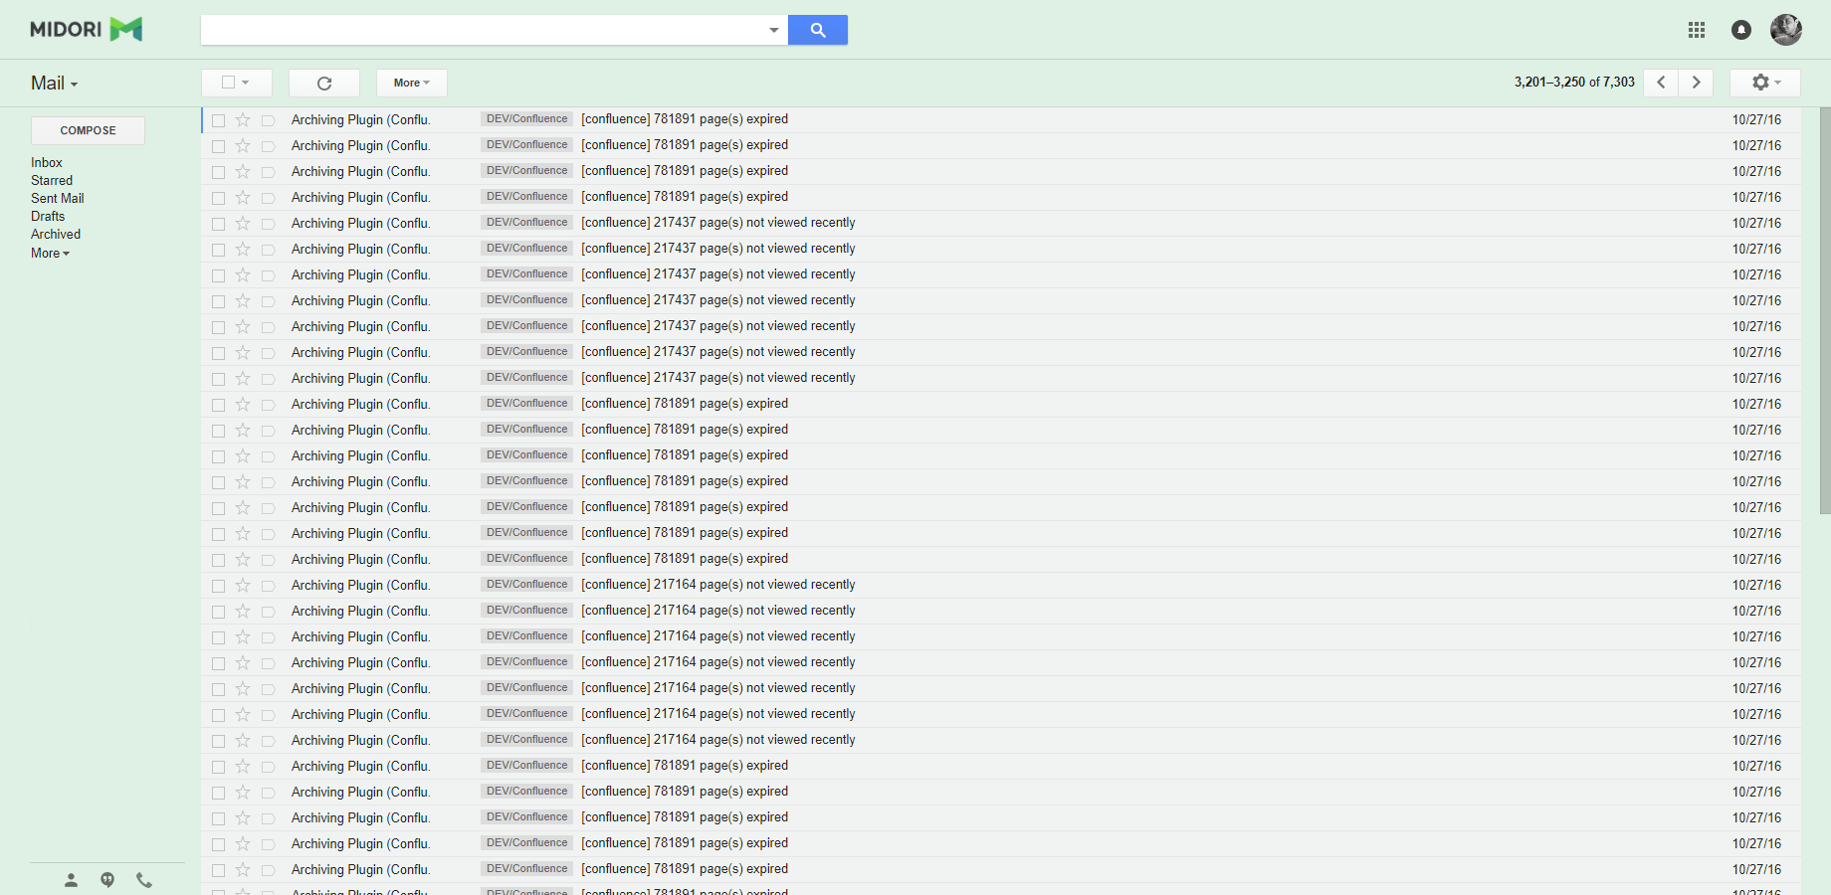
Handling enterprise scale data
Better Content Archiving is used in Confluence instances with millions of pages
Notes:
Finally, I want to leave you with a thought about scalability and enterprise size Confluence instances.
If you work in a large organization you probably thought about this question during this presentation whether this whole content lifecycle management approach will affect the performance of your enterprise size Confluence.
This also makes sense, as the problem of an overgrown Confluence is only gets bigger in an enterprise environment, so you are right to be suspicious about adding an app on top of everything.
Better Content Archiving has been engineered with large instances and their resource requirements in mind.
The Server version, but especially the Data Center version have been thoroughly tested with datasets that resembles or exceeds real life circumstances.
>>NEXT<<
This screenshot is taken about our load-testing system, currently with 1.2 million pages in 15,000 spaces.
These are the notifications emails, sent out to developers after successful lifecycle job runs.
I think if it handled more than a million pages without breaking or slowing down Confluence, it should be able to handle whatever workload you have for Better Content Archiving.

Slide 32

Thank you!
Levente Szabo • levente.szabo@midori-global.com
Notes:
And with that, I would like to thank you for your attention and encourage you to reach out to me with any questions or comments, using my email you see on the screen.
>>NEXT<<

Slide 33



Try our other apps, too (free)!
Better PDF Exporter for Jira
Better Excel Exporter for Jira
Better Commit Policy for Jira
Easy emailing, sharing, archiving, printing for Jira data
Full-blown native Excel exports, spreadsheet reports and Business Intelligence for Jira
Verify the changes committed to Git, Bitbucket, GitHub, GitLab, Subversion & Mercurial against configurable rules
Notes:
And if you liked what you heard, give our other apps a try as well. Those cover slightly different aspects of productivity for business users as well as developers.
Better PDF Exporter exports your Jira data to business documents in PDF format.
Better Excel Exporter creates native Excel files and reports from Jira data, that could abe also enhanced with pivot tables and charts to create a real business intelligence solution for Jira.
Commit Policy Plugin helps developers be more productive and compliant. The app verifies commits against configurable rules, so the code change history is always consistent and easy to follow.

